Slide 1


PRINCIPLES
ON PLEDGING
Based on the article:
Marcos Faiock Bomfim (Jul.-Sept. 2020),
“Why and how to vow regarding offerings”
Dynamic Steward, 24. no. 3 (July 2020):, pp. 21-23

Slide 2
Vows: Only Accepted if Fulfilled
by Faith, not by Works
“I am the vine, you are the branches. He who abides in Me, and I in him, bears much fruit; for without Me you can do nothing.”
John 15:5

Slide 3
Vows: Only Accepted if Fulfilled
by Faith, not by Works
“I can do all things through [a]Christ who strengthens me.”
Phil. 4:13

Slide 4

Risk of Not Vowing
About Offerings
My heart may take control of the giving process. It cannot be trusted (Jer. 17:9).
I may give more than what is reasonable
Or not give at all, when it would be right to do so

Slide 5

1st Principle: Purpose
(2 Cor. 9:7)
“So let each one give as he purposes in his heart, not grudgingly or of [a]necessity; for God loves a cheerful giver.”

Slide 6

By Purposing
I’m able to avoid the frequent burden of deciding
“If” I will give or not
“How much” should I give

Slide 7

2nd Principle: Regularity
“Honor the Lord with your possessions, And with the firstfruits of all your increase; So your barns will be filled with plenty, And your vats will overflow with new wine.”
Prov. 3:9-10 (Emphasis supplied).

Slide 8
2nd Principle: Regularity
Mal. 3:8-10
8 “Will a man rob God?
Yet you have robbed Me!
But you say,
‘In what way have we robbed You?’
In tithes and offerings.
9 You are cursed with a curse,
For you have robbed Me,
Even this whole nation.

Slide 9
2nd Principle: Regularity
Mal. 3:8-10
10 Bring all the tithes into the storehouse,
That there may be food in My house,
And try Me now in this,”
Says the Lord of hosts,
“If I will not open for you the windows of heaven
And pour out for you such blessing
That there will not be room enough to receive it.”

Slide 10
Regularity of my giving
based on
Regularity of God’s giving

Slide 11
Sporadic, Intermittent, or Absent Giving
Based on
Calls from the pulpit
Impulses, emotions, perceptions (may be deceiving)
Sympathy (for someone/something)
Necessities of the Church (my knowledge is limited)
My giving would risk no longer reflecting the recognition of God’s giving

Slide 12
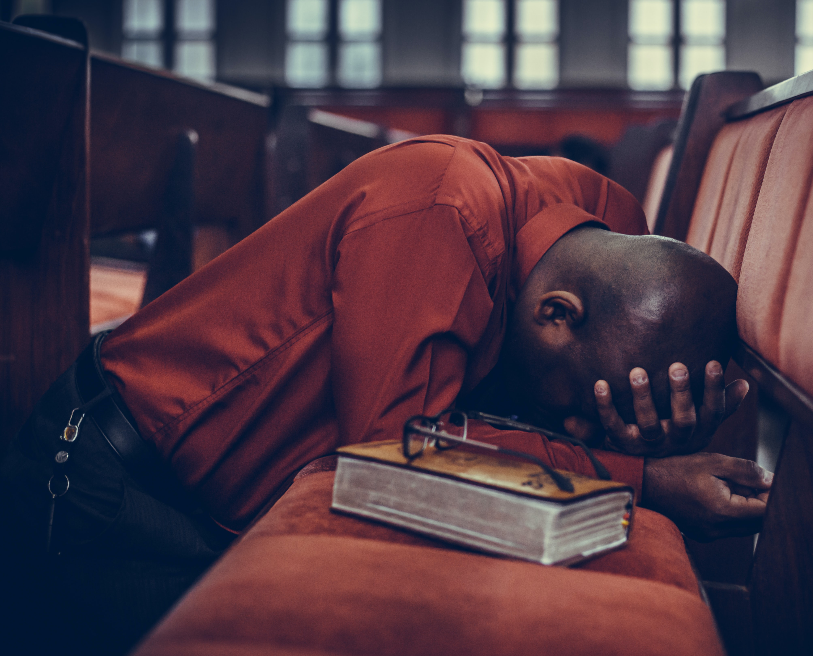
Offering: An Act of Worship
Not as an attempt to “help” the church But in recognition that I have already been “helped” by Him

Slide 13
Offering: An Act of Worship
Not to earn merit
But a grateful answer to His giving

Slide 14

3rd Principle: System
“Every man shall give as he is able, according to the blessing of the Lord your God which He has given you.” Deut. 16:17 (Emphasis provided).

Slide 15
3rd Principle: System
“On the first day of the week let each one of you lay something aside, storing up as he may prosper, that there be no collections when I come.”
1 Cor. 16:2 (Emphasis provided).

Slide 16
Fair Proportional System
Amount adjusts as income adjusts.
Those who receive more, give more.
Those who receive less, give less.
Those who receive nothing, give nothing.

Slide 17
Consider Enlarging the Proportion
“How much more eager will every faithful steward be to enlarge the proportion of gifts to be placed in the Lord’s treasure house, than to decrease his offering…” Counsels on Stewardship, p. 200.

Slide 18
“Those who are recipients of His grace, who contemplate the cross of Calvary, will not question concerning the proportion to be given, but will feel that the richest offering is all too meager, all disproportionate to the great gift of the only-begotten Son of the infinite God….” Counsels on Stewardship, p. 200

Slide 19
By Giving in Proportion
The right ownership is established (He is the Owner)
A partnership is assumed (I am His partner)
I become an unclogged pipeline
Result: “… he who waters will also be watered himself.” Prov. 11:25.

Slide 20
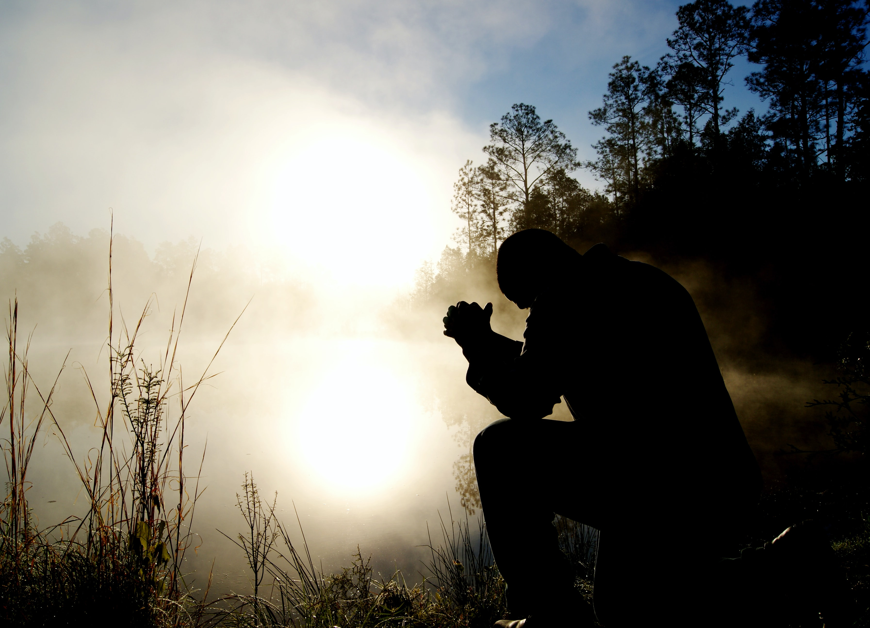
4th Principle: Priority
“But seek first the kingdom of God and His righteousness, and all these things shall be added to you.” Matt. 6:33.

Slide 21
4th Principle: Priority
“Honor the Lord with your possessions, And with the firstfruits of all your increase; So your barns will be filled with plenty, And your vats will overflow with new wine.”
Prov. 3:9-10 (Emphasis supplied).

Slide 22
Before Any Portion is Consumed
“We are not to consecrate to Him what remains of our income after all our real or imaginary wants are satisfied; but before any portion is consumed, we should set apart that which God has specified as His.”
Counsels on Stewardship, p. 81 (Emphasis supplied).

Slide 23
5th Principle: Period
How long will last
Vow
Proportion

Slide 24

6th Principle: Distribution
A Broad Missionary Commission
“But you shall receive power when the Holy Spirit has come upon you; and you shall be [a]witnesses to Me in [1] Jerusalem, and in [2] all Judea and Samaria, and [3] to the end of the earth.” Acts 1:8.

Slide 25
6th Principle: Distribution
“Then I saw another angel flying in the midst of heaven, having the everlasting gospel to preach to those who dwell on the earth—to every nation, tribe, tongue, and people—” Rev. 14:6.

Slide 26
For the Ultimate Resources, Power, Speed and Coverage
We group ourselves in churches
Churches group themselves in Conferences
Conferences group themselves in Unions
Unions group themselves in Divisions

Slide 27

Tithe Alone Will Not Do It
See Numbers 18:21, 24
Counsels on Stewardship, pp. 101-108
General Conference Working Policy 2019-2020, V 14, p. 628

Slide 28

Why Put It All Together?
“We would never be able to accomplish it alone or divided, either in heart or in the pocket”

Slide 29
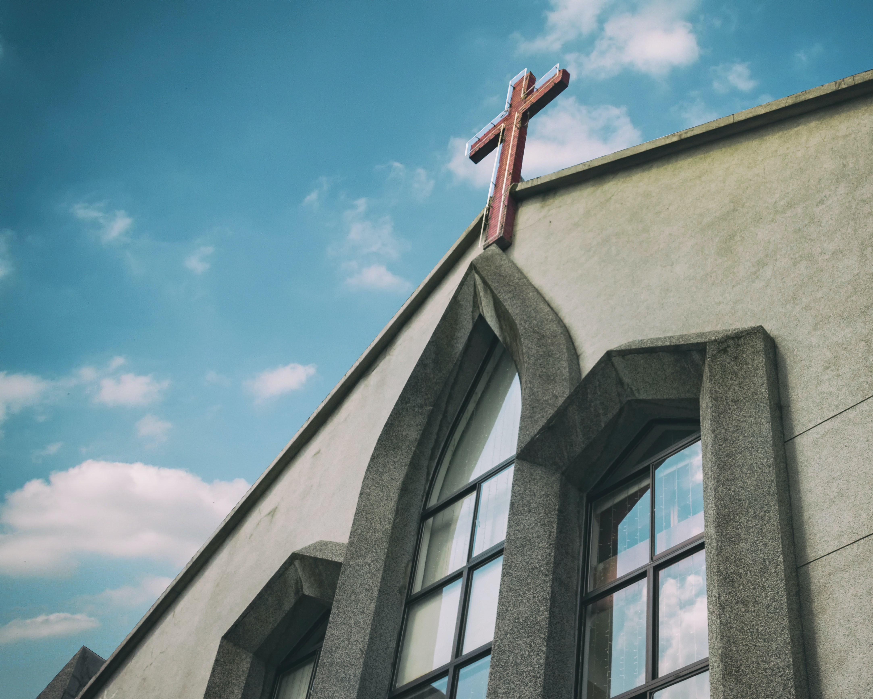
Distribution Suggested by the Combined Offering Plan
Equitable support to all authorized missionary endeavors and territories
A special provision for the local church (cannot be supported by the tithe)

Slide 30
Distribution Suggested by the Combined Offering Plan
50-60% - applied to the local church
20-25% - missionary initiatives on regional level
20% - world missionary fund (“World Budget”)

Slide 31
Distribution Suggested by the Combined Offering Plan
All funds sent to the higher organizations come back to the local level as allowances or services.

Slide 32
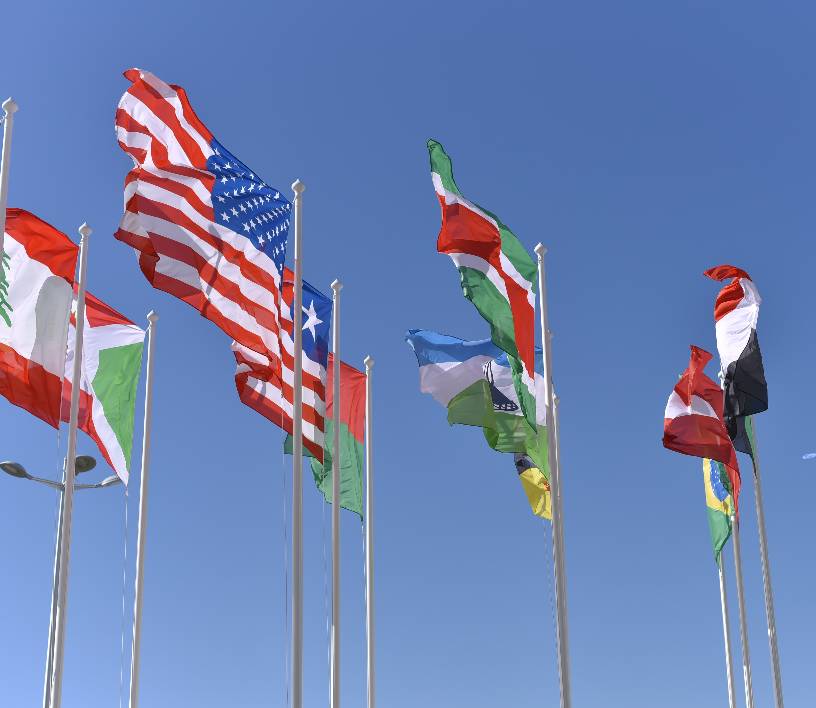
Amazing Results
The Adventist Church is present in 213 out of 235 countries and areas of the world recognized by the United Nation.

Slide 33
Special Offerings Above and Beyond Promise
We cannot risk the entire body while trying to save a limb. No member’s need will justify leaving the whole body unattended!

Slide 34

By Investing Resources Together
We become
Stronger
Bigger
We do it
Better
Faster

Slide 35
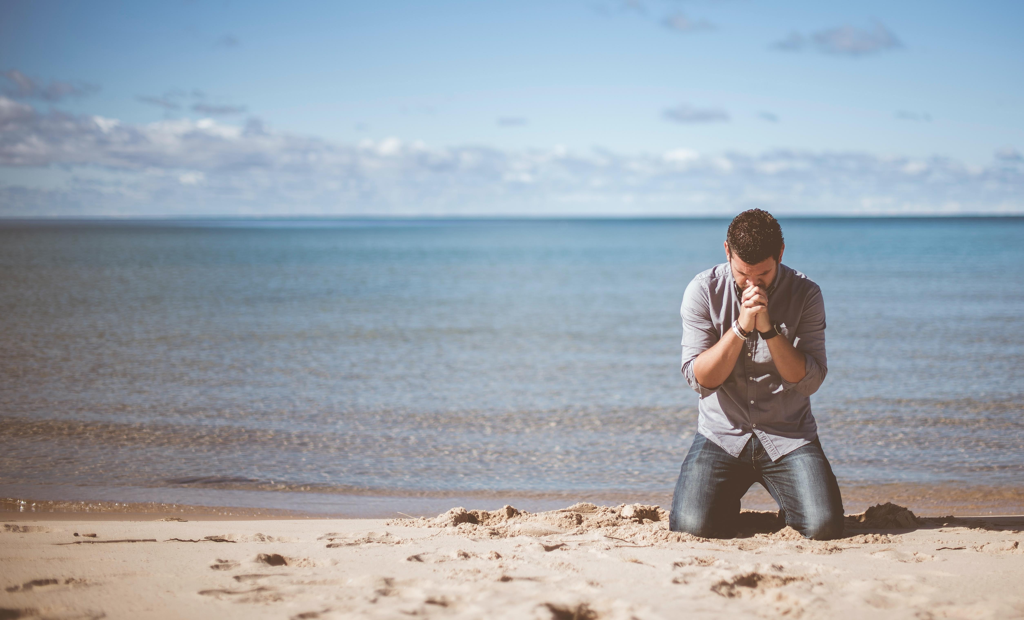
What I Must Renounce
My natural desire to be recognized and praised as a “donor” or “benefactor”.

Slide 36

I May Never Receive
A call of acknowledgment
A thank you letter
An invitation to a donor’s dinner
Or have my name in a wall honor

Slide 37
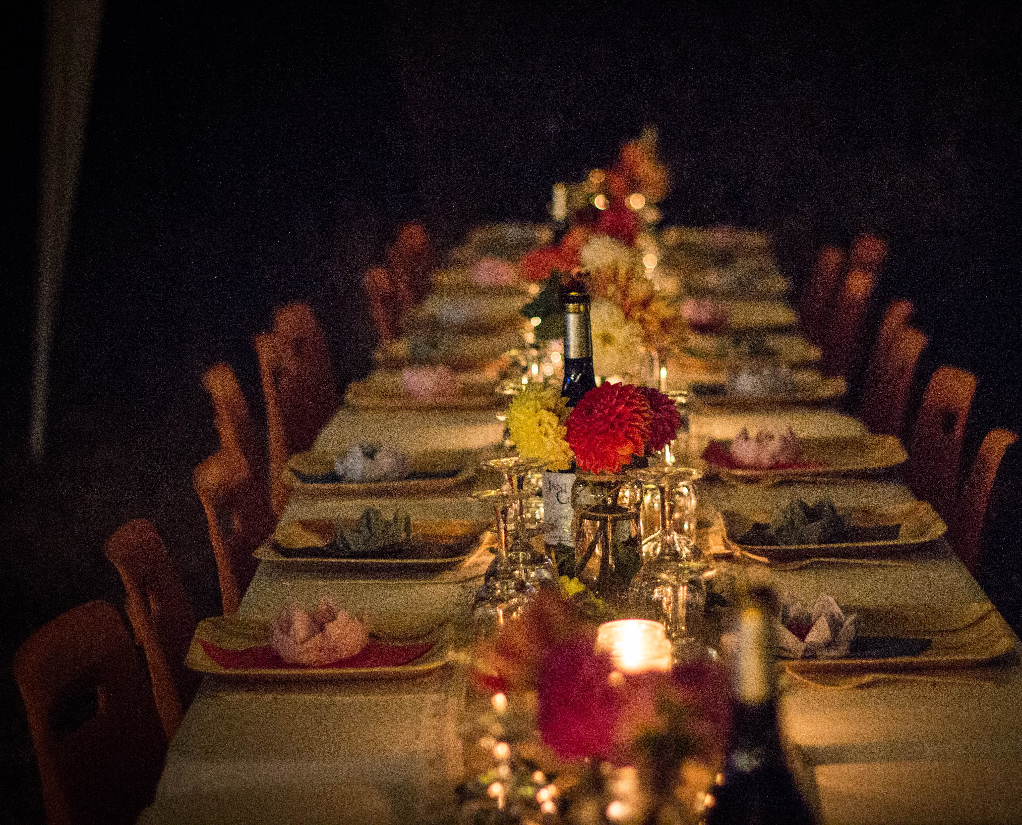
The Dinner I Want to Partake In
With all ransomed reached by the offerings from all of us!

Slide 38
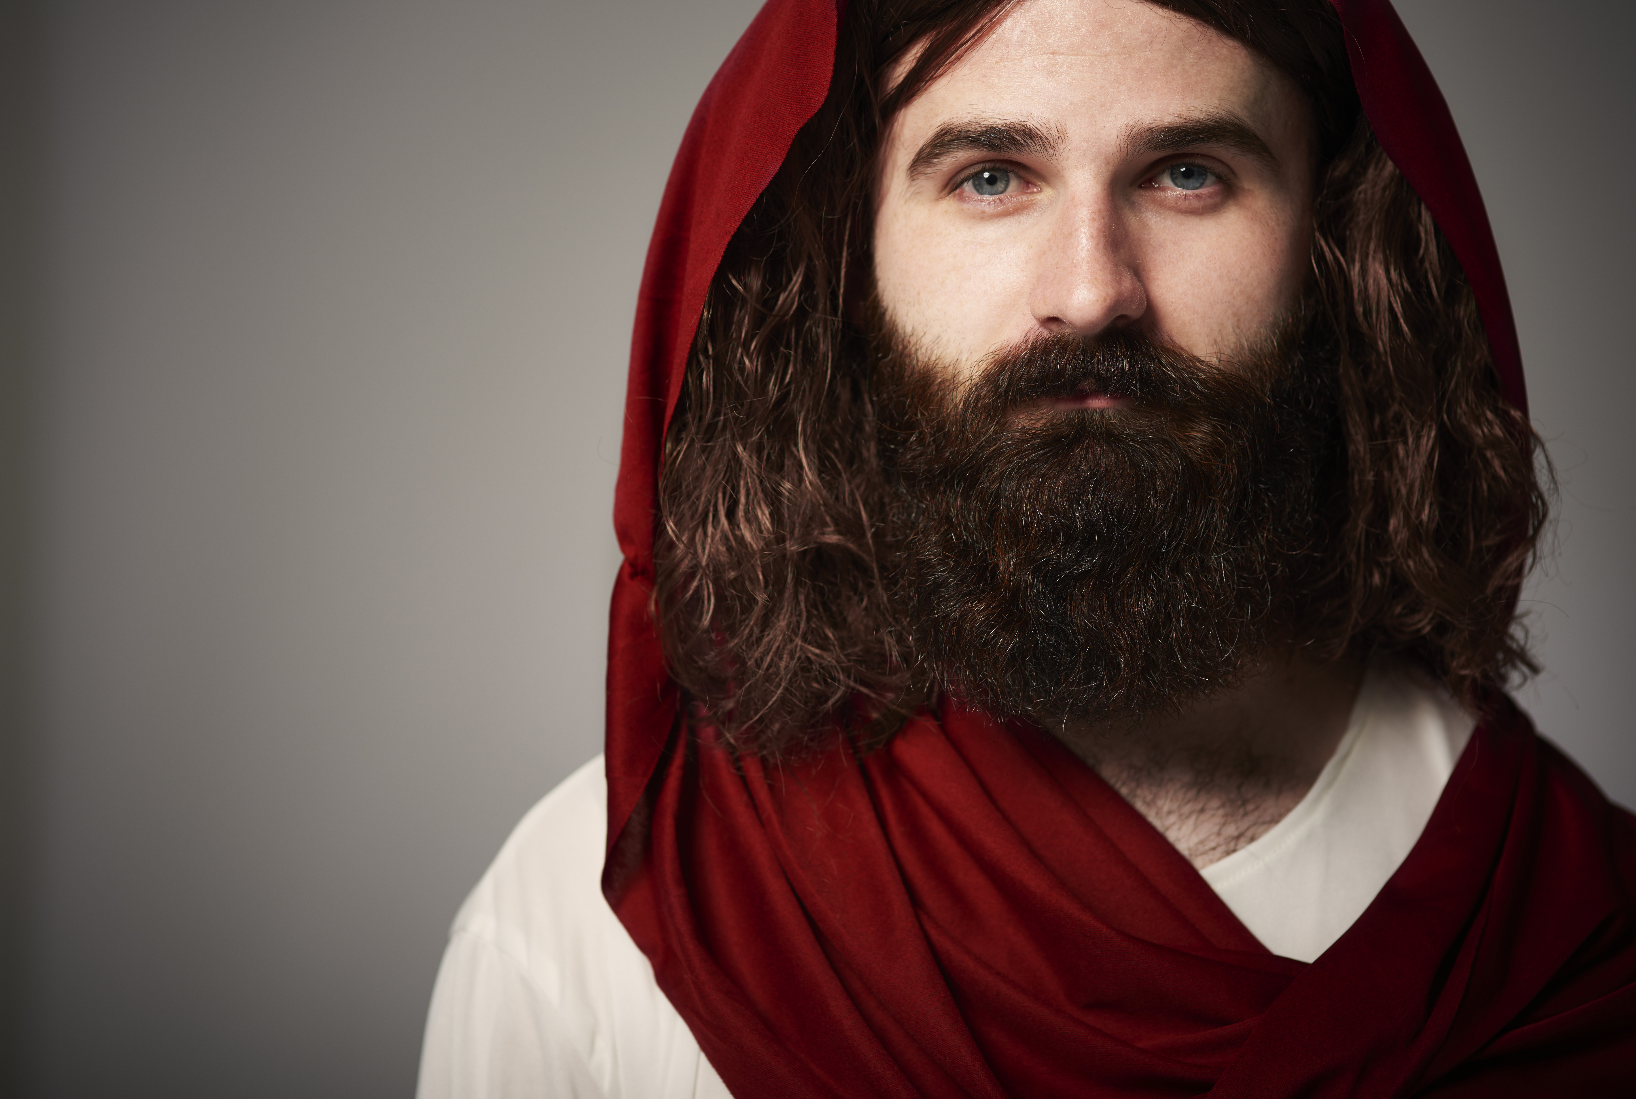
Someone Knows!
“And when he observed him, he was afraid, and said, “What is it, lord?” So he said to him, “Your prayers and your alms have come up for a memorial before God.”
Acts 10:4.

