Slide 1
COMBINED
TO GROW
Reasons for the “new” Offering Plan

Slide 2
WHY
Has the world church adopted the “concept of a simplified offering system?” (2002 GC Spring Meeting Minutes 02-53, April 18, 2002)

Slide 3
WHY
Is the Combined Offering Plan (COP) the giving system recommended, and promoted by the General Conference?” (2002 Annual Council Minutes 02-337, October 9, 2002)

Slide 4
What is the COP
A system of motivation, collection, and distribution of offerings
It “combines” all non-assigned offerings in a single fund.

Slide 5
What is the COP
From there, the resources are distributed, feeding equitably all non-tithe funded expenses of the local and institutional Church.
In all levels and geographic regions.

Slide 6
The COP
recognizes that
Tithes and Regular & Systematic Offerings are the most basic and initial expression of worship.
Tithes and Regular & Systematic Offerings are to be brought to the Storehouse.

Slide 7
The COP is practiced by
9 Divisions – ECD, ESD, IAD, NSD, SAD, SID, SUD, SSD, and WAD.
1 GC Attached Field - MENAU.
2 Divisions adopted it in part of their territories: EUD (Spain and Portugal), and SPD (PNG and Islands).
More than 90 percent of the Adventist world membership

Slide 8
COP’s Goal
To provide growth in at least three aspects:
Theological, Institutional and Individual

Slide 9
THEOLOGICAL
GROWTH

Slide 10
1. COP Recognizes
God as the Focus of Giving
Not
Material needs of the Church
Specific missionary projects
Ministries
Institutions

Slide 11
COP Recognizes that
Humans need to worship God
Worship includes returning tithes and offerings (Psalm 50:14; 66:13-16; 76:11; 96:8-9; 116:17-19)
They should be given as regularly as God blesses
“Honor the Lord with your possessions, and with the firstfruits of all your increase; So your barns will be filled with plenty, and your vats will overflow with new wine.” Prov. 3:9-10.

Slide 12
How should the COP Offering
promotion be?
Thus, “offerings will be promoted as an expression of worship to God in response to His blessing.” 2002 Annual Council Minutes 02-337, October 9, 2002.

Slide 13
2. Suggests a distribution based on the Threefold Missionary Strategy
Based on Acts 1:8 Missionary Commission Strategy
“But you shall receive power when the Holy Spirit has come upon you; and you shall be witnesses to Me in [1] Jerusalem, and in all [2] Judea and Samaria, and to [3] the end of the earth.”
Equally provides for [1] local, [2] regional and [3] international necessities.

Slide 14
3. It Follows the
biblical “Body”
principle
Each part must equally and regularly receive its share of nourishment.

Slide 15
4. Emphasizes “Promise”
(Regular and Systematic Giving)
Regular and systematic offering.
As a proportion or a percentage of any income (Prov. 3:9).
“On the first day of the week let each one of you lay something aside, storing up as he may prosper, that there be no collections when I come.” 1 Cor. 16:2.
“Every man shall give as he is able, according to the blessing of the Lord your God which He has given you.” Deut. 16:17

Slide 16
4. Emphasizes “Promise”
(Regular and Systematic Giving)
A proportion previously “promised” or “purposed” by the worshiper.
”So let each one give as he purposes in his heart, not grudgingly or of necessity; for God loves a cheerful giver.” 2 Cor. 9:7

Slide 17
4. Emphasizes “Promise”
(Regular and Systematic Giving)
As binding as the tithe (Mal. 3:8-10).
“Will a man rob God?... But you say, ‘In what way have we robbed You?’ In tithes and offerings… Bring all the tithes in to the storehouse, and try Me now in this, says the Lord…”

Slide 18
4. Emphasizes “Promise”
(Regular and Systematic Giving)
Offered immediately after the tithe.
Offered before any other expenses or giving (Prov. 3:9; Matt. 6:33).

Slide 19
5. Resembles the
Storehouse principle
An equitable system of distribution.
Comparable to the tithe’s Storehouse principle.

Slide 20
Offerings and the
Storehouse principle
Tithes and regular/systematic offerings—under the same system
The OT applies the Storehouse principle to both (Deut. 12; 18:8; 2 Chron. 31:11-21; Psalm 66:13-16; 96:8-9; 116:17-19; Neh. 10:32-39; 12:44-47; 13:8-14; Mal. 3:8-10).

Slide 21
INSTITUTIONAL

Slide 22
1. Affords a More Spiritual Teaching and Promotion
Educational focus:
Giving as an expression of worship (2002 Annual Council Minutes 02-337, October 9, 2002).
The "Promise" Concept

Slide 23
2. Provides
equitable growth
All the authorized missionary endeavors are funded
More non-tithe funds available on all levels

Slide 24
COP Policy of Distribution for Non-assigned Offerings
50-60% to the local Church
20-30% to the local field, union, division
20% to the world missionary budget

Slide 25
3. Promotes
Unity of Purpose
and Efficiency
No family can thrive if there isn’t unity of pockets
United, we become stronger, go farther and faster

Slide 26
4. Avoids
Congregationalism
and Institutional
Selfishness
Competition for funds generates a congregationalist trend.

Slide 27
4. Avoids
Congregationalism
and Institutional
Selfishness
It is the struggle of the institutions/ministries and the survival of the fittest.
If the local church is depleted, all other ministries will lose their meaning.

Slide 28
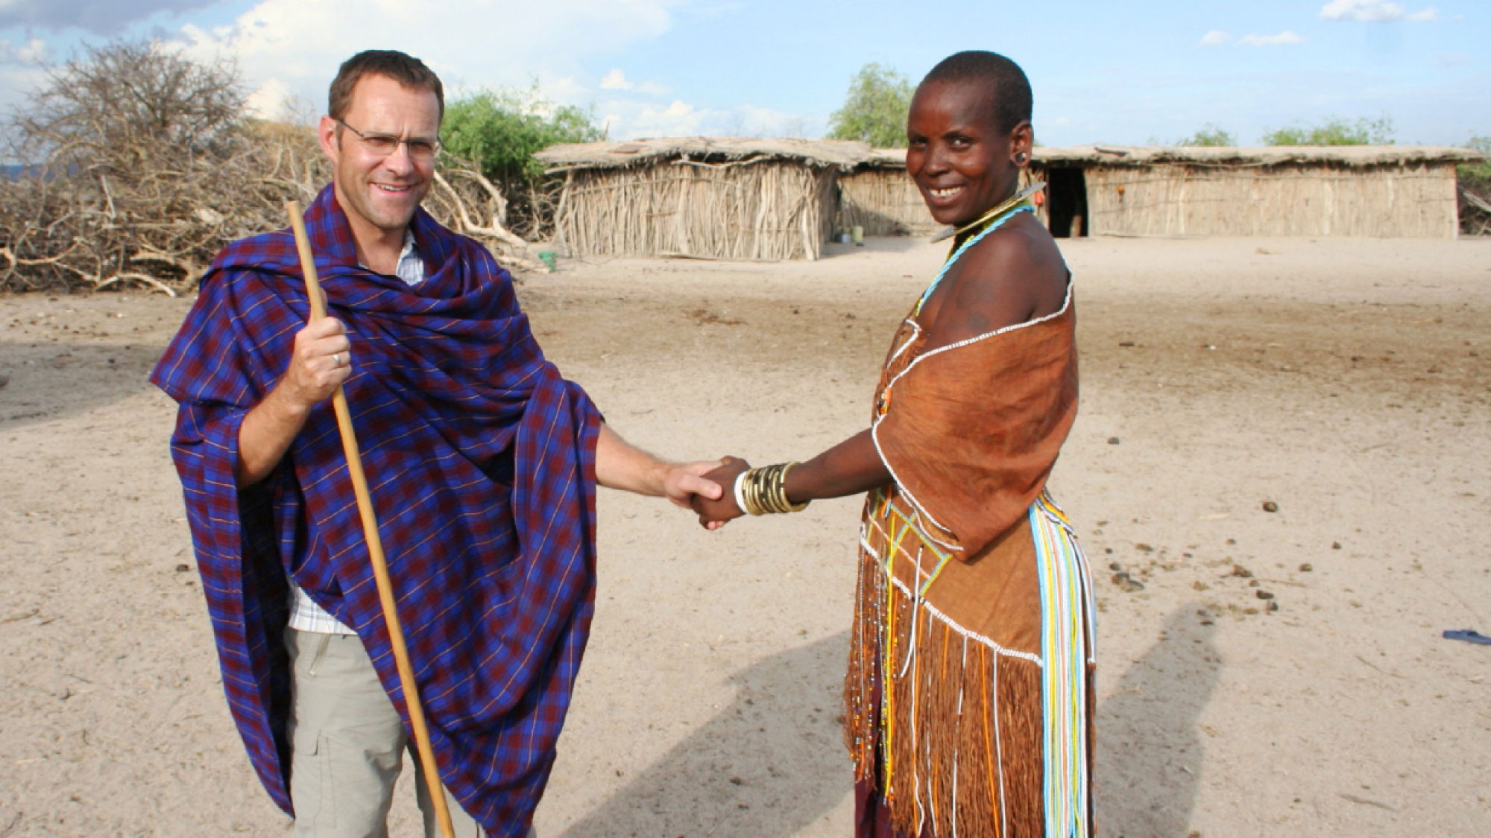
5. It Follows the
“Reflex Influence”
principle (GW, 465)
The more invested there, the more development here
“To show a liberal, self-denying spirit for the success of foreign missions is a sure way to advance home missionary work; for the prosperity of the home work depends largely, under God, upon the reflex influence of the evangelical work done in countries afar off. …” GW, 465

Slide 29
6. Provides Strong
Focus on Supporting
the Local Church
It is the most important entity of the SDA structure.
It is where new members are generated
50-60% of the non-assigned offerings

Slide 30
7. Provides a
Balanced Space
for Project Giving
But only above and beyond regular/systematic offering (Promise)

Slide 31
What the 2002
GC Spring Meeting
Minutes stipulate:
“… direct appeals to the Seventh-day Adventist donor base will be requested to include in their donor materials an affirmation of the donor’s prior responsibility to worship God through tithe and regular support of the Church through systematic offerings.”

Slide 32
What the 2002
GC Spring Meeting
Minutes stipulate:
“… such affirmation shall include a statement such as: ‘Contributions to the appeal should be above and beyond regular return of tithe and systematic offerings through your local church’”

Slide 33
INDIVIDUAL

Slide 34
Emphasizes
Altruist Giving
In opposition to selfish giving, like
“I give only to what I like, prefer, to what I know, or to which will benefit me somehow.”

Slide 35
2. Equates Regular
Offerings and Tithe
in Importance
Regular Offerings as binding as the Tithe (Mal. 3:8-10)
Given after any income (Prov. 3:9)

Slide 36
2. Equates Regular
Offerings and Tithe
in Importance
Given as a percentage of the income (1 Cor. 16:2; Deut. 16:17)
Moved by principle, not emotion.
Members’ hearts will be placed in spiritual realities (Matt. 6:21)

Slide 37
3. Provides a
Broad Missionary
Inclusiveness
Result for combined efforts of members:
Unity and love for missions
Equitable support of local, regional and foreign missions
Satisfaction

Slide 38
4. Develops
Mature Givers
Focus: To worship God as regularly as His blessings are received

Slide 39
4. Develops
Mature Givers
Giving is no longer based on:
Appeals
Relevant projects
Good feelings
Sympathy

Slide 40
4. Develops
Mature Givers
“The followers of Christ should not wait for thrilling missionary appeals to arouse them to action. If spiritually awake, they would hear in the income of every week, whether much or little, the voice of God and of conscience with authority demanding the tithes and offerings due the Lord.” 4T, 474.

Slide 41
4. Develops
Mature Givers
“God has devised a plan by which all may give as He has prospered them, and which will make giving a habit without waiting for special calls.... Until all shall carry out the plan of systematic benevolence, there will be a failure in coming up to the apostolic rule.” 3T, 411.

