Slide 1
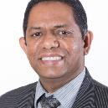
p
artners
With our own means
ANIEL BARBE

Slide 2
The testimony moves forward when the offering grows.

Slide 3
Now it came to pass, afterward, that He went through every city and village, preaching and bringing the glad tidings of the kingdom of God. And the twelve were with Him, and certain women who had been healed of evil spirits and infirmities—Mary called Magdalene, out of whom had come seven demons, and Joanna the wife of Chuza, Herod’s steward, and Susanna, and many others who provided for Him from their substance.
Luke 8:1-3 (NKJV)

Slide 4
Jesus partnered with the 12 disciples and was supported by some women.

Slide 5
SUPPORTING EXPANSION IN MISSION

Slide 6
“Now it came to pass, when the time had come for Him to be received up, that He steadfastly set His face to go to Jerusalem.”
Luke 9:51 (nkjv)

Slide 7
This phase of His ministry was particularly rich in teaching, demonstration of power, and expansion in mission.

Slide 8
During his last trip in Galilee, Jesus used parables to make His instructions clearer.

Slide 9
Another peak experience was the Transfiguration.

Slide 10
During this journey Jesus presented Himself as THE compassionate and almighty.

Slide 11
There WAs also A significant BREAKTHROUGH in mission.

Slide 12
He benchmarked the concept of a universal mission.

Slide 13
It was indeed an exceptional period in Jesus’ earthly ministry. Who provided for the needed resources?

Slide 14
“[...]These women were helping to support them out of their own means.”
Luke 8:3 (Niv)

Slide 15
WOMEN assisted Jesus and His missionary crew.

Slide 16
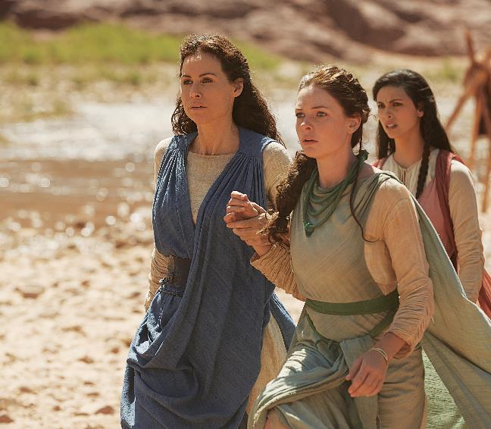
The all-powerful God depended on humans, on a handful of women, for the execution of His mission.

Slide 17
God’s mission for Planet Earth has entered into its final phase.

Slide 18
Do we have the needed logistics to support this expansion?

Slide 19
“He has placed in the hands of his servants the means wherewith to carry forward his work in home and foreign missions.”
ELLEN G. WHITE, Counsels on Stewardship, p. 47

Slide 20
The resources are available; is it possible that they are not yet released?

Slide 21
THE CONTRIBUTIONS OF THE WOMEN

Slide 22
“support” and “own means”

Slide 23
The Greek word diekonoun

Slide 24
An itinerant preacher with 12 disciples definitely had some practical needs.

Slide 25
they needed financial support to survive.

Slide 26
When one invests in growing spirituality, the outcome will be growth in liberality.

Slide 27
These mundane things are essential for the good news to move forward; they are the wheels of mission.

Slide 28
They were providing services according to their abilities; both simple and complex.

Slide 29
The “own means” also refers to financial means.

Slide 30
they started a practice that later would be emulated by the early church—selling assets and bringing the proceeds to support God’s mission.

Slide 31
These women were not exceptions, but they demonstrated an exceptional self-sacrificing spirit.

Slide 32
The pioneers of the Seventh-day Adventist Church were animated by the same spirit.

Slide 33
“Each should keep a missionary box at hand, and drop into it every penny he is tempted to waste in self-indulgence.”
ELLEN G. WHITE, Counsels on Stewardship, p. 290

Slide 34
Do we have our own missionary box, drawer, purse, or bank account?

Slide 35
THE DRIVING FORCES

Slide 36
What were the driving forces behind the spirit of self-denial of these women?

Slide 37
These women were with Jesus (Luke 8:2).

Slide 38
The company of Jesus, the Great Giver, can only transform individuals into His image.

Slide 39
“Among Seventh-day Adventists, tithing behavior is very closely related to a range of other practices relating to religion, such as whether they attend Sabbath School, read and reflect on the Bible each day, and pray often during the day.”
Robert McIver, Tithing Practices Among Seventh-day Adventists, p. 30).

Slide 40
When one invests in growing spirituality, the outcome will be growth in liberality.

Slide 41
these women “had been cured of evil spirits and diseases” (Luke 8:2, NIV)

Slide 42
All have experienced the delivering power and goodness of Jesus.

Slide 43
Stewardship is always the response of a grateful heart.

Slide 44
the beneficiaries show gratitude by partnering.

Slide 45
we give because He has already given. We love Him and others because He first loved us.

Slide 46
THE REAL BENEFICIARIES

Slide 47
But all those who knew him, including the women who had followed him from Galilee, stood at a distance, watching these things.
Luke 23:49 (NIV)

Slide 48
The next occasions that we meet these women are at the foot of the cross (Luke 23:49) and at the burial of Jesus (Luke 23:55).

Slide 49
Service, giving, and witnessing belong to the same package. Let us refrain from being SELECTIVE.

Slide 50
The women who had come with Jesus from Galilee followed Joseph and saw the tomb and how his body was laid in it.
LUke 23:55 (NIV)

Slide 51
They did not run away when Jesus was arrested and condemned.

Slide 52
Faithfulness in supporting God’s mission prepared them for faithfulness in time of crisis.

Slide 53
Their commitment to support Jesus was translated into total dedication to Him.

Slide 54
“For where your treasure is, there your heart will be also.”
Luke 12:34 (Niv)

Slide 55
Our application in supporting God’s mission today is one of the surest indicators of where we will stand during the final crisis.

Slide 56
They were privileged to be the first witnesses of the greatest event in all human history.

Slide 57
Service, giving, and witnessing belong to the same package. Let us refrain from being selective.

Slide 58
Jesus, the all-powerful One, has chosen to associate with human partners in the work of proclaiming the good news of the kingdom.

Slide 59
Involvement in His mission is through both dedicated service and sacrificial giving.

Slide 60
As we taste His goodness, let us reflect on our response.

Slide 61
The result will be mission forward and faster.

Slide 62
p
artners
With our own means
ANIEL BARBE

