Slide 1
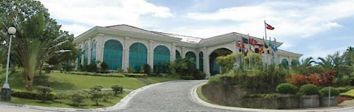

Worldwide Stewardship Ministries Advisory
September 22-23, 2021
Greetings From
Southern Asia Pacific Division
of Seventh-day Adventists
Notes:
Good day everyone….months old in the STW, great responsibility entrusted to me after virus outbreak. Thank you GC STW leaders and collogues

Slide 2
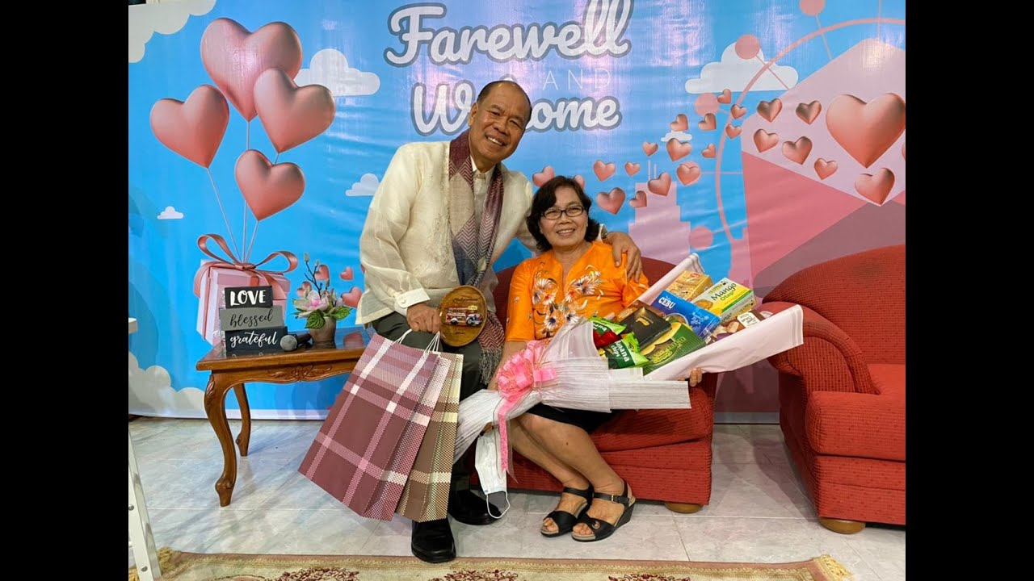
Appreciation for Pastor Noldy Sakul for service rendered
Notes:
We thank Pastor Sakul for 7 years service rendered in STW Ministries Department

Slide 3
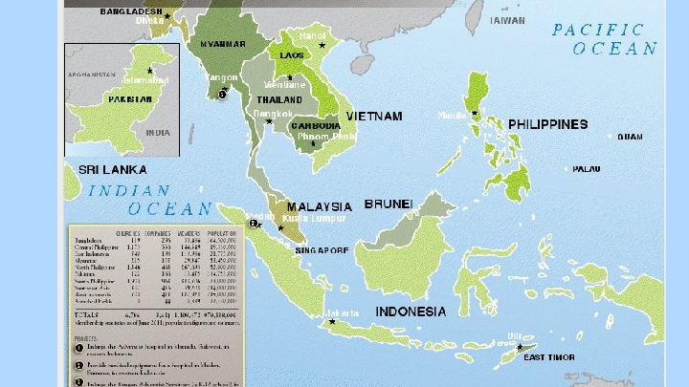
Notes:
SSD oversees the work of spreading the truths of the Gospel in the Southeast Asian countries. There are over 1.6 million Seventh-day Adventists worshipping in more than 7,000 churches, in the territory with a population of over a billion. Almost 90 percent of the Division’s membership live in Indonesia and the Philippines.

Slide 4
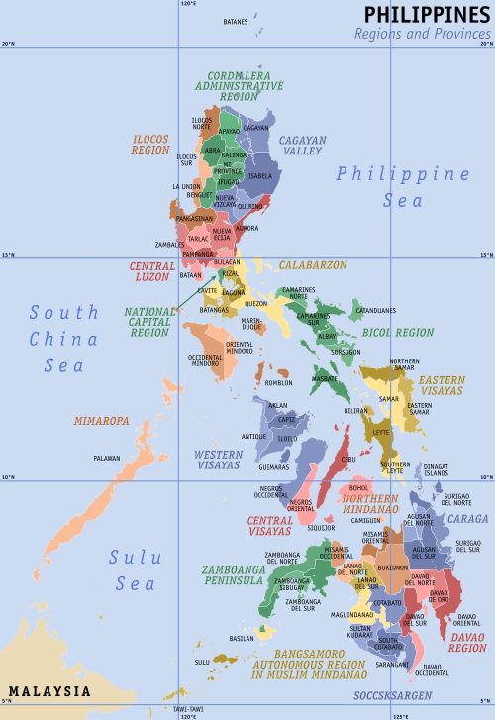
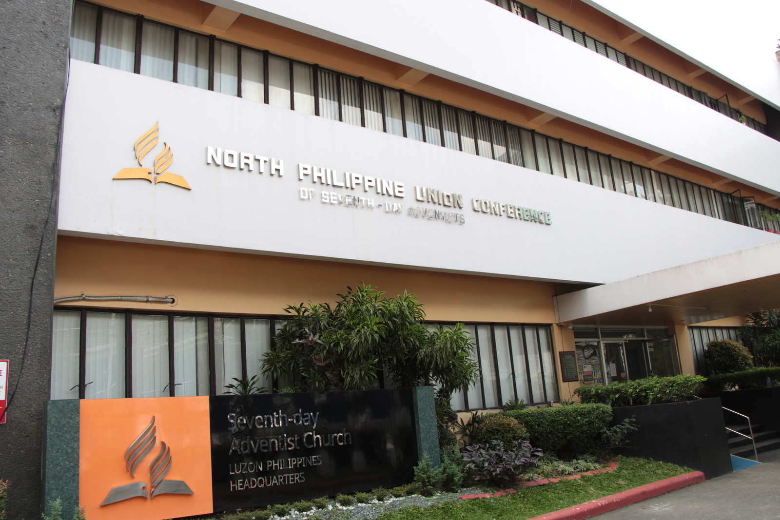
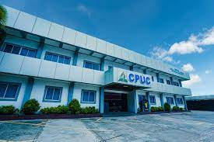
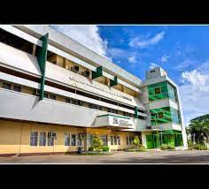
North Philippines Union Conference
Central Philippine Union Conference
South Philippines Union Conference
Notes:
SSD has 11 regional offices called Unions. We have North Philippines, Central Philippines, South Philippines,

Slide 5
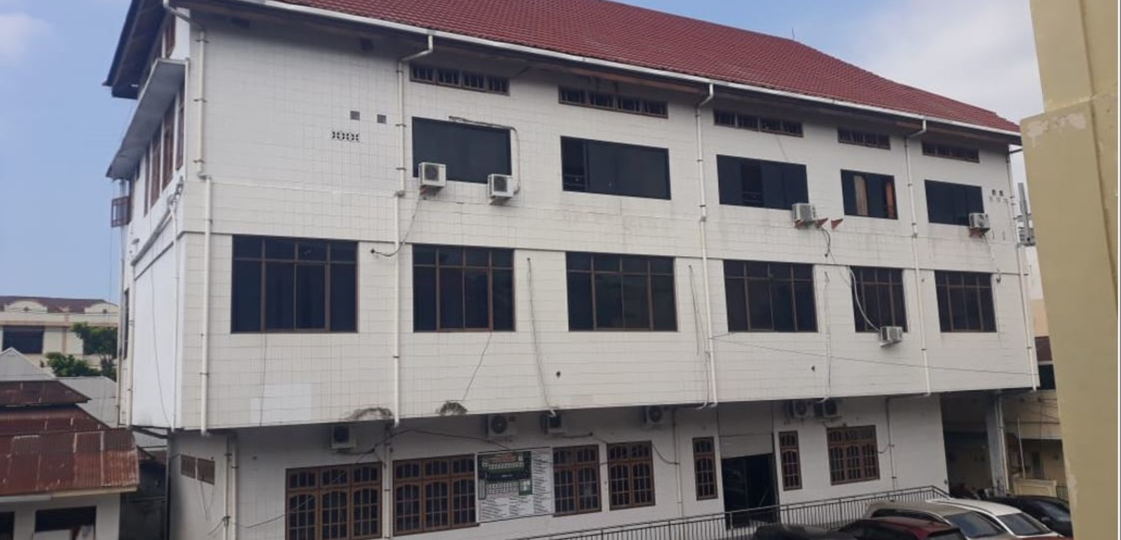
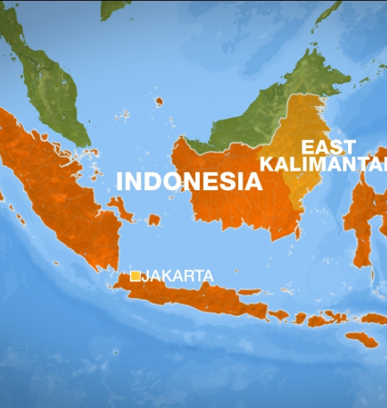
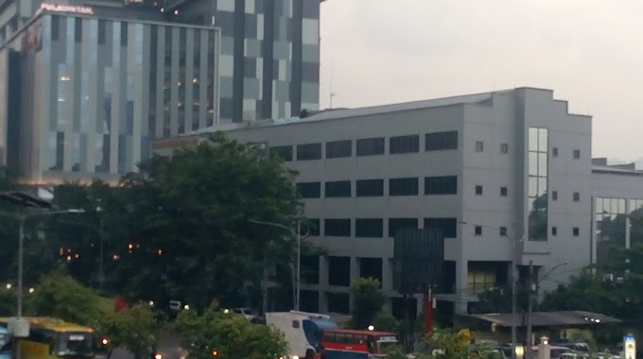
East Indonesia
Union Conference
West Indonesia
Union Mission
Notes:
east Indonesia,, west Indonesia

Slide 6
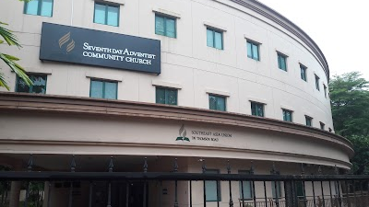







SOUTHEAST ASIA UNION MISSION
Malaysia
Brunei
Singapore
Vietnam
Laos
Thailand
Cambodia
Notes:
7 countries in Southeast Asia Union Mission

Slide 7
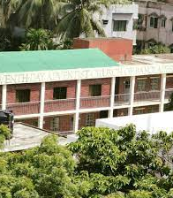

Bangladesh Adventist Union Mission

Slide 8
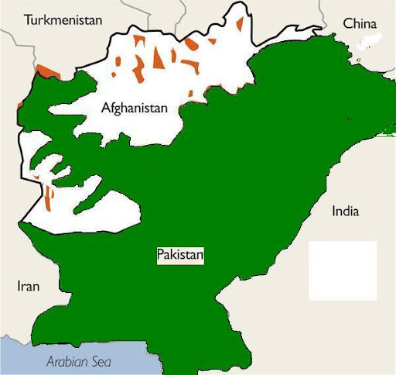

PAKISTAN
UNION MISSION

Slide 9
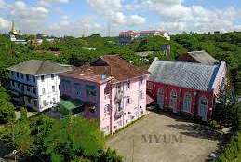

Myanmar
Union Mission

Slide 10
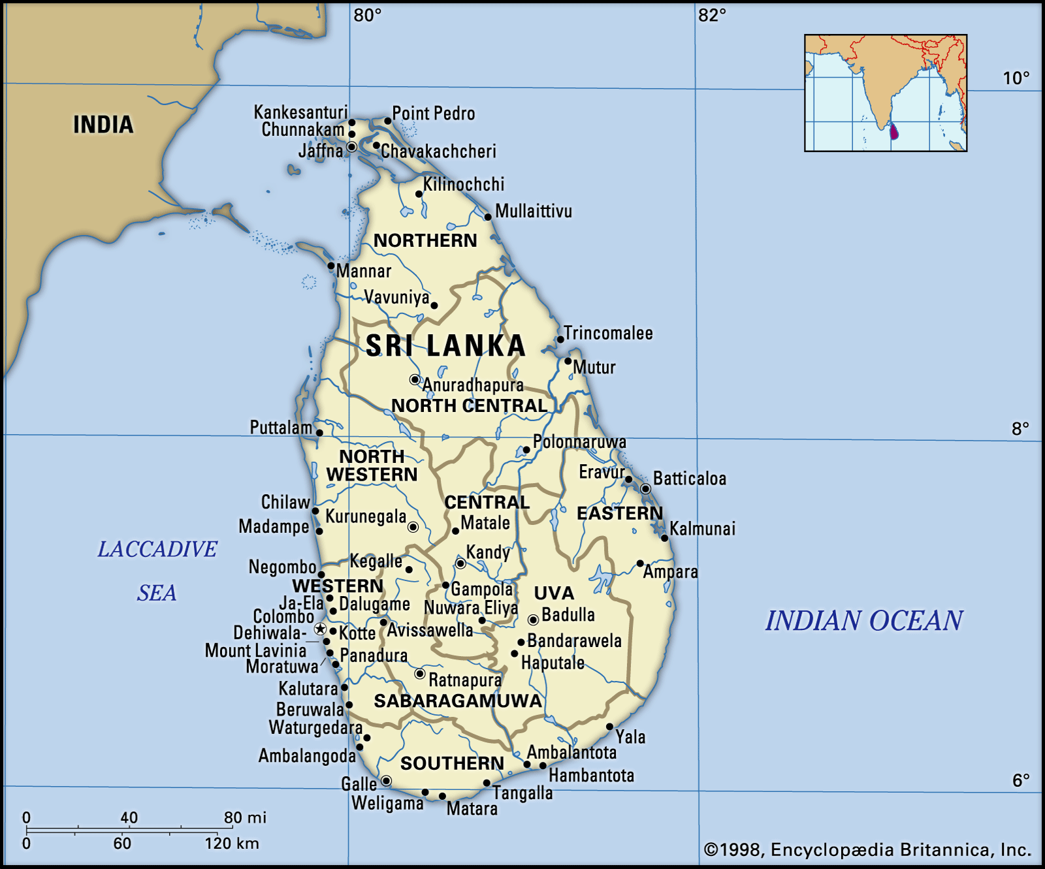

SRI LANKA MISSION
Notes:
as well as mission outposts in Sri Lanka

Slide 11
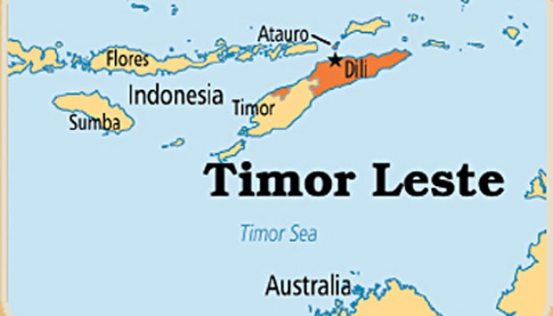

TIMOR LESTE MISSION
Notes:
and Timor-Leste

Slide 12
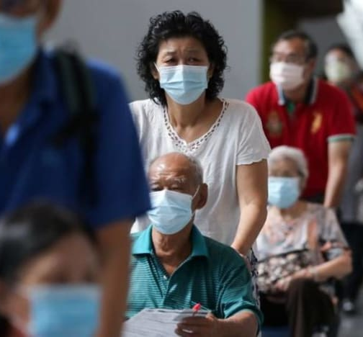
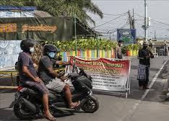

Notes:
The pandemic has had a severe economic impact and has had far reaching effects on our church members as well our society

Slide 13
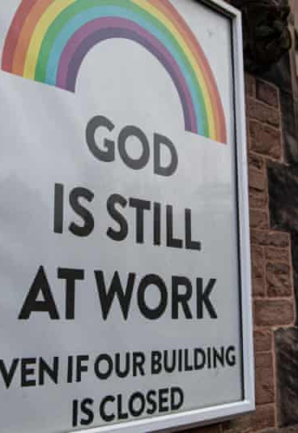
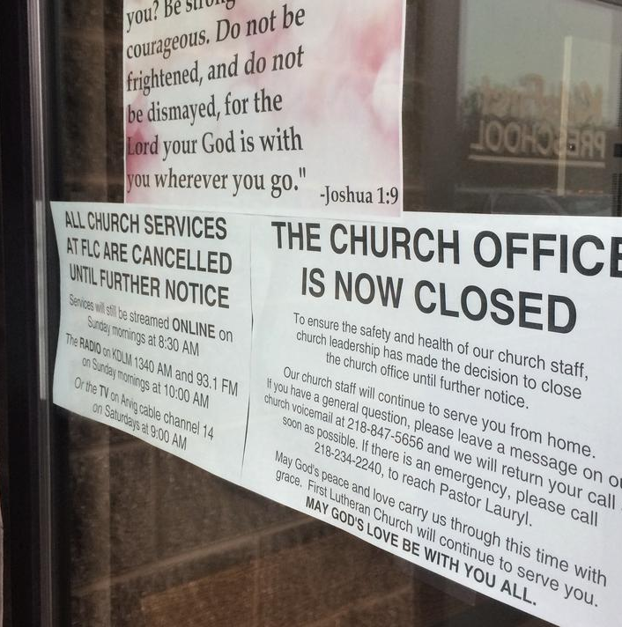
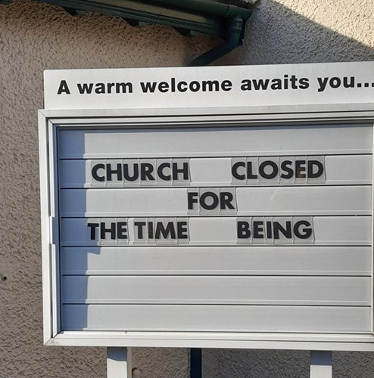
Notes:
The COVID-19 pandemic has impacted religion in various ways, including the cancellation of the worship services for months since March 2020. But God is still at work even if the church building is closed.

Slide 14




“I Will Go” for SSD
2020-2025 SSD for Christ Initiative….
S
Seeking
S
Saving
D
Discipling
“Each One, Reach One
Is called by God family member
has a mission neighbor
has a blessing to share Friend
is empowered to witness Stranger

Slide 15

OUR MISSION
The Mission of the Stewardship ministries in Southern Asia Pacific Division is to help leaders and members develop habits necessary for spiritual growth and faithful stewardship, to make disciple of Jesus Christ to proclaim the everlasting gospel and bringing all to partner fully and sacrificially with God and to increase the member’s faithfulness to God in all Stewardship dimensions and through spiritually revived and faithful stewards.

Slide 16
OUR VISION
SDA members will have a total commitment in faithful partnership with God, to establish the habit of putting GOD FIRST in every area of life, facilitating the growth of a spiritual community of faithful Adventist stewards”, in accomplishing the final mission of the church , to prepare a people for His Kingdom

Slide 17

Notes:
People lost their job

Slide 18
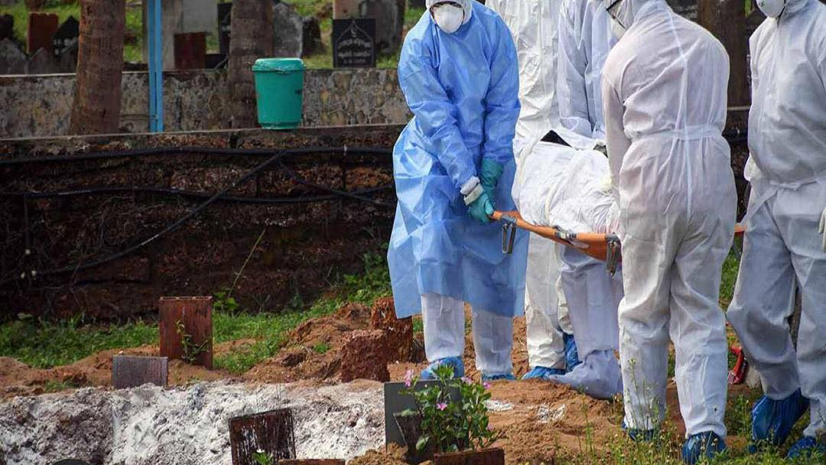
Notes:
Reports record C-19 deaths and spike in new daily cases before the vaccination program. SDA members are not exempted. We have number of church members died of Covid.

Slide 19

Notes:
The limitation of Zoom - It is much more difficult to develop new members through online activities than traditional ways.
older people could be faced with technical and equipment problems, and may therefore be unable to participate in online events of the church.

Slide 20

Notes:
In the financial side, many churches operate on a very thin margin and have little to no reserves. Returning Tithe and giving an offering during the pandemic for the first three months in the year 2020 was challenge for there are many churches are still heavily dependent on gifts that are made in an offering bags when people are physically in church.

Slide 21
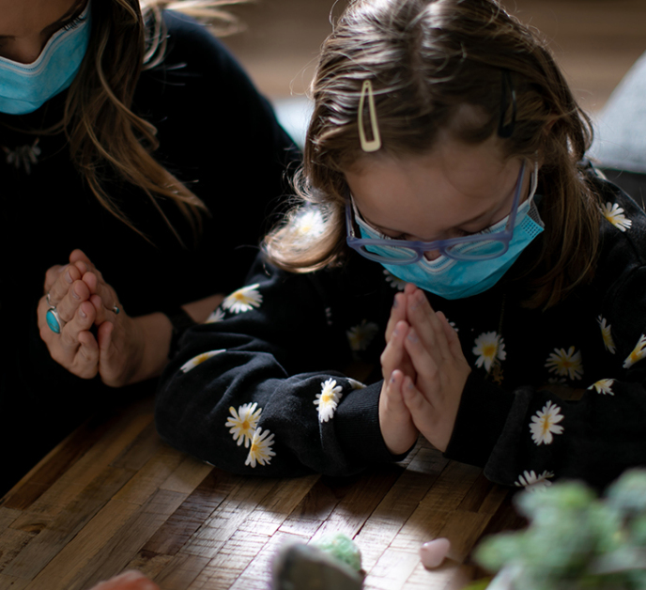
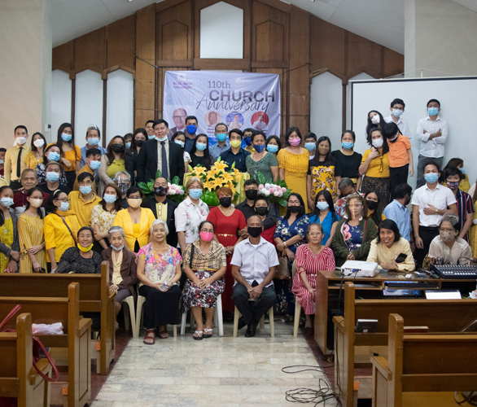
Our response
Notes:
Since the virus outbreak, Seventh-day Adventist Churches throughout SSD has organized both online and small group or family house worship.

Slide 22
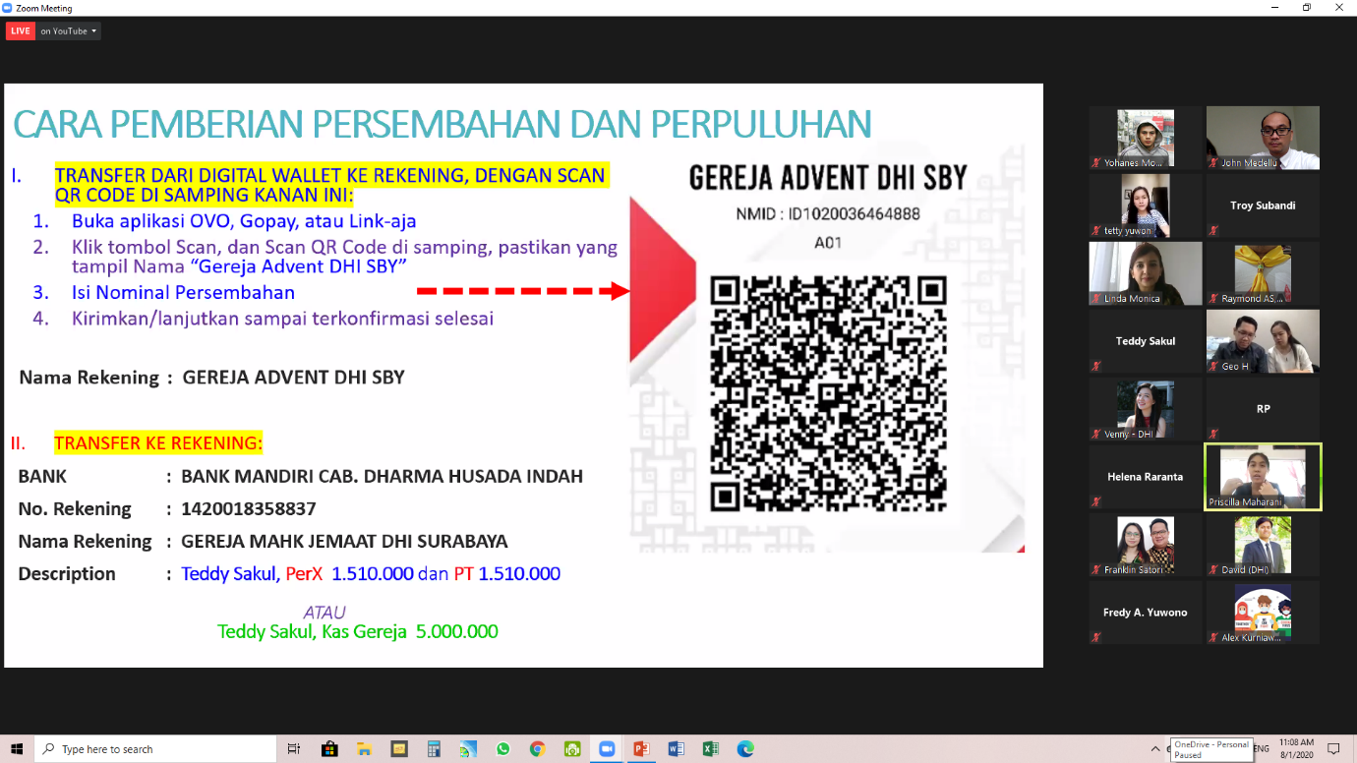
Tithing & Offering through QR CODE
Online banking

Slide 23
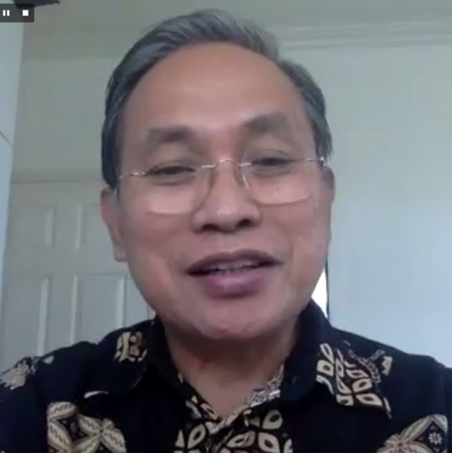
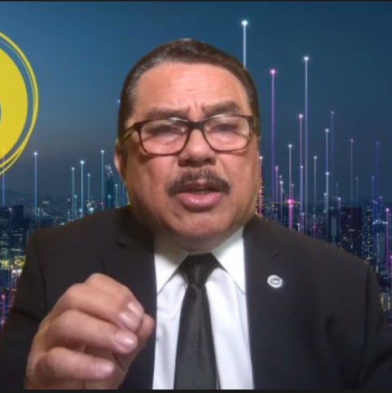
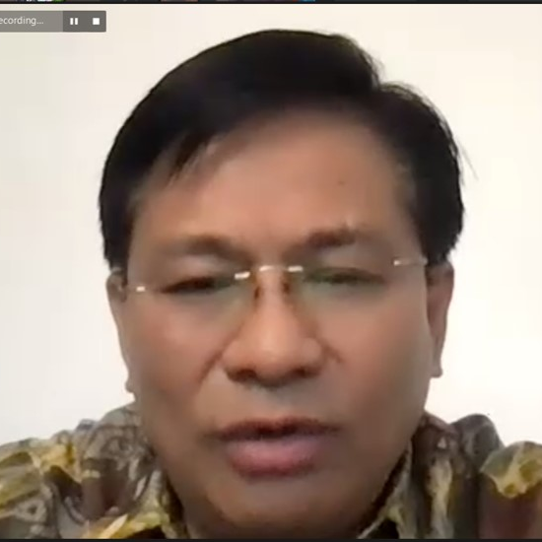
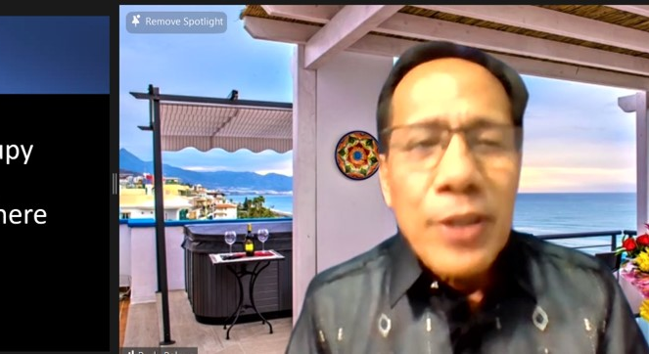
BI-Union
Online Stewardship
Convention
EIUC
&
WIUM

Slide 24
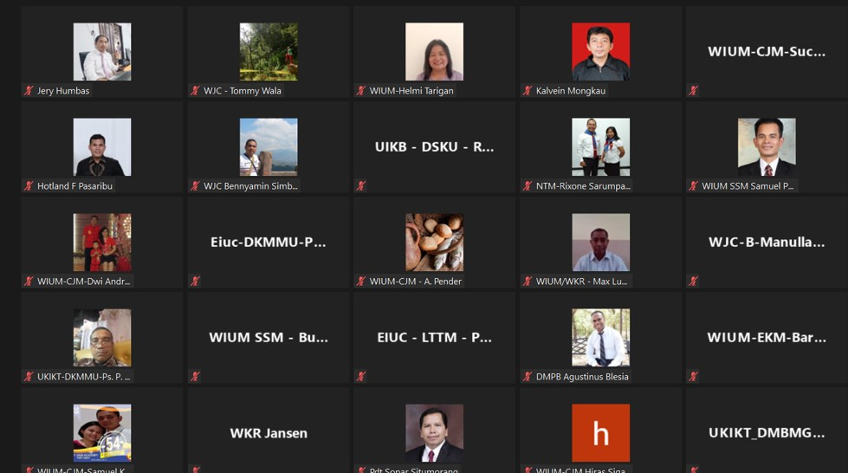
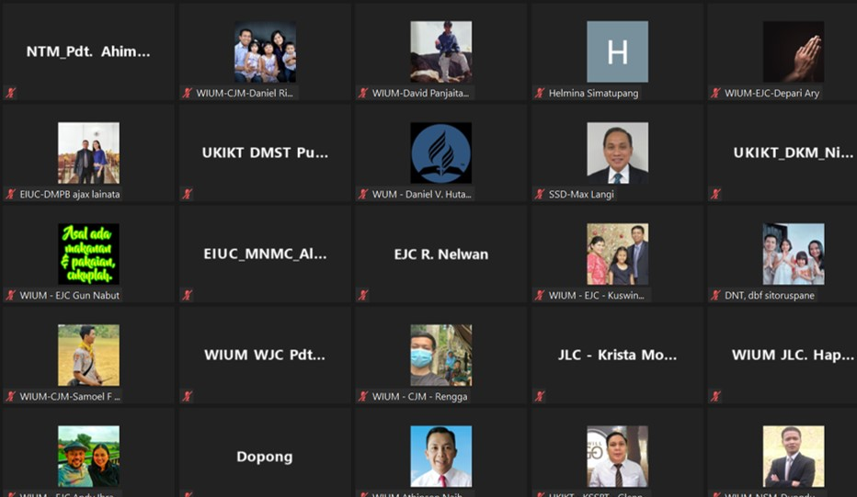
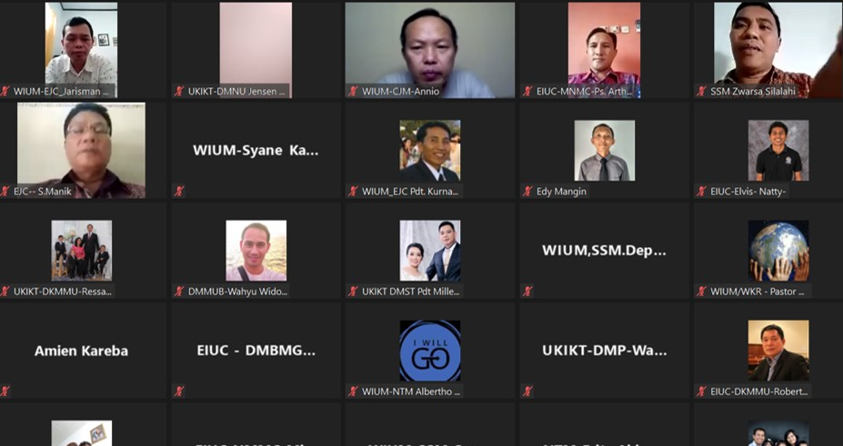
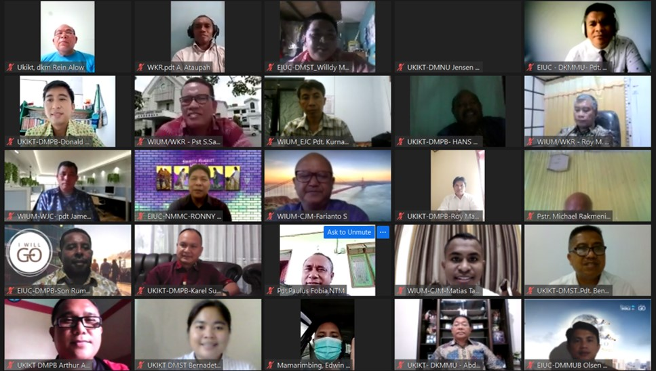
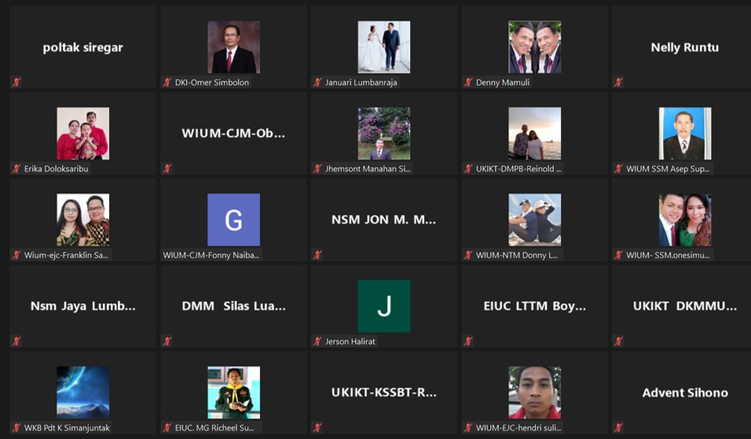
BI-Union
BI-Union Online Stewardship
Convention
EIUC & WIUM

Slide 25
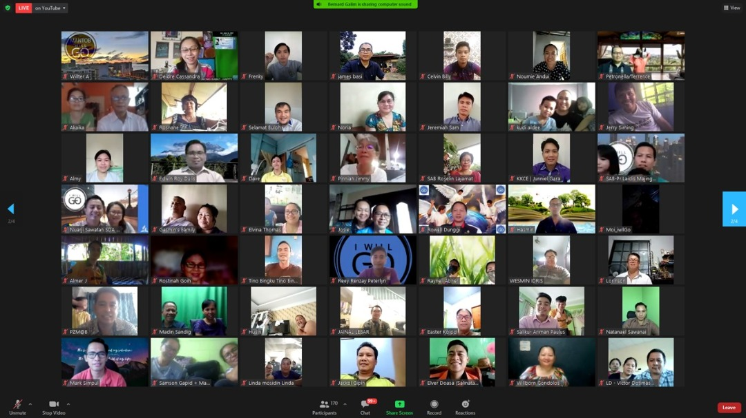
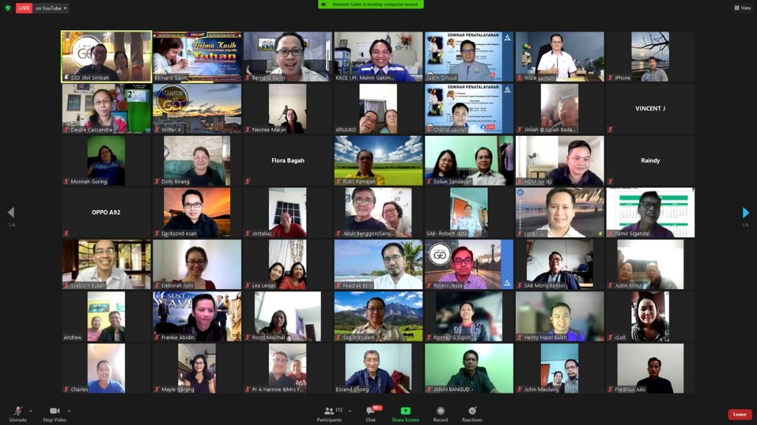
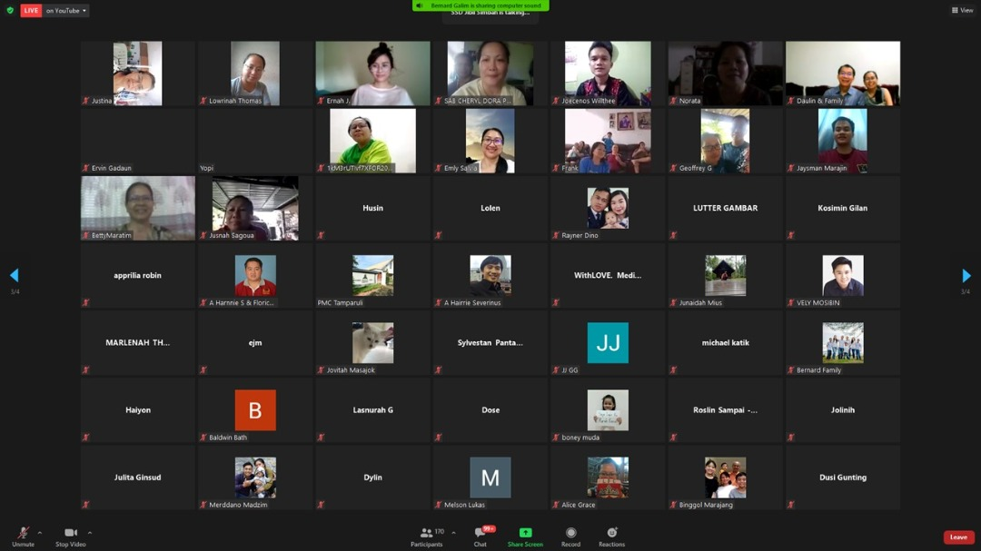
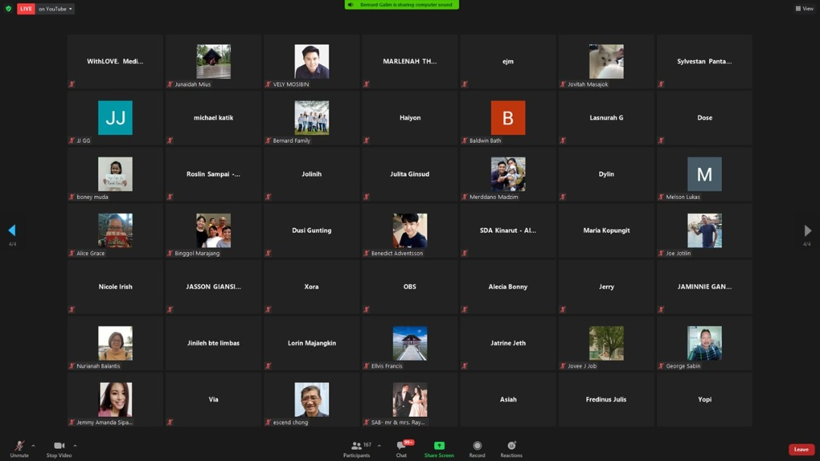
SAUM
ONLINE
GOD FIRST
SEMINAR

Slide 26


Slide 27
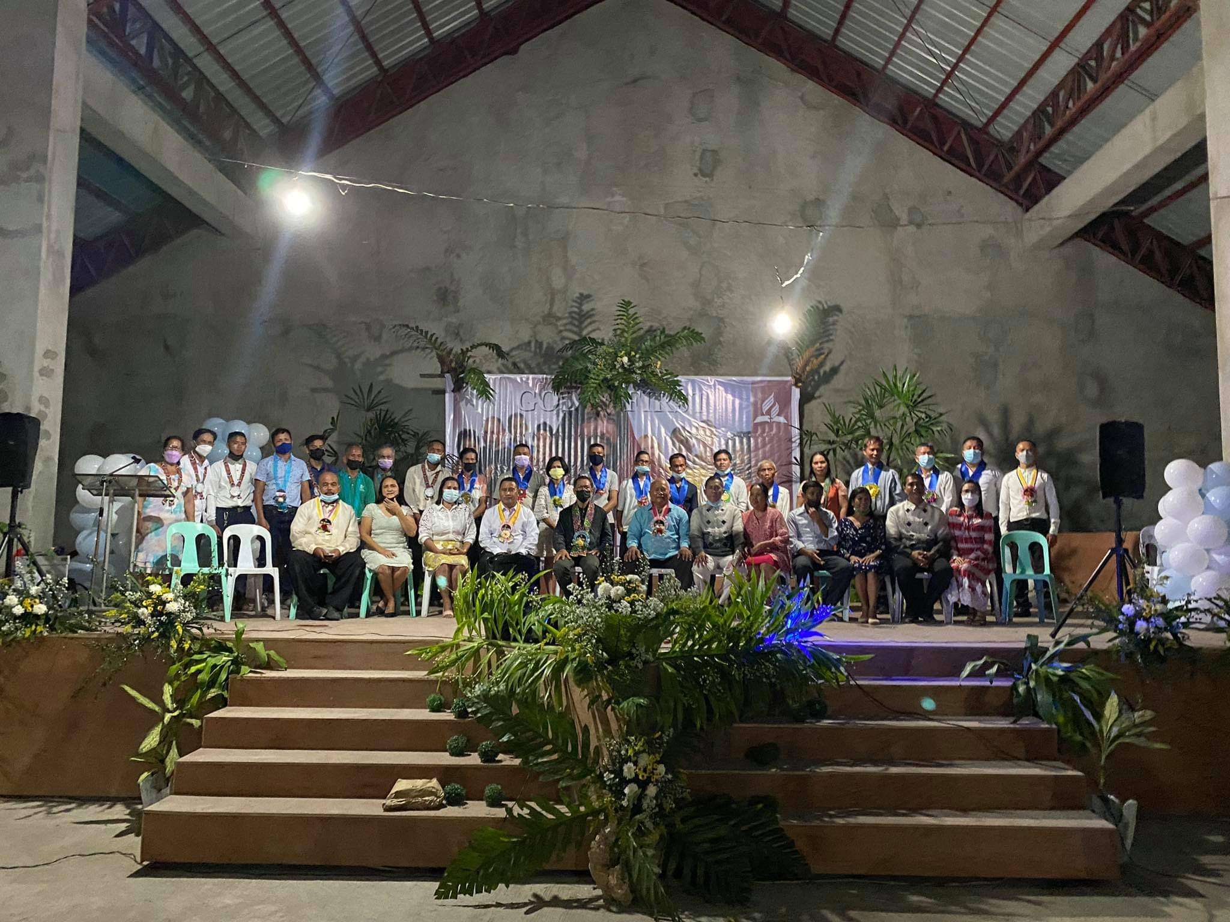
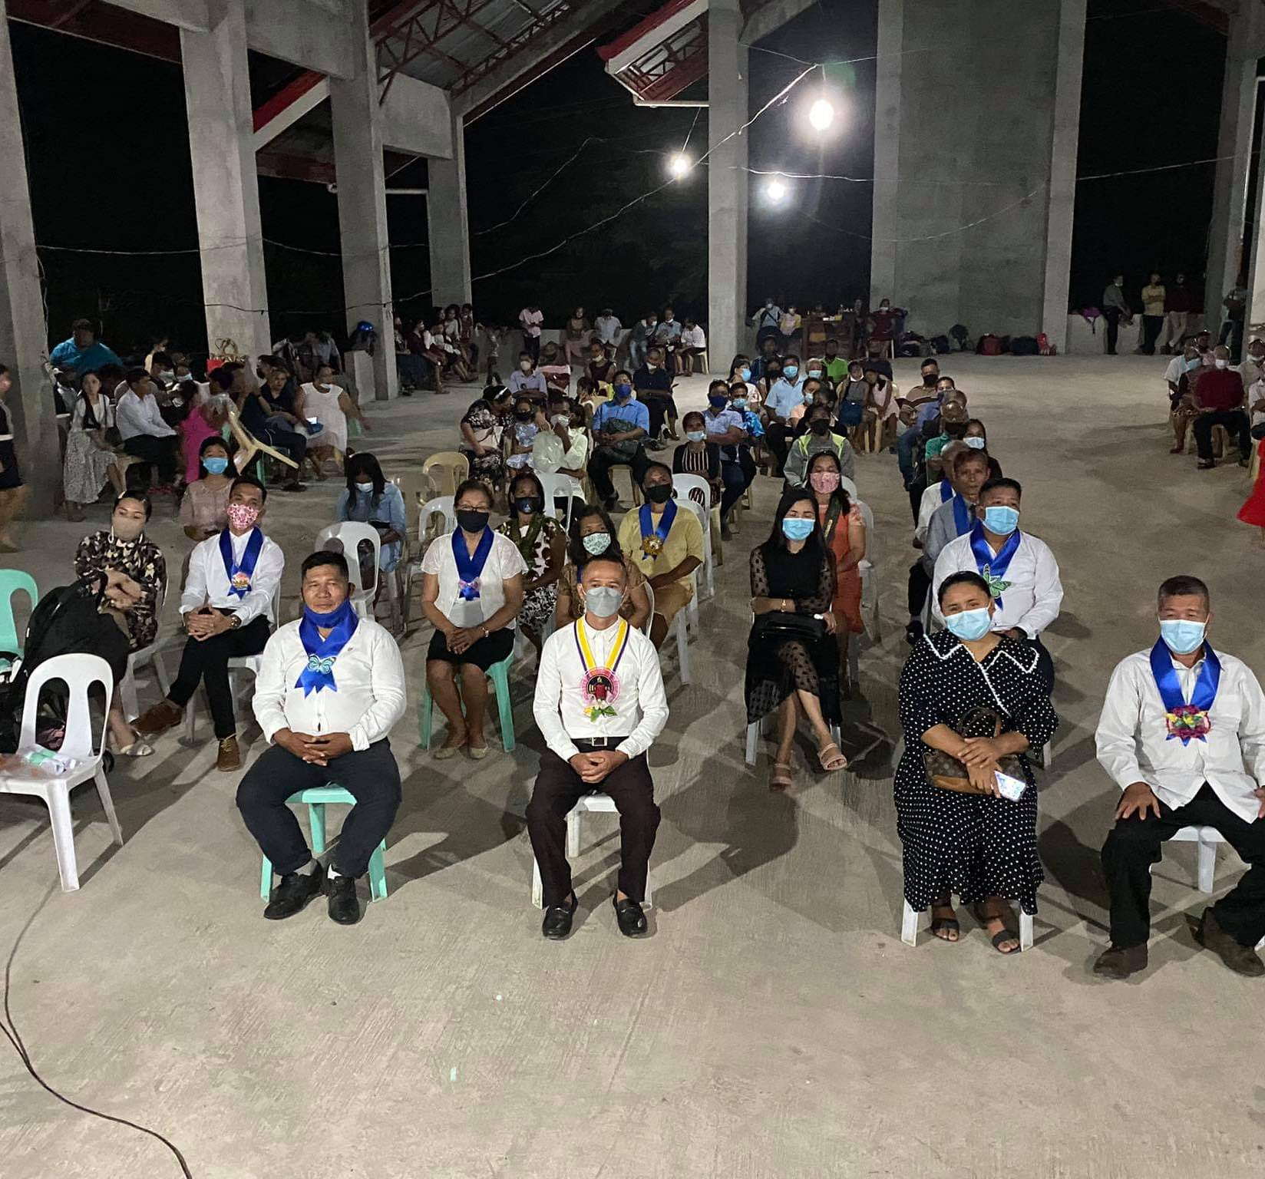
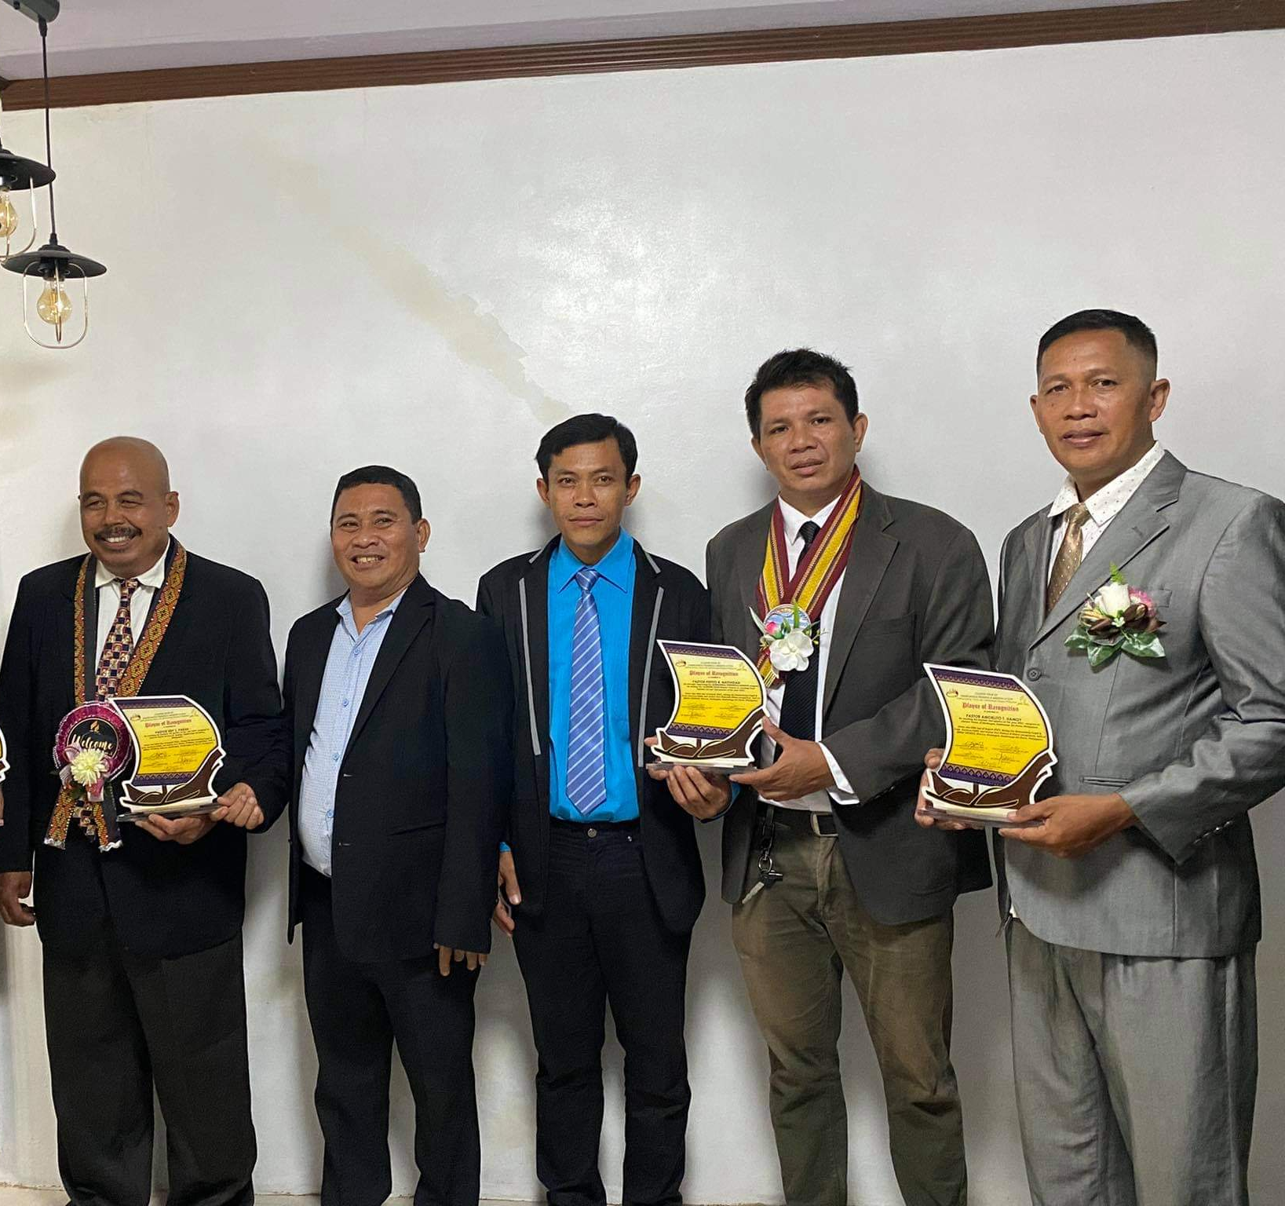
SPUC-ZPM
PUTTING GOD FIRST
SERIES
Notes:
Recognition of workers who achieved their goal both baptism and Tithe

Slide 28

Notes:
Next week

Slide 29
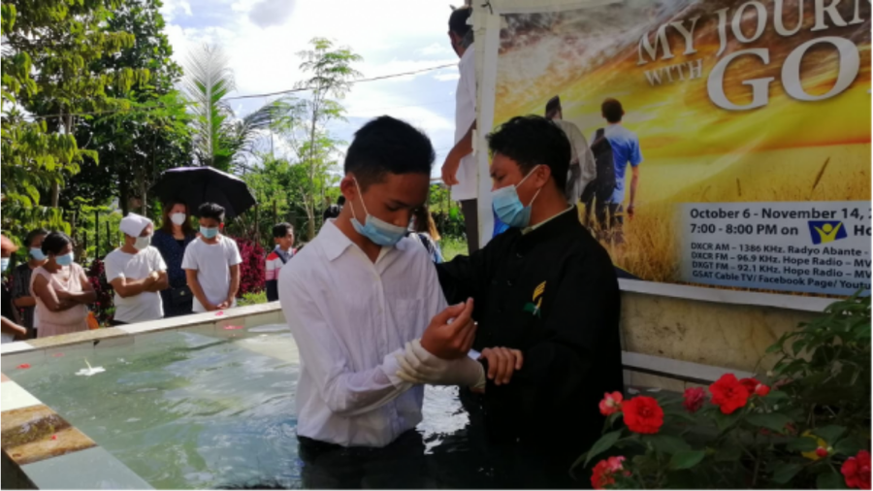
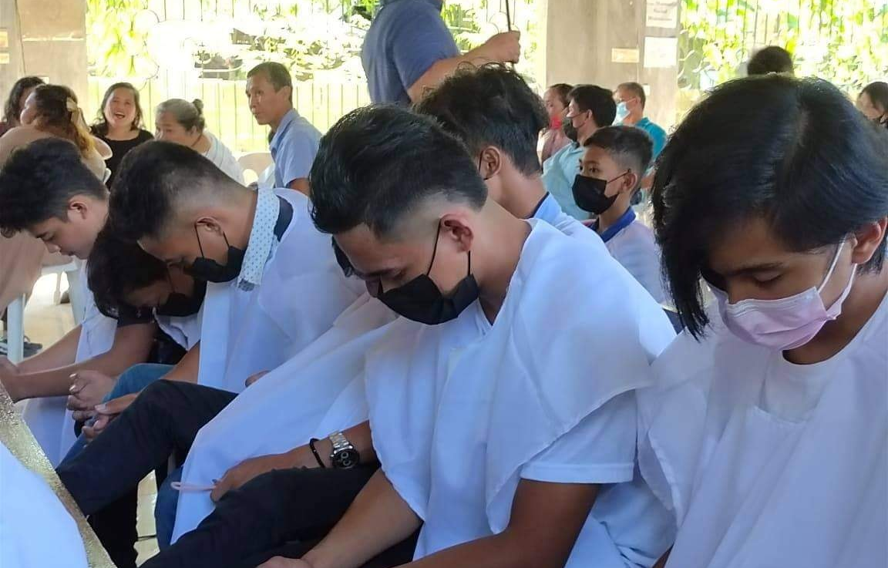
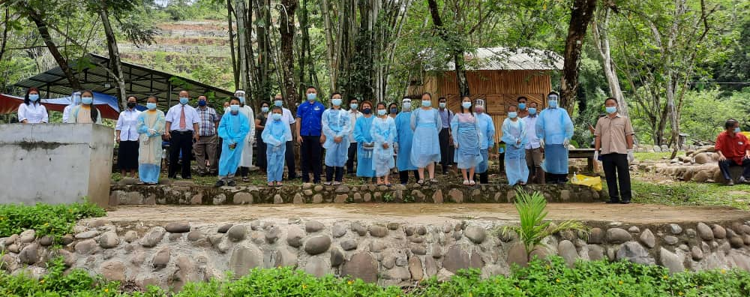
Baptism during the pandemic

Slide 30
TOTAL MEMBERSHIP2019-2021 (JULY)

Slide 31
Membership Statistical Report
For 2019 & 2020 SSD
Year | Church | Companies | Church membership beginning of the year | Baptism | Deaths | Missing | church Membership at End of Year | Church Attendance Average
2019 | 7,653 | 3,707 | 1,563,697 | 98,747 | 4,117 | 22,502 | 1,627,397 | 792,728
2020 | 7,857 | 3,612 | 1,627,397 | 99,262 | 3,927 | 27,865 | 1,688,247 | 683,629

Slide 32
TITHE AND OFFERINGS (USD)
(SSD)
Year | Tithe | Offerings
2019 | 84,791,525.73 | 16,146,408.05
2020 | 87,205,377.66 | 13,561,542.51
2021 | 54,486,350.08 | 8,148,471.19
Notes:
Many churches will even grow stronger. It was during the Pandemic, members faithfully in returning the Lord’s Tithe

Slide 33
TOTAL TITHES 2019-2021 (JULY)

Slide 34
TOTAL GROSS OFFERINGS 2019-2021 (JULY)
Notes:
There was a drop in the Offerings. The SSD Stewardship Department Ministries is going to priorities of teaching stewardship and nurturing generosity.

Slide 35
TITHES, OFFERINGS AND MEMBERSIP 2019-2021 (JULY)
Notes:
By God’s grace, stewardship and generosity ministry must adapt and change. I believe that most of our faith communities can and will recover from pandemic disaster.

Slide 36



THANK YOU
PUTTING

