Slide 1
COMBINED
TO GROW
Reasons for the “new” Offering Plan

Slide 2
WHY
Has the world church adopted the “concept of a simplified offering system?” (2002 GC Spring Meeting Minutes 02-53, April 18, 2002)

Slide 3
WHY
Is the Combined Offering Plan (COP) the giving system recommended, and promoted by the General Conference?” (2002 Annual Council Minutes 02-337, October 9, 2002)

Slide 4
What is COP
A system of motivation, collection, and distribution of offerings
It “combines” all non-assigned offerings in a single fund.

Slide 5
What is COP
From there, the resources are distributed, feeding equitably all non-tithe funded expenses of the local and institutional Church.
In all levels and geographic regions.

Slide 6
The COP
recognizes that
Tithes and Regular & Systematic Offerings are the most basic and initial expression of worship.
Tithes and Regular & Systematic Offerings are to be brought to the Storehouse.

Slide 7
The COP was
adopted by
9 Divisions – ECD, ESD, EUD (Spain and Portugal), IAD, NSD, SAD, SID, SPD (PNG and Islands), SUD, SSD, and WAD.
More than 90 percent of the Adventist world membership

Slide 8
COP’s Goal
To provide growth in at least three aspects:
Theological, Institutional and Individual

Slide 9
THEOLOGICAL
GROWTH

Slide 10
1. COP Recognizes
God as the Focus of Giving
Not
Material needs of the Church
Specific missionary projects
Ministries
Institutions

Slide 11
COP Recognizes that
Humans need to worship God
Worship includes returning tithes and offerings (Psalm 50:14; 66:13-16; 76:11; 96:8-9; 116:17-19)
They should be given as regularly as God blesses (Prov. 3:9-10).

Slide 12
COP Offering
promotion
Thus, “offerings will be promoted as an expression of worship to God in response to His blessing” (2002 Annual Council Minutes 02-337, October 9, 2002).

Slide 13
2. Suggests a distribution
based on the Threefold
Missionary Strategy
Acts 1:8 Strategy
Equally provides for [1] local, [2] regional and [3] international necessities.

Slide 14
3. It Follows the
biblical “Body”
principle
Each part must equally and regularly receive its share of nourishment.

Slide 15
4. Emphasizes “Promise”
(Regular and Systematic Giving)
Regular and systematic offering.
Previously “promised” or “purposed” by the worshiper (2 Cor. 9:7).
As a proportion or a percentage (1 Cor. 16:1; Deut. 16:17) of any income (Prov. 3:9).

Slide 16
4. Emphasizes “Promise”
(Regular and Systematic Giving)
As binding as the tithe (Mal. 3:8-10).
Offered immediately after the tithe.
Offered before any other expenses or giving (Prov. 3:9; Matt. 6:33).

Slide 17
6. Resembles the
Storehouse principle
An equitable system of distribution.
Comparable to the tithe’s Storehouse principle.

Slide 18
Offerings and the
Storehouse principle
Tithes and regular/systematic offerings—under the same system
The OT applies the Storehouse principle to both (Deut. 12; 18:8; 2 Chron. 31:11-21; Psalm 66:13-16; 96:8-9; 116:17-19; Neh. 10:32-39; 12:44-47; 13:8-14; Mal. 3:8-10).

Slide 19
INSTITUTIONAL

Slide 20
1. Affords a More
Spiritual Teaching
and Promotion
Educational focus:
Giving as an expression of worship (2002 Annual Council Minutes 02-337, October 9, 2002).
The Promise Concept

Slide 21
2. Provides
equitable growth
All the authorized missionary endeavors are funded
More non-tithe funds available on all levels

Slide 22
COP Policy of
Distribution for
Non-assigned Offerings
50-60 percent to the local Church
20-30 percent to the local field, union, division
20 percent to the world missionary budget

Slide 23
3. Promotes
Unity of Purpose
and Efficiency
No family can thrive if there isn’t unity of pockets
United, we become stronger, go farther and faster

Slide 24
4. Avoids
Congregationalism
and Institutional
Selfishness
Competition for funds generates a congregational trend.
It is the struggle of the species and the survival of the fittest.
If the local church is depleted, all other ministries will lose their meaning.

Slide 25
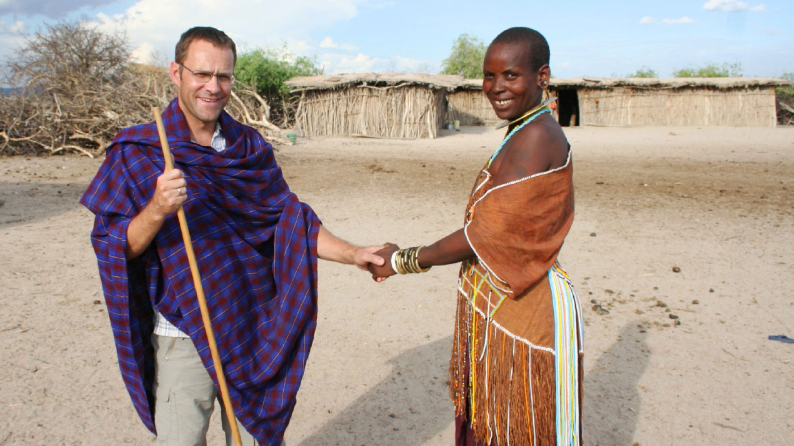
5. It Follows the
“Reflex Influence”
principle (GW, 465)
The more invested there, the more development here

Slide 26
6. Provides Strong
Focus on Supporting
the Local Church
It is the most important entity of the SDA structure.
It is where new members are generated
50-60% of the non-assigned offerings

Slide 27
7. Provides a
Balanced Space
for Project Giving
But only above and beyond regular/systematic offering (Promise)

Slide 28
What the 2002
GC Spring Meeting
Minutes stipulate:
“… direct appeals to the Seventh-day Adventist donor base will be requested to include in their donor materials an affirmation of the donor’s prior responsibility to worship God through tithe and regular support of the Church through systematic offerings.”

Slide 29
What the 2002
GC Spring Meeting
Minutes stipulate:
“… such affirmation shall include a statement such as: ‘Contributions to the appeal should be above and beyond regular return of tithe and systematic offerings through your local church’”

Slide 30
INDIVIDUAL

Slide 31
Emphasizes
Altruist Giving
In opposition to selfish giving
“I give only to what I like, prefer, to what I know, or to which will benefit me somehow.”

Slide 32
2. Equates Regular
Offerings and Tithe
in Importance
Regular Offerings as binding as the Tithe (Mal. 3:8-10)
Given following any income (Prov. 3:9)

Slide 33
2. Equates Regular
Offerings and Tithe
in Importance
Given as a percentage of the income (1 Cor. 16:2; Deut. 16:17)
Moved by principle, not emotion.
Members’ hearts will be placed in spiritual realities (Matt. 6:21)

Slide 34
3. Provides a
Broad Missionary
Inclusiveness
Result for combined efforts of members:
Unity and love for missions
Equitable support of local, regional and foreign missions
Satisfaction

Slide 35
4. Develops
Mature Givers
Focus: To worship God as regularly as His blessings are received

Slide 36
4. Develops
Mature Givers
Giving is no longer based on:
Appeals
Relevant projects
Good feelings
Sympathy

Slide 37
4. Develops
Mature Givers
“The followers of Christ should not wait for thrilling missionary appeals to arouse them to action. If spiritually awake, they would hear in the income of every week, whether much or little, the voice of God and of conscience with authority demanding the tithes and offerings due the Lord.” 4T, 474.

Slide 38
4. Develops
Mature Givers
“God has devised a plan by which all may give as He has prospered them, and which will make giving a habit without waiting for special calls.... Until all shall carry out the plan of systematic benevolence, there will be a failure in coming up to the apostolic rule.” 3T, 411.

