Slide 1
DAY 6

Slide 2
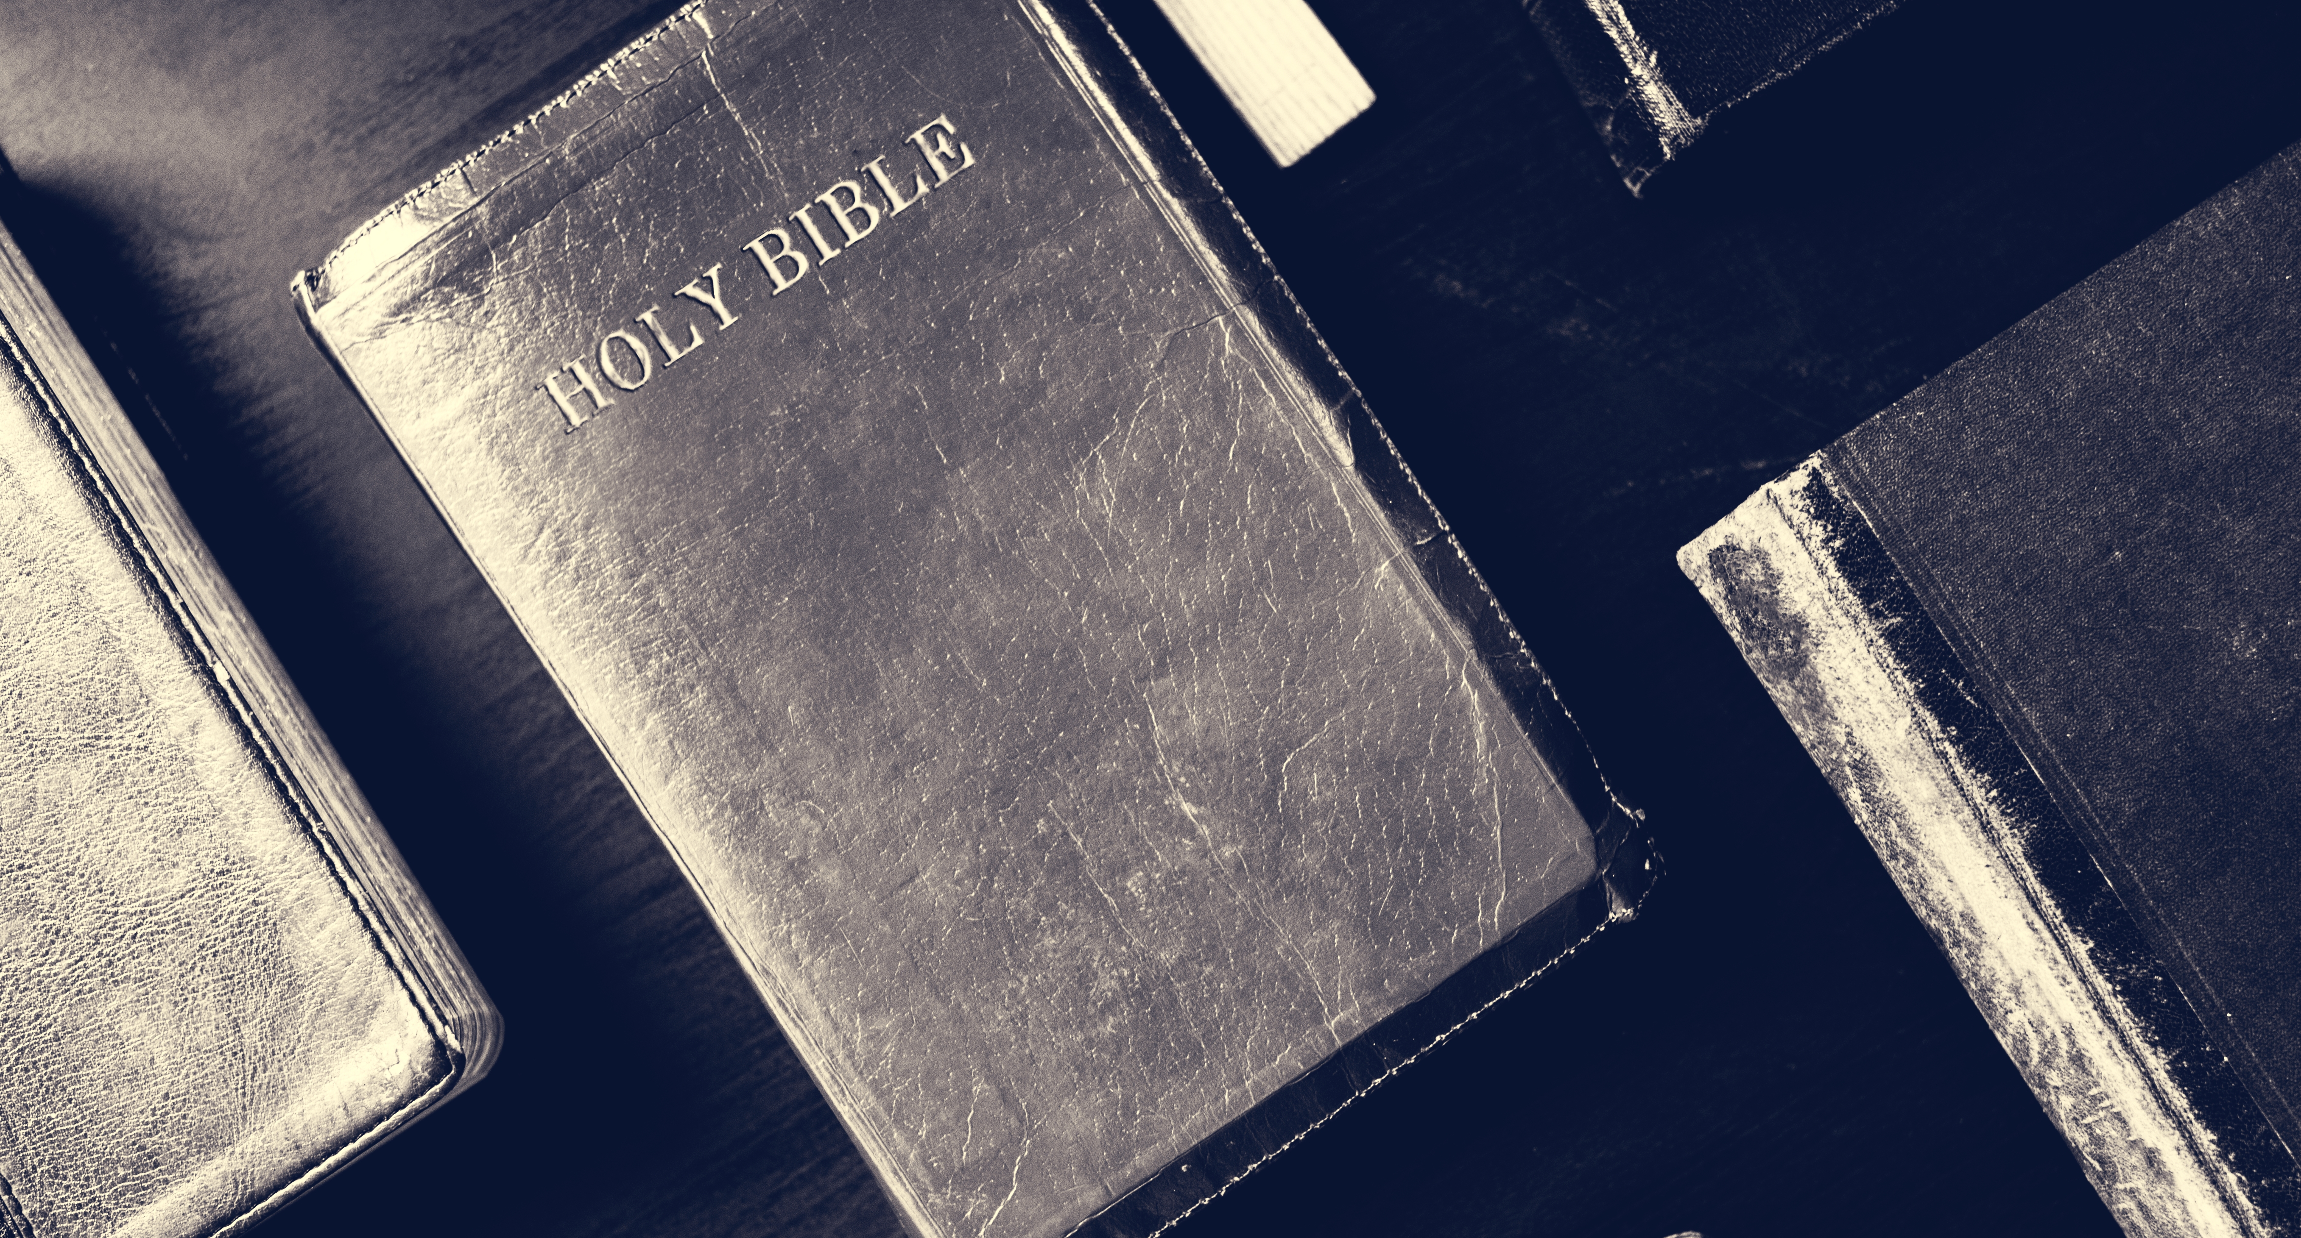
Back to Bethel
“And the stone which I have set as a pillar shall be God’s house, and of all that You give me I will surely give a tenth to You” (Gen. 28:22).

Slide 3
Bethel, the Meeting Place with God

Slide 4
Vows at the Place of Worship

Slide 5
Vow Renewal

Slide 6
Questions:
How does worship change my life and that of my family?
John abruptly concludes his first epistle with the warning, “Little children, keep yourselves free of idols” (1 John 5:21). Why?
Are there any delays in my life regarding faithfulness in returning the tithe? What keeps me from committing to God as Jacob did?

Slide 7
Five Times Rewarded
“For God loves a cheerful giver”
(2 Cor. 9:7).

Slide 8
Children’s Story:
Five Times Rewarded
“For God loves a cheerful giver”
(2 Cor. 9:7).

Slide 9
Questions:
Do you think God needs our money? Why do you think He wants us to return the tithe?
How can you share what you have with God and other people?
Do you think you can find ways to return the tithe, even though you might not have an income?

