Slide 1
DAY 7

Slide 2
The Gift of Love
“But Jesus said, ‘Let her alone; she has kept this for the day of My burial’” (John 12:7).

Slide 3
The Context in the Gospel of John

Slide 4
Dinner at Simon’s House

Slide 5
Two Characters with Totally Different Attitudes

Slide 6
Gifts for God

Slide 7
Questions:
Am I happy that God has instituted the offering system, or is it something that bothers me?
Are there gifts that God does not accept today, and if so, what are they?
I am willing to decide that my offering is not out of impulse or made of sums that do not represent me. To what extent is my offering a symbol of the sacrifice at Calvary?

Slide 8
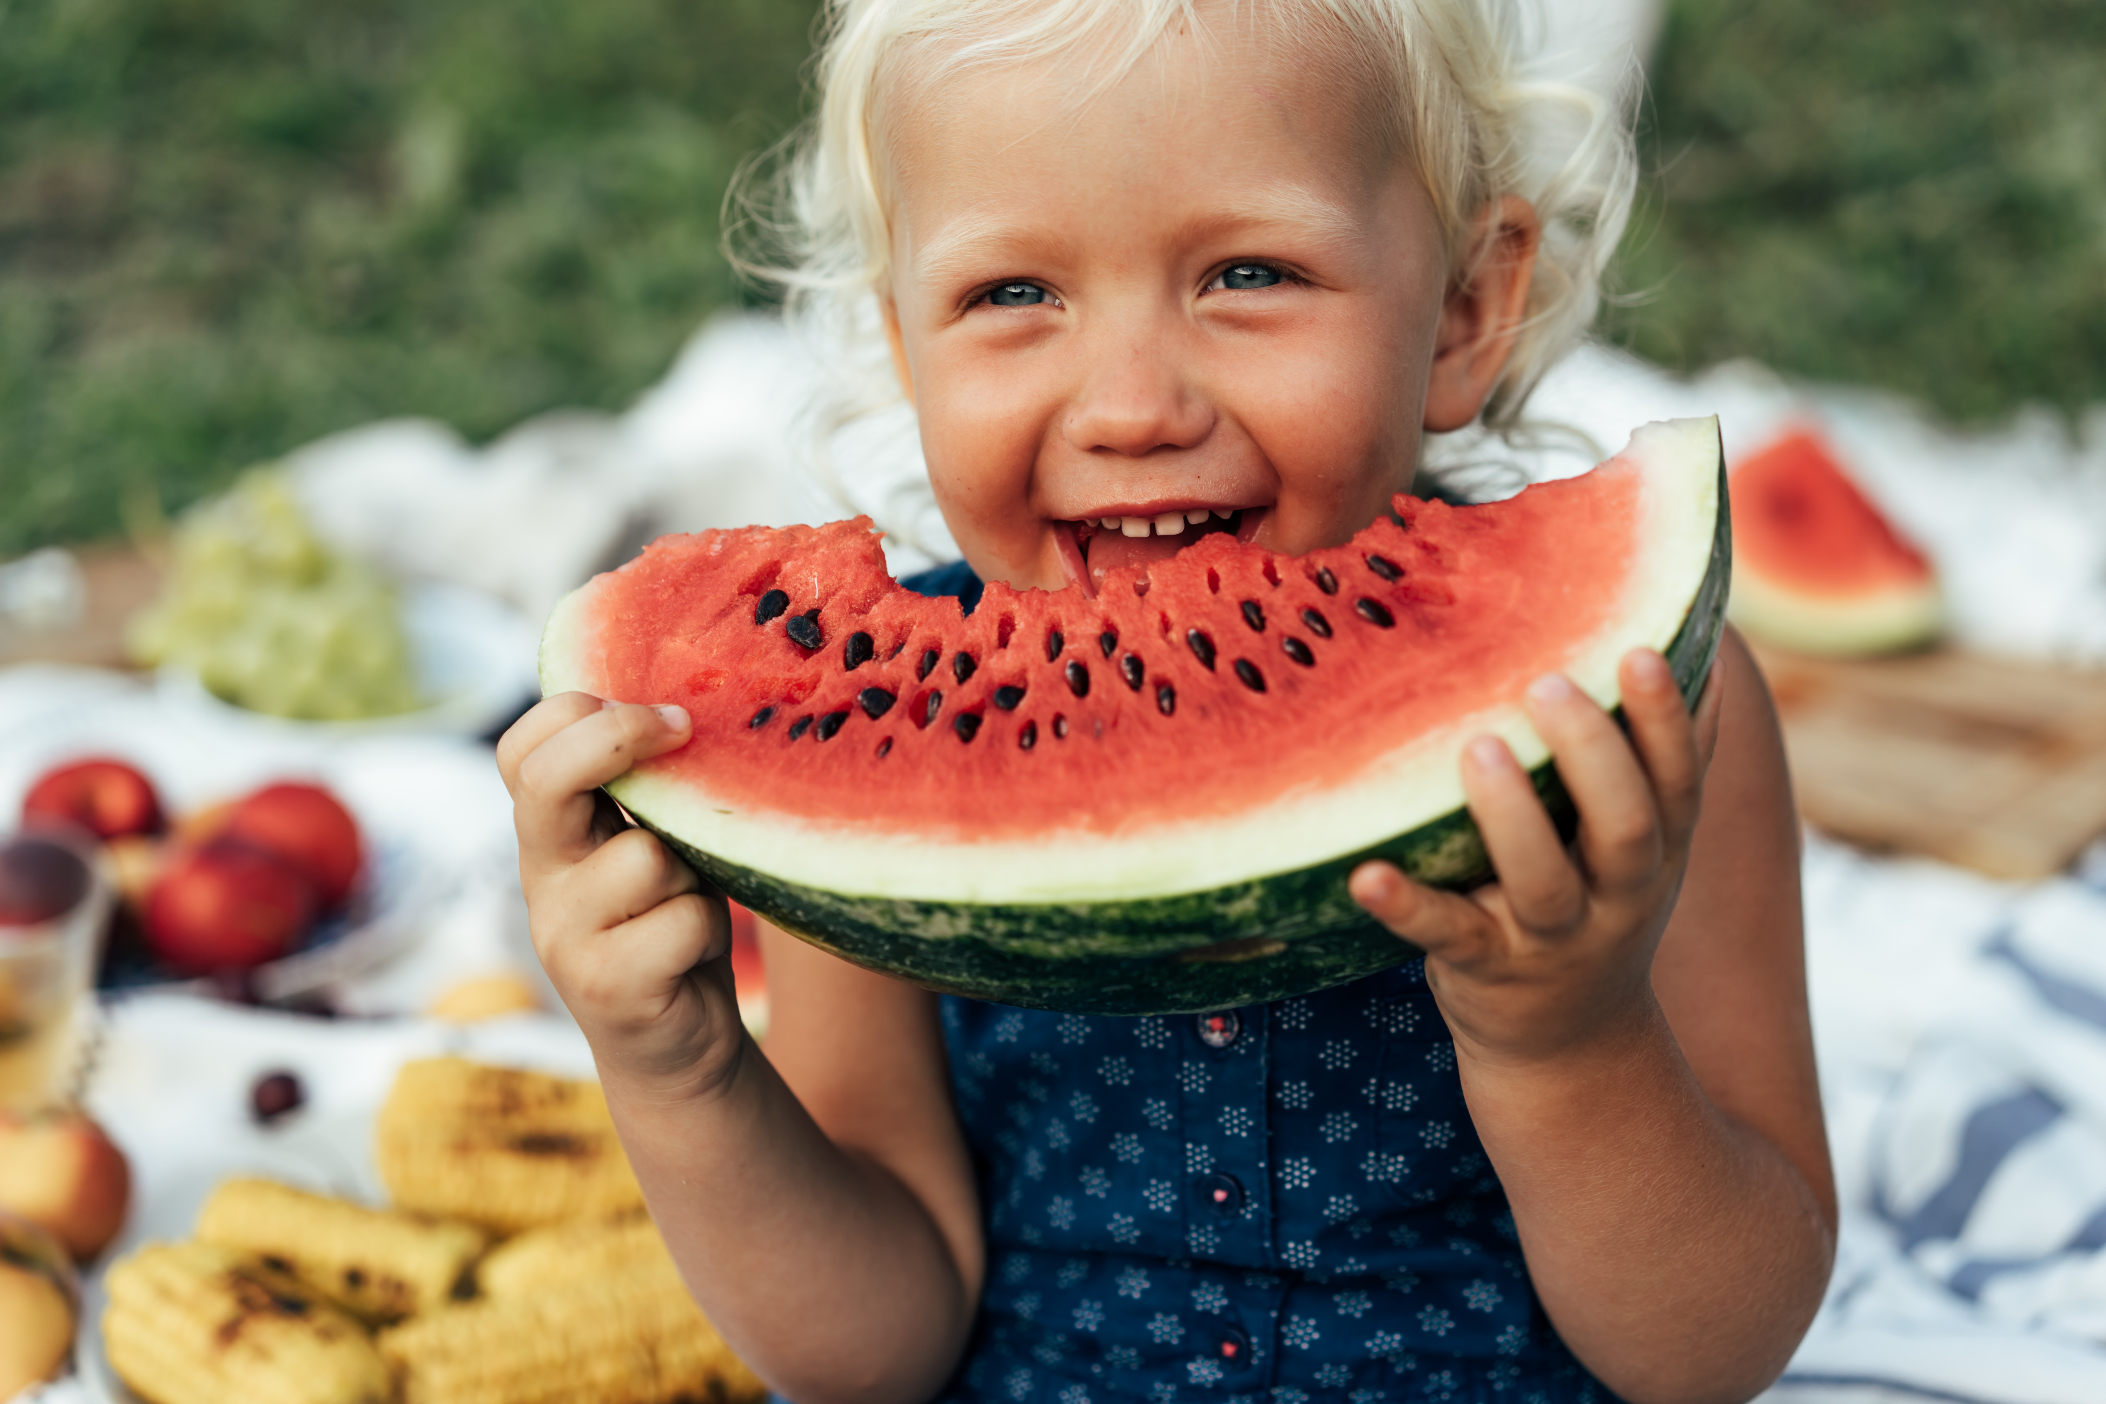
Children’s Story
“Render . . . to God the things that are God’s” (Matt. 22:21).

Slide 9
Children’s Story:
“Render . . . to God the things that are God’s” (Matt. 22:21).

Slide 10
Questions:
Why do you think God wants us to give offerings to church?
How can our money help others to know Him?
Challenge: try to save as much as possible this week and give the sum at church, asking God to use it as a blessing to those in need.

