Slide 1


W
DO YOU REALLY NEED WHAT YOU
ANT?
MURVIN CAMATCHEE

Slide 2
Do not worry about your life.
MATt. 6:25, NIV

Slide 3
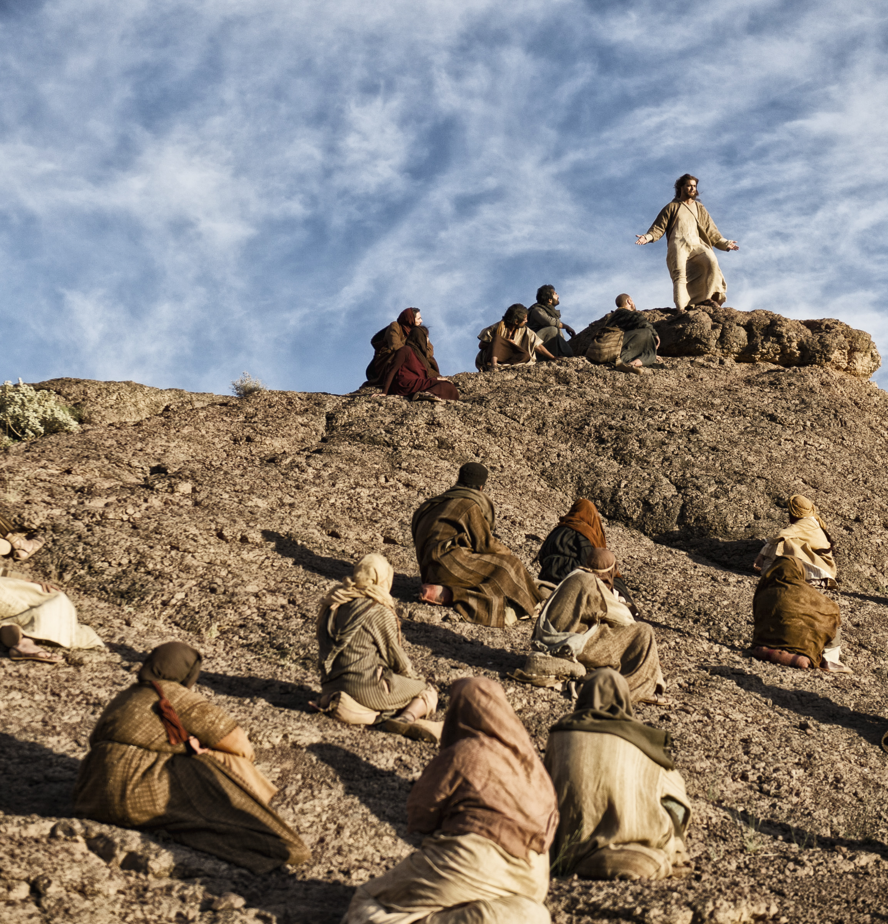
This phrase pronounced by Jesus is an imperative, indicating that His followers are constrained to obey this command.

Slide 4
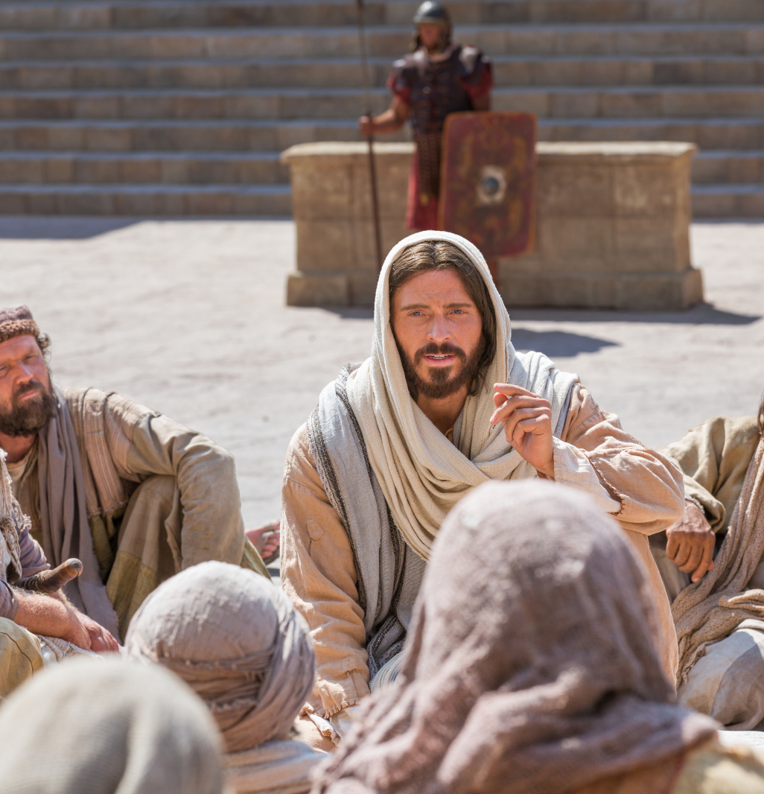
It is an obligation.

Slide 5
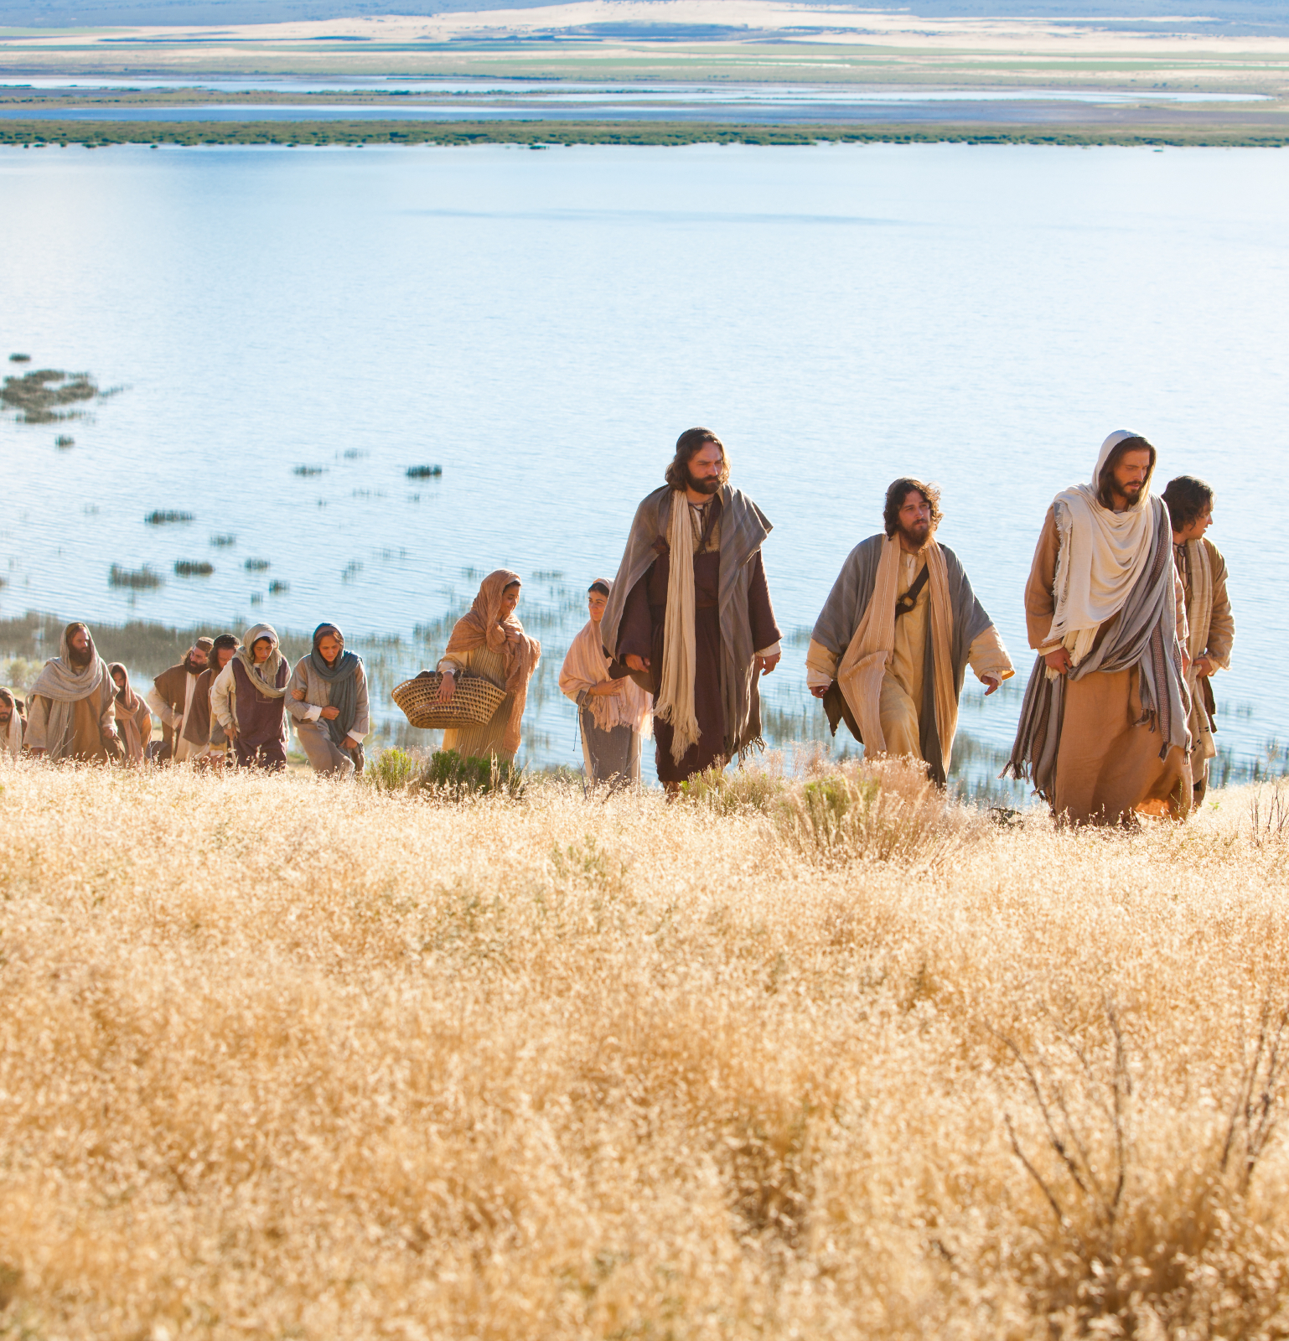
Jesus is saying: You should not be worried, because my Father will take care of your needs.

Slide 6

God, who is the same yesterday, today, and forever, will continue to provide for His children in miraculous ways.

Slide 7

To remain faithful to His promise, God provides us with financial resources.

Slide 8

But still, many who would say that they believe in God’s promises, cannot stop worrying and consequently suffer from financial stress.

Slide 9

Financial stress is the negative feeling that one will not have sufficient funds to meet the needs and necessities of life.

Slide 10

Financial stress is not a result of God not keeping His promise…

Slide 11

but rather a lack of good financial behaviors that keep one from enjoying God’s blessings.

Slide 12
BUDGETING

Slide 13

One very common bad financial behavior is the LACK of budgeting.

Slide 14

If you want to make good financial decisions, the most basic and probably the most efficient tool is to create and follow a budget.

Slide 15

Such a practice will hold you accountable on where the money that you are earning is going. . .

Slide 16
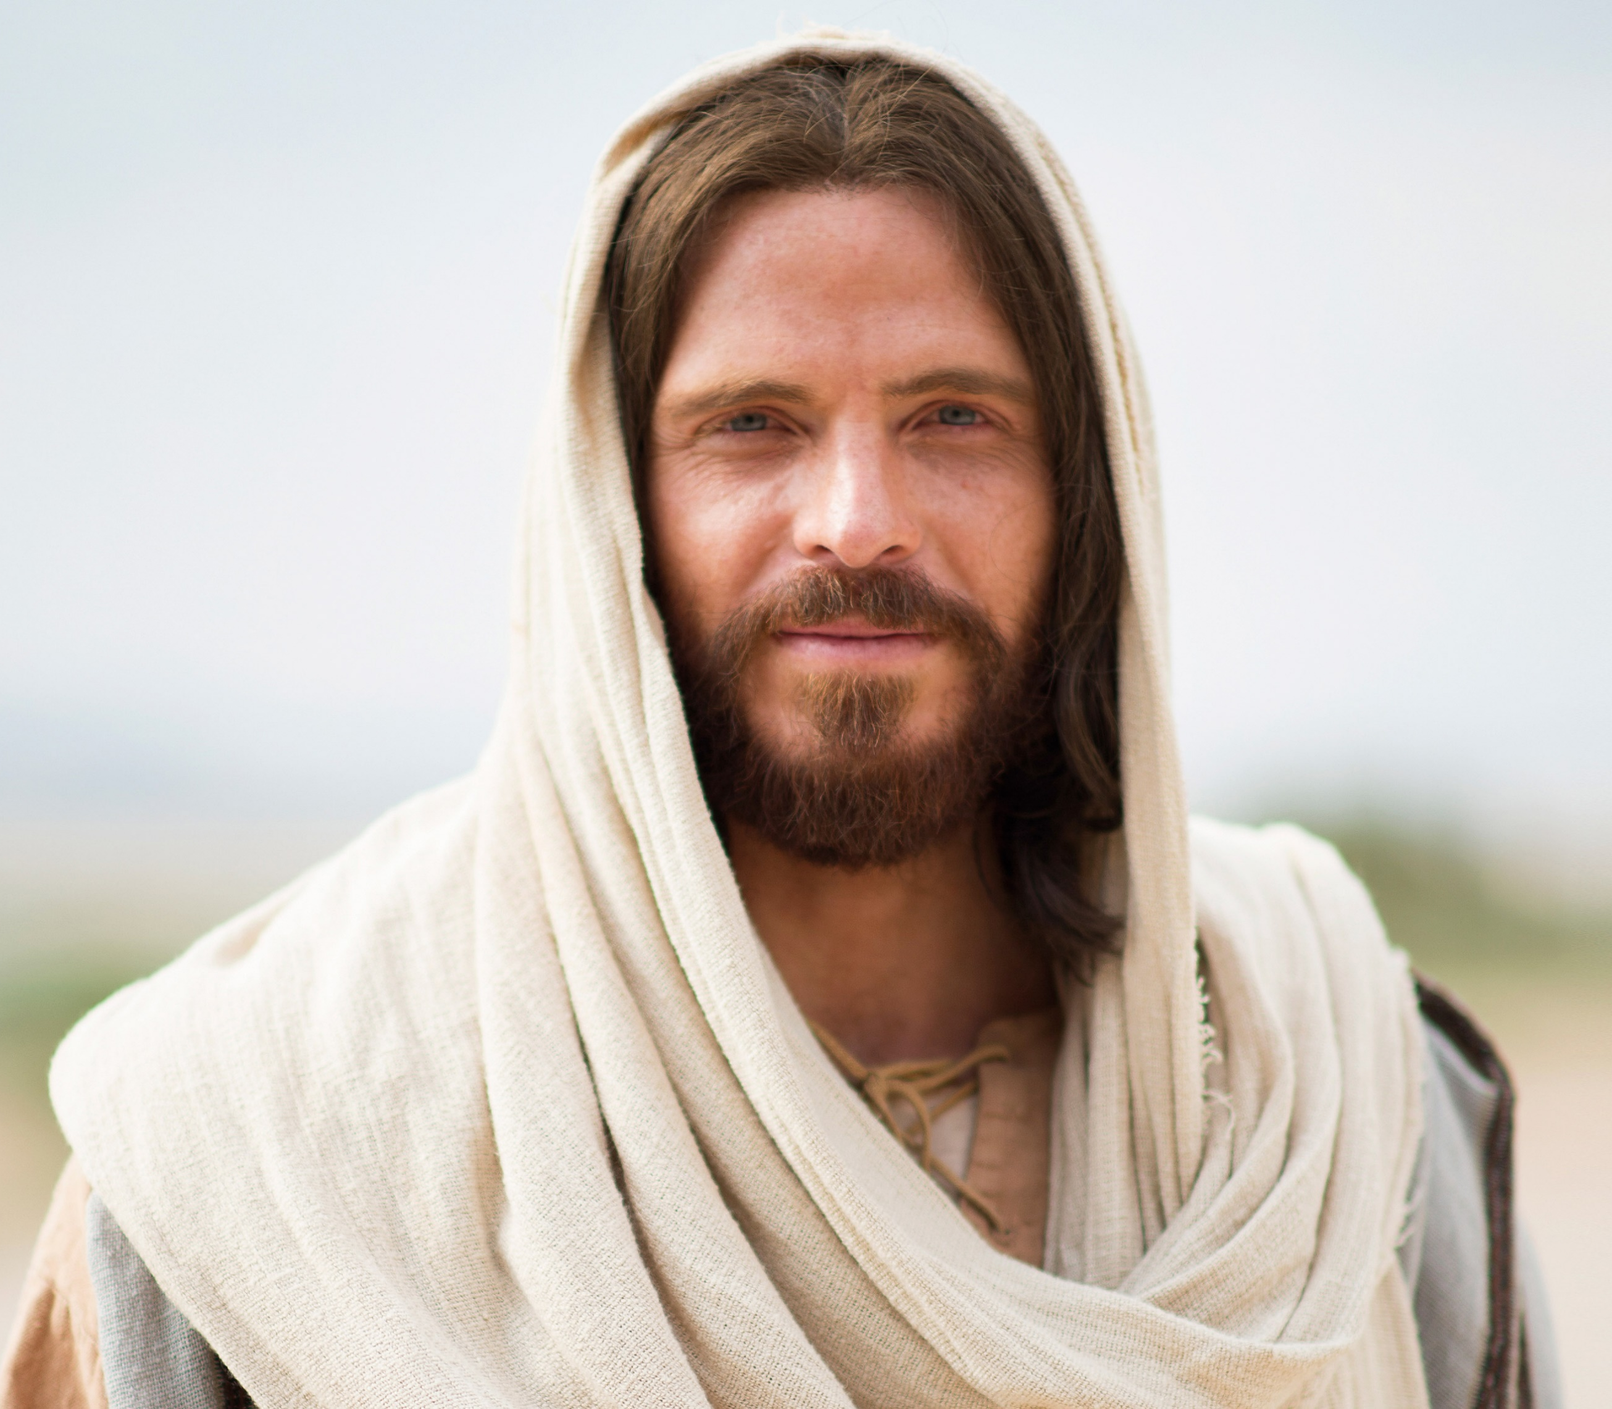
and to see that God truly and infallibly remains faithful to His promises.

Slide 17

Budgeting is thus a decision-making process that will enable you to choose the best possible alternative.

Slide 18
STEP 1: GATHERING OF FACTS

Slide 19

The more information you are able to GATHER, the more effective this process will be.

Slide 20

The facts, once available, should be listed under the two main segments of your budget, which are: your income and your expenses.

Slide 21
Budget | Expenses
 | Needs (Compulsory) | Wants (optional)
Budget 1 | Known need | Wants
budget 2 | Known need | Wants
 | Known need | Wants
 | Known need | Wants
Total budget | Total Needs | Total Wants

Slide 22
STEP 2: NEEDS VERSUS WANTS

Slide 23

Another very important step in budgeting is the ability to clearly distinguish between needs and wants.

Slide 24

A need is anything that is essential for a person to live, whereas a want is what a person desires but may or may not have it.

Slide 25

Unfortunately, many make the mistake of considering their wants as equal to their needs. The following table gives us an idea of how to make the distinction between needs and wants:

Slide 26
ITEM | NEEDS (COMPULSORY) | WANTS (OPTIONAL)
Tithe (10% of your total budget) | x
Offering ( ……% of your total budget) | x
Grocery | x
Mortgage | x
Health Insurance | x
Retirement | x
Clothing | ? | ?
Tv |  | x
Water, energy | x
Gas | x
Cellphone | ? | ?
Leisure |  | x
Income Tax | x

Slide 27

The importance of this exercise is that it helps to identify the expenses that could be perceived as being compulsory, but which actually are not.

Slide 28

Do I really need designer clothes this time, or can I content myself with just regular clothes?
Do I really need unlimited data on my phone, or will 10GB per month be enough?

Slide 29
STEP 3: KNOWING THE FIGURES

Slide 30

The next step would be to include besides each item its corresponding amount. For this, you will need to examine all your previous expenses.

Slide 31

This will help you to obtain a true picture of reality and to use figures that are as accurate as possible.

Slide 32

For items that you would consider as being partly a need and partly a want, make sure that the corresponding amounts are clearly identified, as illustrated in the table below.

Slide 33
Monthly Budget: $ 3.500
ITEM | NEEDS | WANTS
Tithe (10% of your total budget) | $350
Offering ( ……% of your total budget)* | $350
Grocery | $300
Mortgage/rent | $1.000
Health Insurance | $50
Retirement | $50
Clothing (montly avarage) | $75 | $250
TV |  | $100
Water, energy | $75
Gas | $120
Celphone | $30 | $30
Leisure |  | $250
tax | $500
Tithe (10% of your total budget)? | $2,900 | $630
* In this example, the percentage of total income for offerings is assumed to be 10%

Slide 34
STEP 4: KNOWNS VERSUS UNKNOWNS

Slide 35

A good budget should include a line for unknowns.

Slide 36

Most experts would recommend that in your savings/emergency fund, there should be at least three months worth of living expense.

Slide 37

Living expenses are defined here as the items you would have to continue to pay for even if, for example, you lose your job.

Slide 38
ITEM | Budgeted amount (by Month)
 | Needs / Essential
Grocery | $300
Mortgage/rent | $1.000
Health Insurance | $50
Clothing (monthly average) | $75
Water/Energy | $75
Gas | $120
Celphone | $30
Total | $1.650

Slide 39

it is primordial that you always include the savings/emergency fund (unknown) as a budget line.

Slide 40

However, once your savings/emergency fund has reached the minimum required amount, it is strongly recommended that you continue to increase it, but this time you will have more flexibility to use part of your surplus toward your wants.

Slide 41
WORST-CASE SCENARIO

Slide 42
What if your needs exceed your income? The first thing to do would be to go back to Step 3.

Slide 43

Another alternative would be to increase your income by probably finding a different job.

Slide 44

If your mortgage/loan repayments are pretty high, you should think of talking to your banker for a refinancing.

Slide 45

Learning how to make and follow a budget it is by far the most important ELEMENT OF
FINANCIAL LITERACY.

Slide 46

It is essential that each and every person not only takes this process seriously, but that they do it prayerfully, asking for God’s guidance and wisdom.

Slide 47

Budgeting will not only keep us from being financially stressed, but it will also help us to remain faithful to God and to support His mission with the resources that He has blessed us with.

Slide 48
W
DO YOU REALLY NEED WHAT YOU
ANT?
MURVIN CAMATCHEE

