Slide 1
FOR WHOM
DO YOU TOIL
By Howard Dayton, Co-founder and CEO of Crown Financial Ministries, Gainesville, Georgia.

Slide 2
Summary: When we recognize that we are employed by Christ and not man, we will become more faithful to our tasks. Read to discover the five responsibilities that make our work for Christ more meaningful.

Slide 3
FIRST
ASSIGNMENT

Slide 4
During a fifty-year career the average person spends 100,000 hours working. Unfortunately, many people just endure their work. And this is because of a worldly view of work that keeps them focused on the fact that twenty-five percent of their lives is devoted to a distasteful job.

Slide 5
Even before sin entered the human race, God instituted work. Genesis 2:15 says, “The Lord God took the man and put him into the Garden of Eden to cultivate it and keep it.” The very first thing the Lord did with Adam was to assign him work.

Slide 6
Work was initiated for our benefit in the sinless environment of the Garden of Eden. After the Fall, work was made more difficult.

Slide 7
Genesis 3:17 reads, “Cursed is the ground because of you; in toil you shall eat of it all the days of your life. Both thorns and thistles it shall grow for you; and you shall eat the plants of the field; by the sweat of your face you shall eat bread.”

Slide 8
Work is so important that in Exodus 34:21 God gives this command: “You shall work six days, but on the seventh day you shall rest.” The Old Testament believer was required to work six days.

Slide 9
In the New Testament Paul is just as direct when he wrote in 2 Thessalonians, “If anyone will not work, neither let him eat.”

Slide 10
A house builds a carpenter

Slide 11
A primary purpose of work is to develop character. For example, while the carpenter is building a house, the house is also building the carpenter. Skill, diligence, manual dexterity, and judgment are refined.

Slide 12
A job is not merely a task designed to earn money; it is also intended to produce godly character in the life of the worker. Scripture reveals we are actually serving the Lord in our work.

Slide 13
Colossians 3:23 says, “Whatever you do, do your work heartily, as for the Lord rather than for men? It is the Lord Christ whom you serve.” This perspective has profound implications.

Slide 14
Consider your attitude toward work. If you could see Jesus Christ as your boss, would you try to be more faithful in your job? The most important question you need to answer every day is: “For whom do I work?” You work for Christ.

Slide 15
The Lord wants us to work hard. “Whatever your hand finds to do, do it with all your might” (Eccl. 9:10).

Slide 16
Proverbs 12:27 says, “The precious possession of a man is diligence.”

Slide 17
In Scripture, hard work and diligence are encouraged, while laziness is soundly condemned. “He who is slack in his work is brother to him who destroys” (Prov. 18:9).

Slide 18
But don’t overwork! Working too hard has reached epidemic proportions. A frantic, breathless, over-commitment to work pervades our culture. Hard work must be balanced with the priorities of our relationship with the Lord and our family.

Slide 19
If your job demands so much of your time and energy that you neglect your relationship with Christ or your family, then you are working too hard; perhaps the job is too demanding or your work habits need changing.

Slide 20
Exodus 34:21 reads, “You shall work six days, but on the seventh day you shall rest; even during plowing time and harvest you shall rest.”

Slide 21
Rest can become an issue of faith. Is the Lord able to make our six days of work more productive than seven days? Yes! The Lord instituted this weekly rest for our physical, mental, and spiritual health.

Slide 22
Several work responsibilities that we have were modeled by Daniel.

Slide 23
RESPONSIBILITY 1
HONESTY

Slide 24
Daniel 6:4 tells us that “No evidence of corruption” could be found in Daniel’s work. He was absolutely honest, and we must be as well.

Slide 25
RESPONSIBILITY 2
FAITHFULNESS

Slide 26
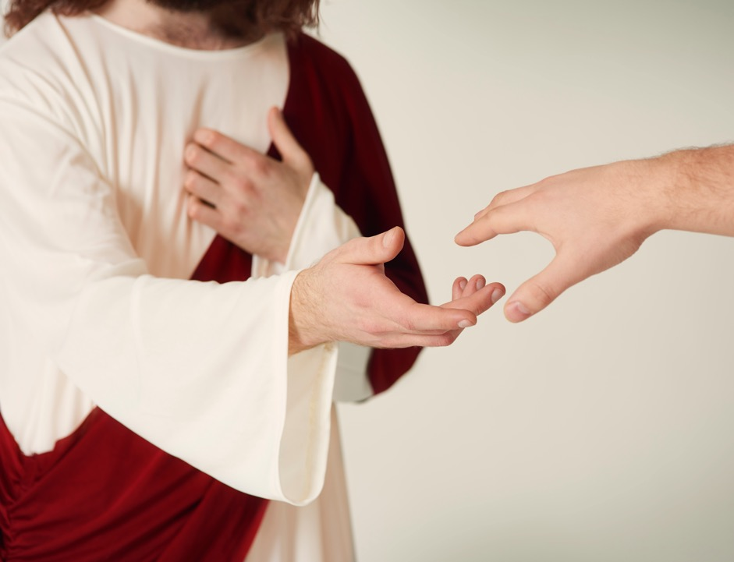
In Daniel 6:4, Daniel is described as “faithful.” The godly worker needs to establish the goal of being faithful and excellent in work. Then he or she needs to work hard to attain that goal.

Slide 27
RESPONSIBILITY 3
PRAYER

Slide 28
Daniel 6:10 reads, “Daniel continued kneeling on his knees three times a day, praying and giving thanks before his God, as he had been doing previously.”

Slide 29
Daniel governed the most powerful nation of his day. Few will ever be faced with the magnitude of his responsibilities and the time demands that must have been required. Yet Daniel knew the importance and priority of prayer. If you are not praying consistently, your work is suffering.

Slide 30
RESPONSIBILITY 4
HONOR

Slide 31
1 Peter 2:18 reads, “Servants [or employees], be submissive to your masters [or employer] with all respect, not only to those who are good and gentle, but also to those who are unreasonable.”

Slide 32
One way to honor your employer is never to participate in gossip behind your employer’s back—even if he or she is not an ideal person.

Slide 33
RESPONSIBILITY 5
SHARE YOUR FAITH

Slide 34
At the appropriate time, Daniel spoke of his faith in God to those around him. Listen to what King Darius said in Daniel 6:20.

Slide 35
“Daniel, servant of the living God, has your God, whom you constantly serve, been able to deliver you from the lions?” Daniel 6:20.

Slide 36
King Darius would never have known about the living God if Daniel had not communicated his faith at appropriate moments. Daniel’s profession of faith in God would not have as powerfully influenced King Darius if Darius had not observed how Daniel did his work. Daniel fulfilled his responsibilities with honesty and faithfulness while honoring those around him.

Slide 37
Daniel influenced his employer—one of the most powerful people in the world—to believe in the only true God. You have that same opportunity in your own God-given sphere of work.

Slide 38
A job well done earns you the right to tell others you work with about the reality of Christ. As we view our work from God’s perspective, our potential to earn more income increases, dissatisfaction turns to contentment from a job well done, and drudgery is replaced with excitement over the prospect of introducing others to the Savior.

Slide 39
FOR WHOM
DO YOU TOIL
By Howard Dayton, Co-founder and CEO of Crown Financial Ministries, Gainesville, Georgia.

