Slide 1
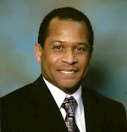
G
OD’s DESIRE
FOR ME TO BE WEALTHY
DELBERT
PEARMAN

Slide 2
“WEALTH COMES IN MANY FORMS, ONE OF WHICH IS MONEY. MONEY IS PURPOSELY CIRCULATED IN SHORT SUPPLY FOR SEVERAL GOOD REASONS, ONE BEING TO GIVE US THE INCENTIVE TO WORK FOR IT.

Slide 3
If money came easily many of us would not have the inclination to produce goods and services beyond our immediate consumption. If we count all the liquid money in the world, it would amount to approximately 26.730 trillion US dollars.

Slide 4
This would include the total quantity of notes and coins in circulation, plus demand deposits held by nonbank financial institutions, national and local governments, nonfinancial public enterprises, and the private sector of the economy
(CIA World Factbook).”

Slide 5
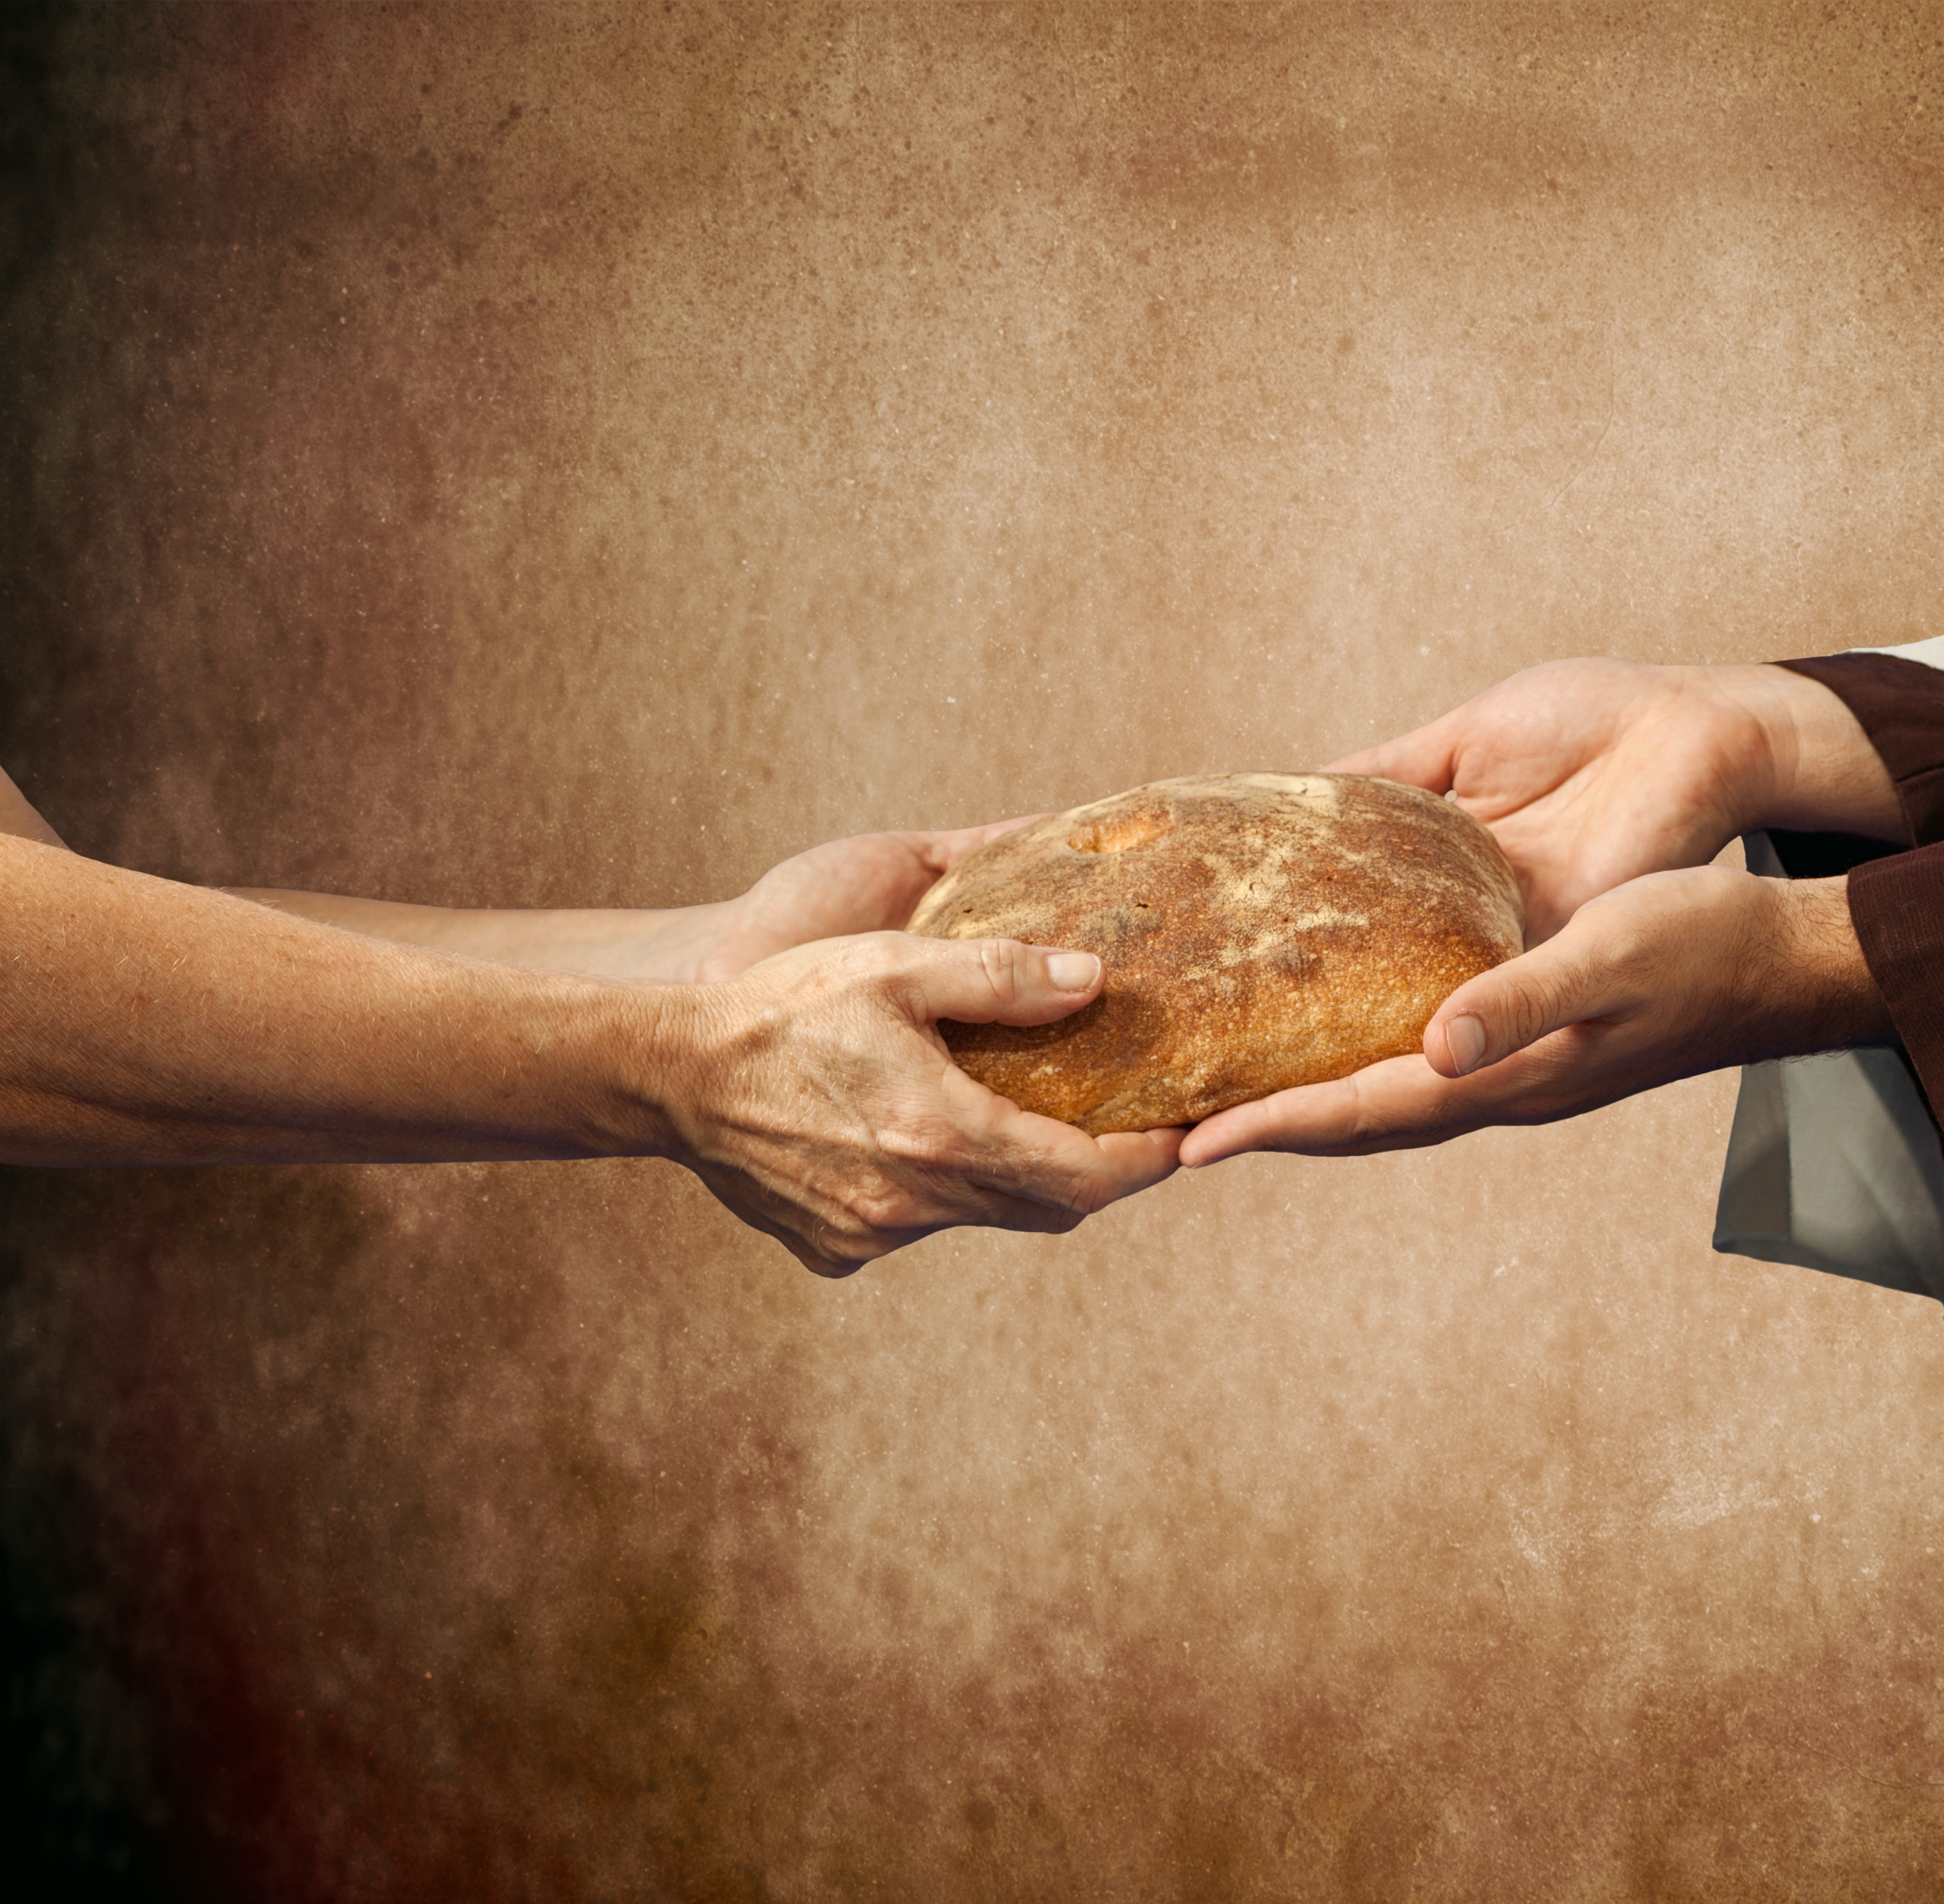
"THE DESIRE TO ACCUMULATE WEALTH IS AN ORIGINAL AFFECTION OF OUR NATURE, IMPLANTED THERE BY OUR HEAVENLY FATHER FOR NOBLE ENDS."

Slide 6
Money is an essential commodity that everyone needs. Ellen G. White reminds us of God’s desire for His children to have lots of it. She writes, “The desire to accumulate wealth is an original affection of our nature, implanted there by our heavenly Father for noble ends” (Counsels on Stewardship, p. 148).

Slide 7
The last phrase, “for noble ends,” indicates a specific objective for accumulating wealth.

Slide 8
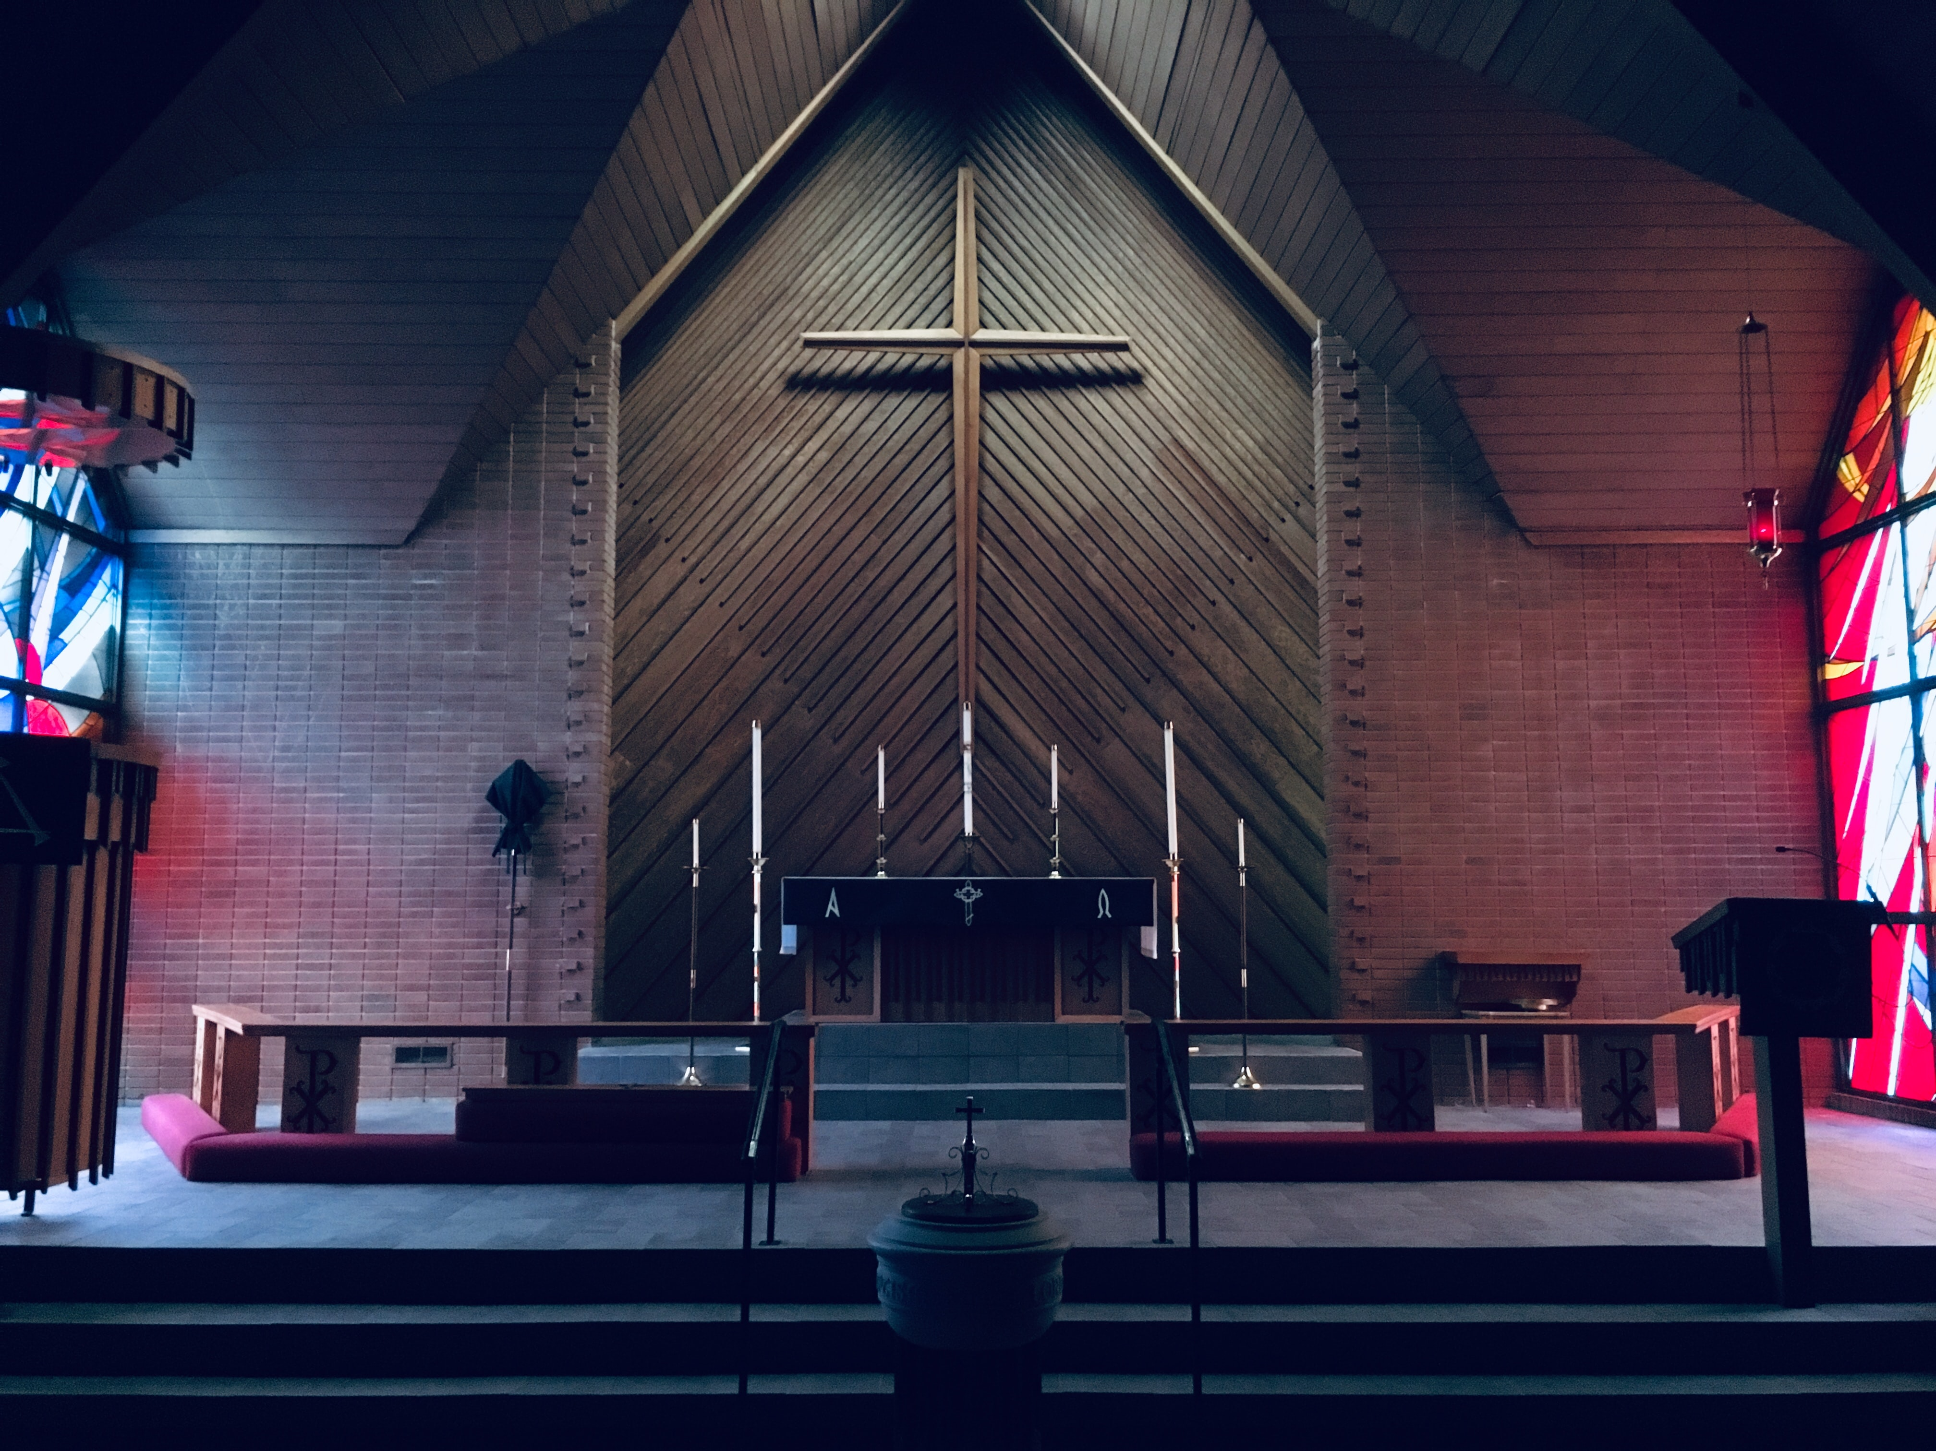
GOOD OBJECTIVES WOULD INCLUDE:
Supporting God’s church through tithe, offerings and special gifts. Malachi 3:10-12 promises special blessings for those who do so.

Slide 9
GOOD OBJECTIVES WOULD INCLUDE:
Meeting our basic needs for food, clothing and shelter and paying off debt (1 Tim. 5:8).

Slide 10
GOOD OBJECTIVES WOULD INCLUDE:
Contributing to society through taxes and charitable contributions (Rom. 13:7).

Slide 11
GOOD OBJECTIVES WOULD INCLUDE:
Setting aside savings for emergencies and retirement (2 Cor. 12:14).

Slide 12
GOOD OBJECTIVES WOULD INCLUDE:
Providing for conveniences, enjoyment and accomplishments beyond the basic needs of our families and for others such as outings, advanced education, celebration of special events, etc. (2 Chron. 1:12).

Slide 13
As with most of God’s gifts to mankind, Satan has distorted God’s desire for us to be wealthy through:
Covetousness: There is a natural desire in the human heart to desire something that belongs to someone else. The accumulation of wealth becomes an end in itself with no other objective than to accumulate more (Heb. 13:5).
Pride: The love of money is the root of all evil (1Tim. 6:10).
Diversion: The pursuit of money competes for our interest, our time and our energy. It easily diverts our attention from more important priorities, such as giving attention to our spiritual needs, nurturing relationships and caring for our health (Matt. 6:21).

Slide 14
We are reminded in 3 John 1:2 that the Lord is mindful of our temporal needs and wants us to excel in our temporal as well as spiritual affairs (SDA Bible Commentary, Vol. 7, p. 695). However, we must always be careful that our pursuit of wealth does not eclipse our primary responsibility—that of seeking first the kingdom of God and His righteousness (Matt. 6:33).

Slide 15
Footnotes:
1. CIA World Factbook, https://www.cia.gov/library/publications/resources/the-world-factbook/fieldss/2116.html#xx (Accessed: 11 September, 2015).
2. Counsels on Stewardship, E.G. White (1940) Review and Herald Publishing Assn.; Takoma Park, Washington, D.C.
3. Seventh-day Adventist Bible Commentary, Vol. 7 (1980) Review and Herald Publishing Assn.; Hagerstown, MD.
Source: Article by Delbert Pearman, previously published in Dynamic Steward, vol. 19, no. 4, October-December 2015, p. 15. https://stewardship.adventist.org/2015-19-4.pdf

Slide 16
GOD’S DESIRE FOR ME TO BE WEALTHY
By Delbert Pearman

