Slide 1
How to Increase Giving in the Local Church?
Marcos Faiock Bomfim
GC Stewardship Ministries

Slide 2
Why increase giving?
To have more money?
To have more funds in the Church?
To increase spirituality?
To have more people in heaven?

Slide 3
Jesus’ main reason for increasing giving:
“For where your treasure is, there your heart will be also.” Matt. 6:21 (NKJV).

Slide 4
The lesser light…
“...Withholding from God always brings a curse. Spiritual prosperity is closely bound up with Christian liberality....” CS, 49 (Emphasis provided).

Slide 5
The lesser light…
“Those churches who are the most systematic and liberal in sustaining the cause of God are the most prosperous spiritually.” 3T405

Slide 6
1. To consider (and teach) giving as a Spiritual Discipline.
Regular SDA tithers have also other common practices (McIver, 2016):
Sabbath School attendance
Open and close the Sabbath
Study the Sabbath School Quarterly
Read and reflect on the Bible daily
Pray often during the day
Robert McIver, Tithing practices among Seventh-day Adventists: A study of tithe demographics and motives in Australia, Brazil, England, Kenya and the United States. (Cooranbong, NSW: Avondale Academic Press), 153.
How to increase giving:

Slide 7
How to increase giving:
2. Focus more on motivation than in destination
“I will go into Your house with burnt offerings; I will pay You my vows… Come and hear… and I will declare what He has done for my soul.”
Psalm 66:13-16

Slide 8
How to increase giving:
3. Focus on giving as a trust developing practice
“Oh, fear the Lord, you His saints! There is no want to those who fear Him… Those who seek the Lord shall not lack any good thing.”
Psalm 34:9, 10

Slide 9
How to increase giving:
4. Strong focus on “Promise” (Deut. 16:17; 1 Cor. 16:2)
Offerings: as important as tithe; under the same system (Mal. 3:8)
System: percentage based
Regularity: based on income; every time there is an income/increase

Slide 10
How to increase giving:
4. Strong focus on “Promise” (Deut. 16:17; 1 Cor. 16:2)
There must be a promise, a proposal (“purpose”): giving by principle, not compulsion, appeals, etc. (2 Cor. 9:7)
Starting with church’s officials

Slide 11
Tithes & Offerings: Same System
“In the Bible system of tithes and offerings [Promise] the amounts paid by different persons will of course vary greatly,
since they are proportioned to the income....” CS, 73.

Slide 12
If all would follow God’s plan:
“…there would be meat in the house of the Lord. The cause of benevolence would no longer be dependent on the
uncertain gifts of impulse,
and vary according to the changing feelings of men...” (CS 199, 200.)

Slide 13
How to increase giving:
5. Teaching the Storehouse Principle (Deut. 12; 2 Chron. 31; Neh. 10-13; Mal. 3:8-10)
Practically adapted in the NT (Acts 4:32-5:11)
Implicitly endorsed by the NT (1 Cor. 9:13)
Adapted by the SDA
The only way to fulfill the Commission of the 3 Angels’ Message

Slide 14
How to increase giving:
6. Strong and spiritual moments of worship during collection
Language of worship x fundraising
Prayer and appropriated music
Testimonies
Developing gratitude

Slide 15
How to increase giving:
7. Promoting God’s Promises
Is it true that God still blesses the giver?
Does He love the cheerful giver?
Is the Bible trustworthy?
Is it everything wrong with the Prosperity Theology?
What is wrong with it?

Slide 16
Let’s not throw away the baby with the water…
Don’t allow the fear of being labeled as Prosperity Theology promoter to prevent you from sharing God’s true and faithful promises found in the Bible, which are fulfilled after the act of giving.

Slide 17
The lesser light…
“… His word is our assurance that He will so bless us that we shall have still larger tithes and offerings to bestow…” CS, 89.

Slide 18
How to increase giving:
8. To facilitate the act of giving
To train deacons and deaconesses
Plenty of Envelopes/pens available
E-Giving: information and practice

Slide 19
How to increase giving:
9. To increase transparency and accountability
To promote the use of the envelope (regular or electronic)
Available Information about destination
Regular reports about how funds are and were spent
Receipts faithfully returned

Slide 20
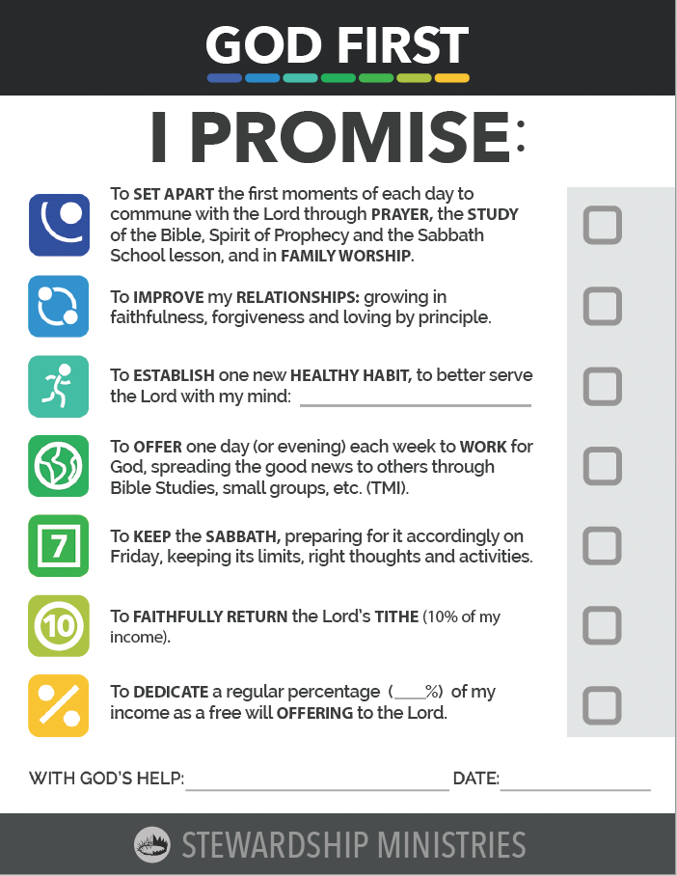
How to increase giving:
10. Regular Renewal of Vows Ceremonies
As part of the spiritual growth package
Emphasizing “Promise”
Using the Commitment Cards
Starting with church’s officials
On special occasions (New Year, Christmas, Anniversaries, Pre-marriage Education, etc.)

Slide 21
How to increase giving:
11. Visitation program
Once a year
With a spiritual agenda
Using the Commitment Cards

Slide 22
How to increase giving:
12. Invite New Members to Become “Promisors”
Starting with a low percentage
Include “Promise” on Bible Study series
Envelope: give & instruct how…
Download e-Giving app & Instruct…
Instructions about the destination…

Slide 23
How to increase giving:
13. Teaching and applying the “Reflex Influence” Principle
“To show a liberal, self-denying spirit for the success of foreign missions is a sure way to advance home missionary work;
for the prosperity of the home work depends largely, under God, upon the reflex influence of the evangelical work done in countries afar off. …” GW, 465

Slide 24
How to inspire members to give?
“One way church leaders can inspire giving is by committing the church to give away a higher percentage of its [church’s] own income.”
Randy Alcorn, How Pastors Can Model and Teach What God’s Word Says About Financial Stewardship.

Slide 25
How to inspire members to give?
“For the same reason that churches wanting to discourage their people from incurring debt should not incur debt, churches wanting to encourage giving should give.”
Randy Alcorn, How Pastors Can Model and Teach What God’s Word Says About Financial Stewardship.

Slide 26
How to increase giving:
14. By the local field/Union adopting the Combined Offering Plan
Strong focus on the local church
50%-60% of ALL offerings belong to the Local Church
The “Reflex Influence” principle is respected and practiced
Equally supports all levels

Slide 27
“Honor the Lord with your possessions, and with the firstfruits of all your increase; so your barns will be filled with plenty, and your vats will overflow with new wine.” Prov. 3:9, 10.

