Slide 1
m
On the Frontlin of
Ission
Good news: The Line is Moving
MICHEL GUILOVOGUI KALAPILI

Slide 2
Since December 2014, Rachel and Gnouma have been a special pair. They started to serve as Global Mission pioneers in the city of Conakry, Guinea. People call them the evangelists.

Slide 3
They spend their days befriending the community and visiting families.

Slide 4
Their major challenge is the Muslim background of the majority of the population; 88 percent of the people are Muslims in Guinea.

Slide 5
Intercessory prayer and fasting have proven essential to create interests in people to start Bible studies.

Slide 6
Many times these study groups must meet in secret places.

Slide 7
A Caring MOther

Slide 8
Two years ago our two evangelists tried to share the book, The Great Hope, with a Muslim woman, Salma, but she refused to accept it.

Slide 9
After some time, her son became seriously ill and was hospitalized. As his situation worsened, Salma called the evangelists to ask for prayer.

Slide 10
God answered, and the boy was healed. The mother began coming to church for Bible study in spite of the opposition of her husband.

Slide 11
The mother has been beaten several times, sometimes in public. Once the Adventist mission had to take her to the hospital for treatment.

Slide 12
Often, because of her new faith, she was deprived of food.

Slide 13
The last time she was brutalized was after she attended the evening God-First prayer meeting led by Stewardship Ministries in January 2019.

Slide 14
The following day, Friday, Salma, as usual—in spite of the beating—came to clean the Adventist Central Church of Conakry and to pray while the majority of the community people converged at the Mosque. On Sabbath morning, she was faithfully at church.

Slide 15
The Twin Sisters

Slide 16
After the divorce of their parents, Rachida and Shaheen, twin sisters, remained with their Muslim father. They themselves were practicing Muslims.

Slide 17
While they visited their mother during a holiday, they met our two Global Mission pioneers, Rachel and Gnouma.

Slide 18
At first the twins were adamant about Prophet Mohammed being the last prophet and disagreed strongly with the idea that Jesus could be the Son of God.

Slide 19
After much prayer and several Bible studies with the Global Mission pioneers, the girls adopted the Christian faith and chose to be baptized at one-year intervals. This decision was not without repercussion.

Slide 20
When their father observed that they were no longer performing the Islamic prayers, he started questioning them. At first, they were afraid to disclose their new faith.

Slide 21
Their father brought an Islamic teacher to teach them the Quran. One day, the father saw them studying the Bible, and this confirmed his doubts.

Slide 22
They were severely beaten. Their father threw their personal belongings outside the house and disowned them. With the support of their mother and the Global Mission pioneers, the twin sisters are now active Adventist Youth members and happily singing in the church choir.

Slide 23
The field is ripe, and lives are transformed daily in Conakry, Guinea and elsewhere. By God’s grace, the church in Guinea grew more than 10 percent last year

Slide 24
As we support Global Mission pioneers and other missionaries through our offerings, God’s mission is expanding in “unreachable” localities.

Slide 25
Global Mission pioneers' work is very fruitful in West-Central Africa Division. As most of our countries are Muslim-dominated areas, the main strategy is friendship evangelism through door to door visitations. Our pioneers usually try to show Christ first through good actions before the way is opened for Bible studies.

Slide 26
Global mission pioneers
Global mission pioneers are laypeople who volunteer for at least a year to establish a congregation in an unentered area within their own culture.
They have the advantage of knowing the culture and speaking the language; thus they blend with the local people. This is also far-less expensive than sending overseas missionaries.
More than 2,500 Global Mission pioneers are now working around the world. Since 1990, pioneers have established more than 11,000 new Seventh-day Adventist congregations.
Global Mission pioneers share the good news through wholistic ministry including caring for the sick, teaching agricultural skills, running literacy programs, holding evangelistic meetings, and giving Bible studies.

Slide 27
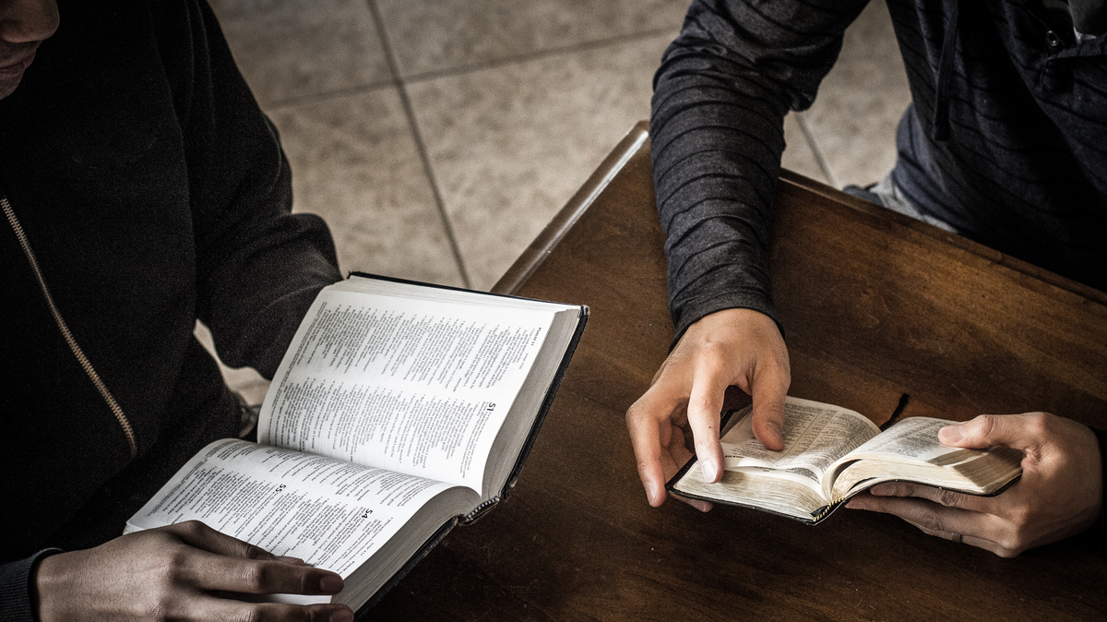
m
NA LINHA DE FRENTE DA
Issão
BOAS NOVAS: A LINHA ESTÁ SE MOVENDO!
MICHEL GUILOVOGUI KALAPILI

