Slide 1
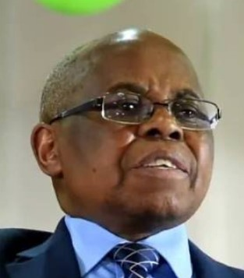
Jimmy’s
Ninth Birthday Gift
SAUSTIN SAMPSON MFUNE

Slide 2
Enjoy the gifts. Follow the donor's instructions.

Slide 3
It was Jimmy’s ninth birthday.

Slide 4
Mother sneaked into the kitchen and returned with a birthday cake.

Slide 5
Dad slipped away unnoticed to his bedroom to collect Jimmy’s surprise birthday gift.

Slide 6
It was a bicycle.

Slide 7
I love you, Dad! I love you, Mom!” Then he hugged and kissed the bicycle as he repeatedly said, “Thank you, Dad and Mom.”

Slide 8
Jimmy was eager to try out his new bike. He grabbed the bicycle, but Dad told him to wait.

Slide 9
he needed to know some rules to guide him on how to ride his bicycle.

Slide 10
These rules were not meant to limit his enjoyment. They were meant to protect him and others.

Slide 11
when people know what they can and cannot do, it gives them freedom to enjoy the gifts received.

Slide 12
“Can I go now and ride my bicycle?” Dad and Mom looked at each other and then said, “Yes.” And Mom added, “Be careful!”

Slide 13
Two days went by without any incident.

Slide 14
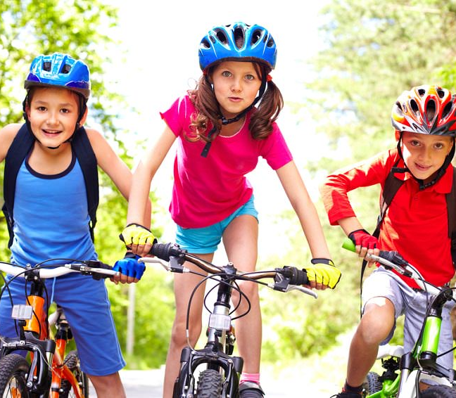
But late one afternoon as Dad was walking home from class after a long day of teaching, at a distance he saw Jimmy and two of his friends cycling. And they were peddling as fast as their little legs could pedal.

Slide 15
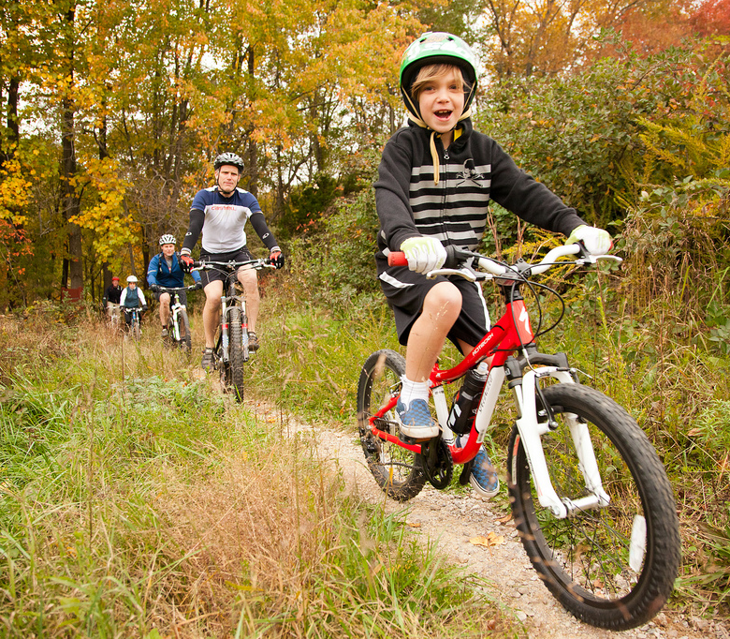
There were high bushes forming a hedge along the sides on the road, so Jimmy couldn’t see what was coming on the crossroad.

Slide 16
His father, however, was walking along the crossroad from the opposite side, so he could see that a vehicle was approaching the crossing point of the two roads. When he realized that Jimmy and his friends were speeding toward the crossing point, he shouted, “Jimmy, stop!” Jimmy, however, didn’t hear the warning.

Slide 17
a car from the other side of the crossroad hit the bike and threw Jimmy up into the air.

Slide 18
Jimmy was badly hurt. His bicycle was completely mangled

Slide 19
his right hand bone was broken. He also had a broken rib. Jimmy had to remain in the hospital for five days.

Slide 20
the doctor said, “when your parents give you rules, it’s because they are trying to protect you.

Slide 21
Even though it was you who disobeyed, your parents also suffered as well.

Slide 22
Remember that laws are for your safety

Slide 23
as they drove home, a tearful Jimmy, who was still in lots of pain…

Slide 24
told his parents that he was very sorry for disobeying them.

Slide 25
rules are there to protect and not to enslave someone.

Slide 26
gifts are fully enjoyed when one follows the instructions of the giver.

Slide 27
A grateful mom, with tears in her eyes, was happy and relieved that her son was alive. She kissed him on his forehead. Tears welled in Jimmy’s eyes as well, as the car left a trail of dust when it meandered down a long and dusty road back to the Mission station.

Slide 28
Jimmy’s
Ninth Birthday Gift
SAUSTIN SAMPSON MFUNE

