Slide 1
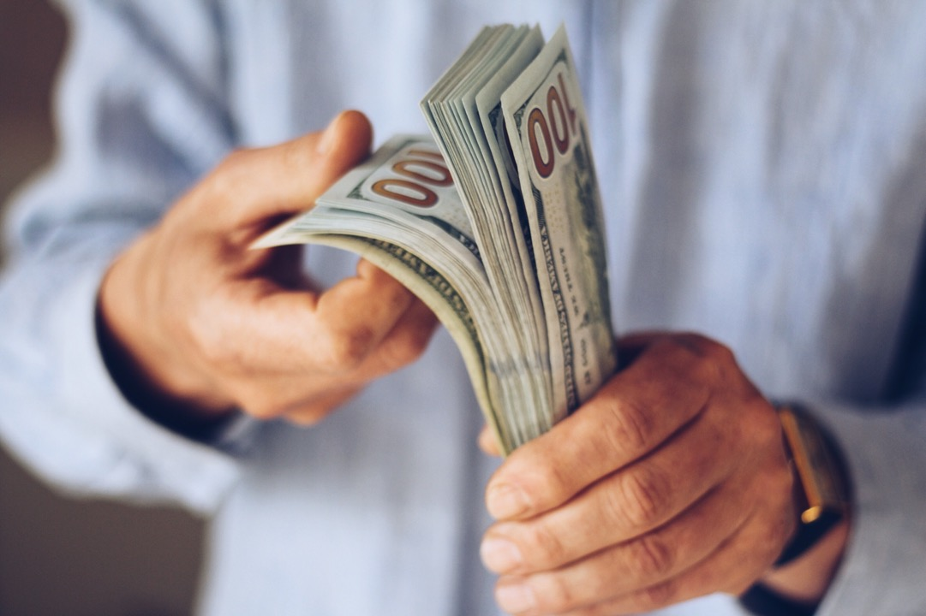
M
ONEY TALKS
PART ONE
by Jerry Lutz,

Slide 2
Luke 16:1-13

Slide 3
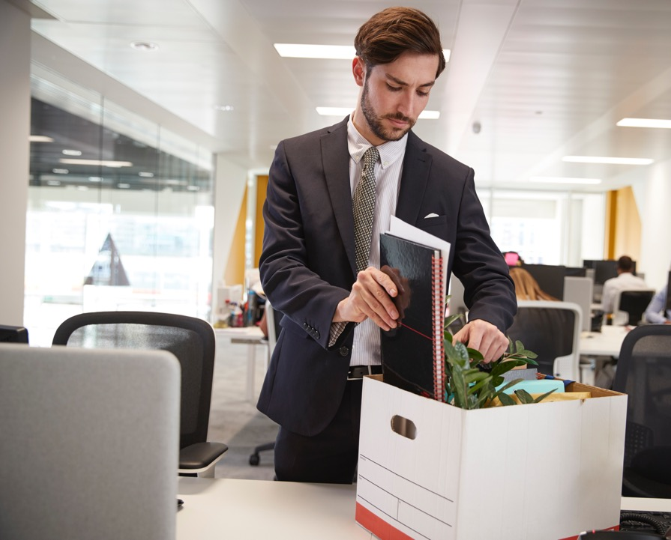
The story begins with a scandal common to their society and ours. An employee is fired for wasting corporate funds. What is he to do? How is he to feed himself? Where is he to live?

Slide 4
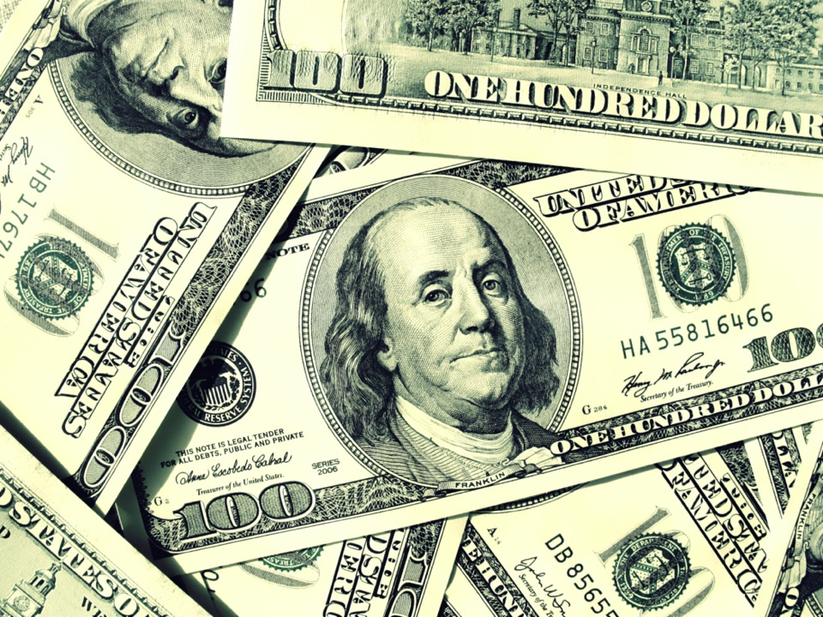
So, he put together a rather ingenious, post-employment, forced retirement plan. All he had to do was cause those who were indebted to his master to become indebted to him at no personal cost. If someone owed a hundred dollars, he said, just give me half and we’ll consider your account settled.

Slide 5
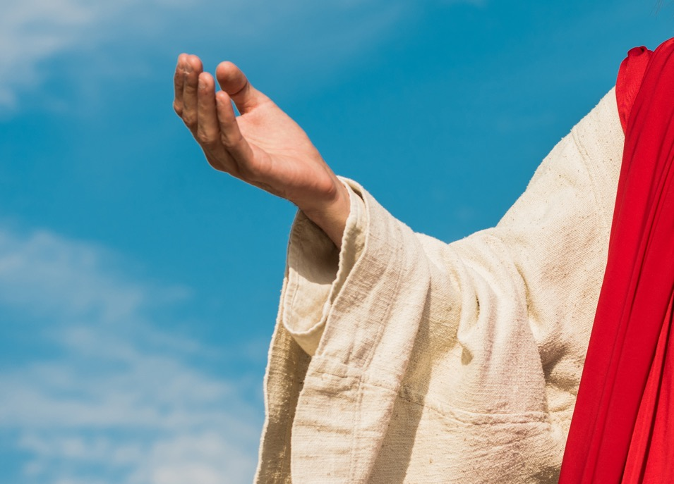
Why would Jesus tell such a story—one in which the values of the principal characters are obviously contrary to everything He’d always stood for? It’s shocking! Maybe just the thing we need to make sense of life is to be shocked into a higher level of awareness by the Lord Himself.

Slide 6
Two perplexing problems with this story:
1. The employer commended the dishonest employee because he was shrewd (verse 8).
2. The story suggests that an unholy alliance with mammon is a means of getting to heaven (verse 9).

Slide 7
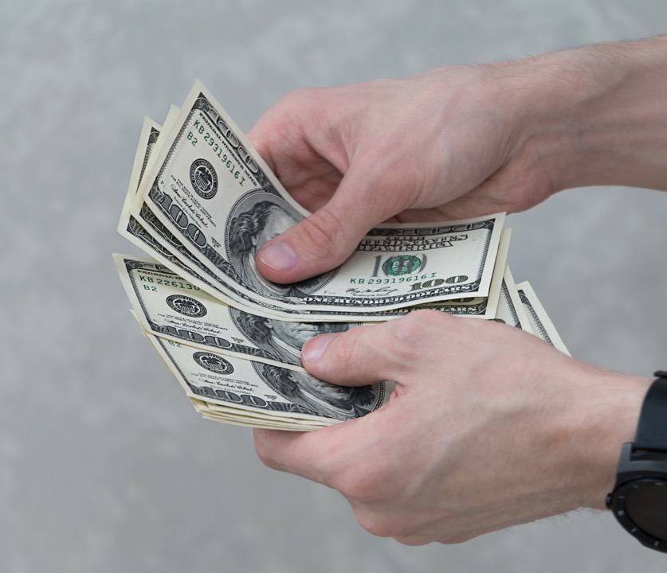
Certainly, Jesus wouldn’t encourage such behavior. So, what is the solution to these two problems? Christ was not the one who commended the unjust steward.

Slide 8
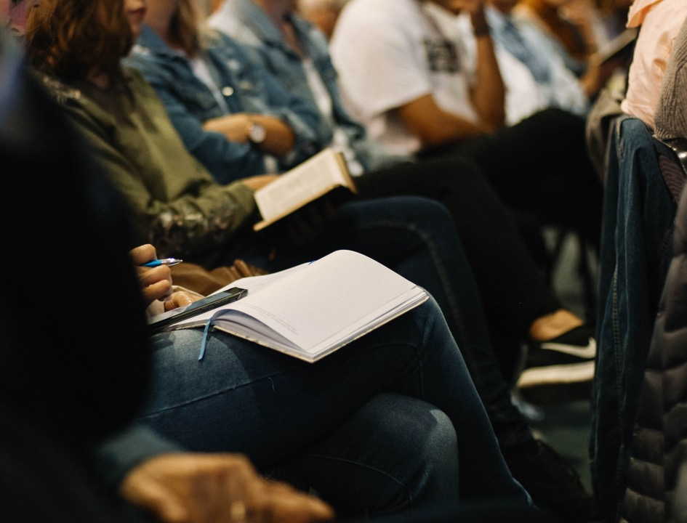
It was rather, an outrageous story with a very serious twist. By telling this larger-than-life parable, Jesus gained His listeners’ attention and held them through to the profound conclusions He draws in verses 10, 11 and 12.

Slide 9
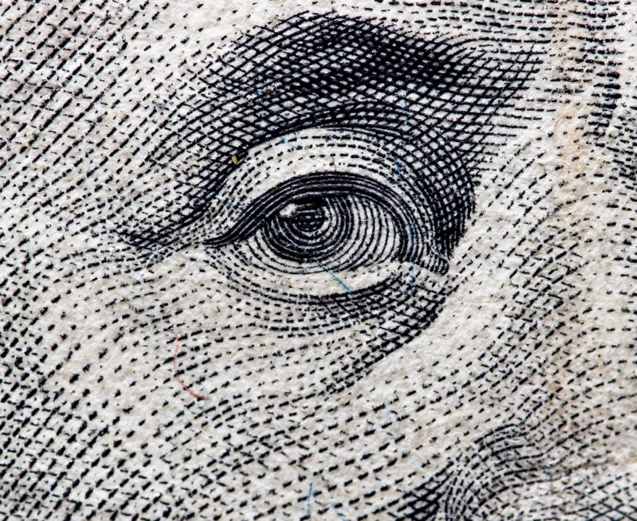
THREE CONCLUSIONS FROM THIS STORY:

Slide 10
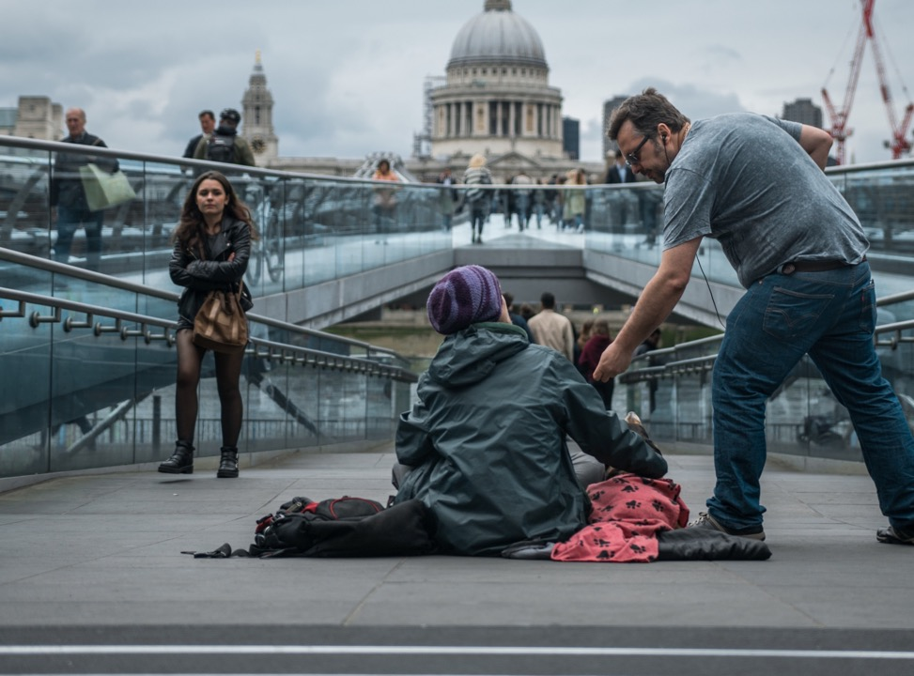
1. Honesty is not just a series of good deeds that look good on your salvation resume, but an attitude that touches the whole life. The real test of character doesn’t rest on major moral decisions alone but on the little things that seem inconsequential. Most people will be honest in the great, obvious matters, especially if they think they are apt to be caught.

Slide 11
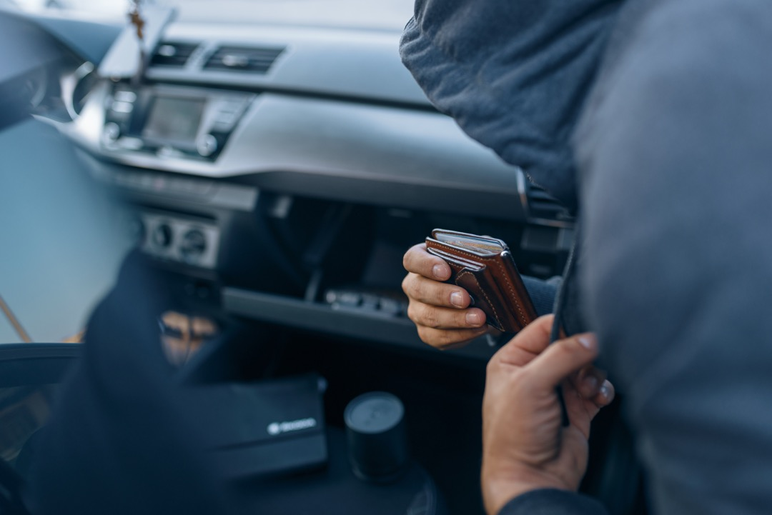
According to Jesus, a Christian is honest in small matters that no one would ever bother to check.
For example, one who would never think of stealing a mini-mart candy bar would not be likely to commit grand theft.

Slide 12
Whoever is faithful in small matters will be faithful in large ones.

Slide 13
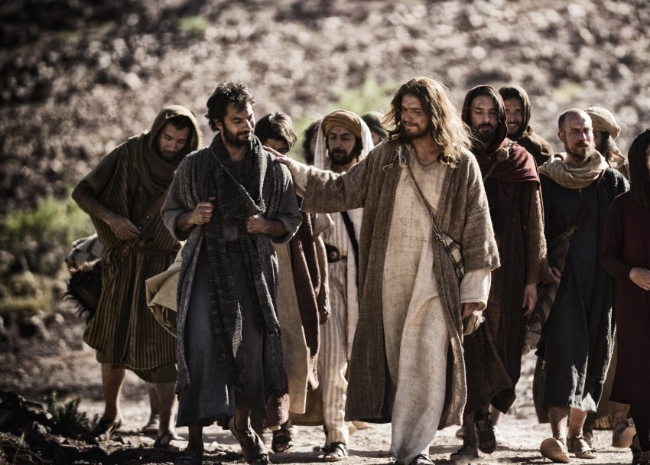
This was an especially important lesson the disciples needed to learn if they were going to be faithful followers and advance the gospel around the world.

Slide 14
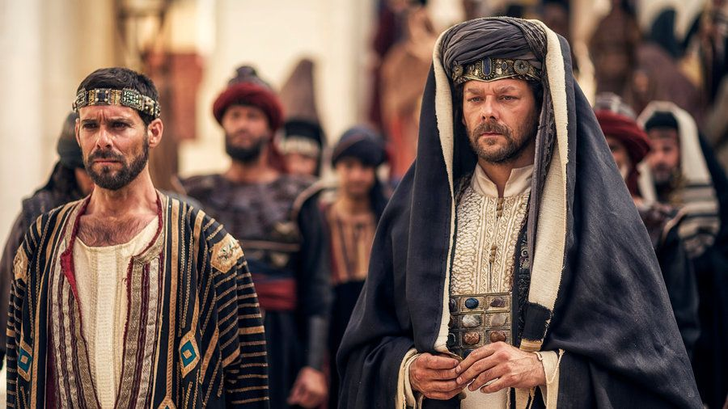
Theirs would be a demanding job that would require nothing but the highest ethical and moral integrity if they hoped to be successful.

Slide 15
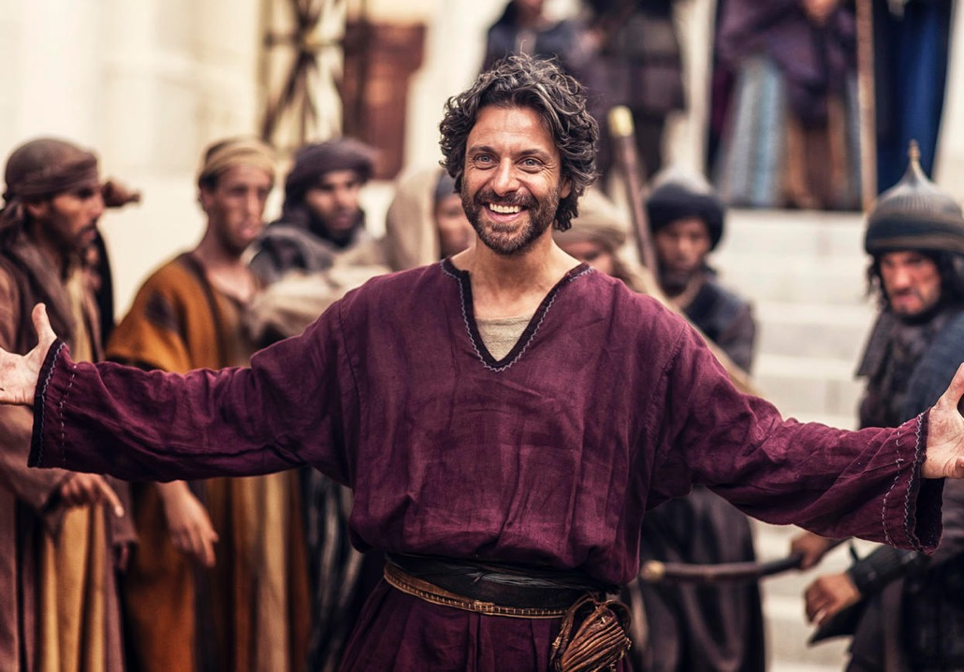
This was a message the publicans also needed to hear. Jesus realized that their employment brought them into great temptation—many of them were guilty of usury and unscrupulous business practices. And those who were not already involved were surrounded by the temptation to do so.

Slide 16
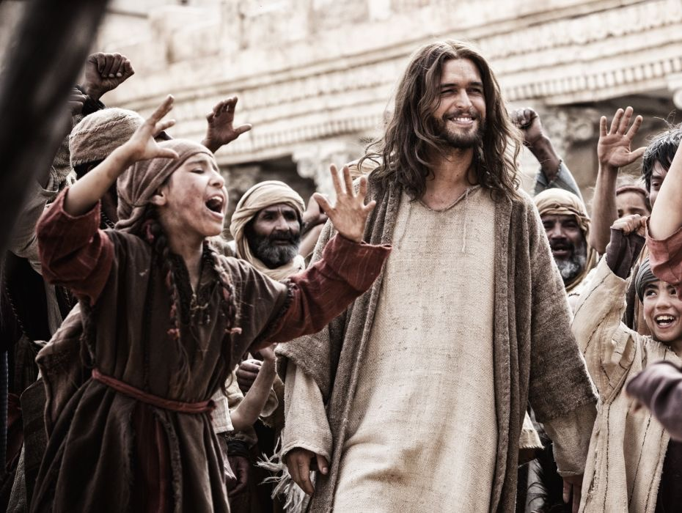
There had been among the publicans just such a case as that represented in the parable, and in Christ’s description they recognized their own practices.... From the picture of their own dishonest practices many of them learned a lesson of spiritual truth.”—Christ’s Object Lessons, p. 368

Slide 17
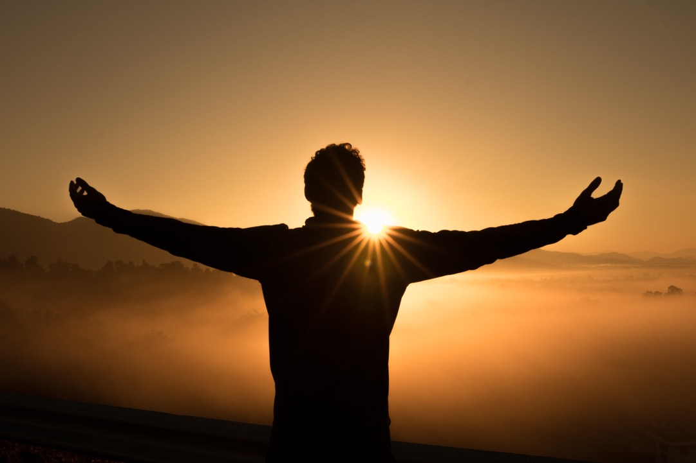
2.If we are not honest in the way we handle false material wealth, we’ll not be honest in the way we handle true spiritual wealth (see Luke 16: 11). “Money is not required to buy one necessity of the soul.”—Henry David Thoreau

Slide 18
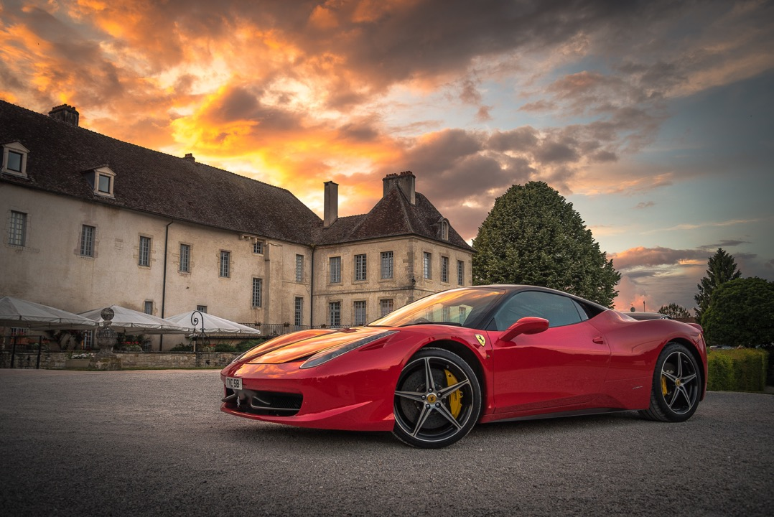
Would you still be rich if you lost all of your capital assets? In the world, personal worth, value, and success are measured mostly by how much property and goods one acquires. But according to Jesus, the true measure of wealth is how much we would be worth if we lost all our worldly possessions.

Slide 19
Not worth as regarded by the world, but worth as measured in heaven. If you had nothing to your name except life itself, would you still be wealthy in things that are of true value—eternal value?

Slide 20
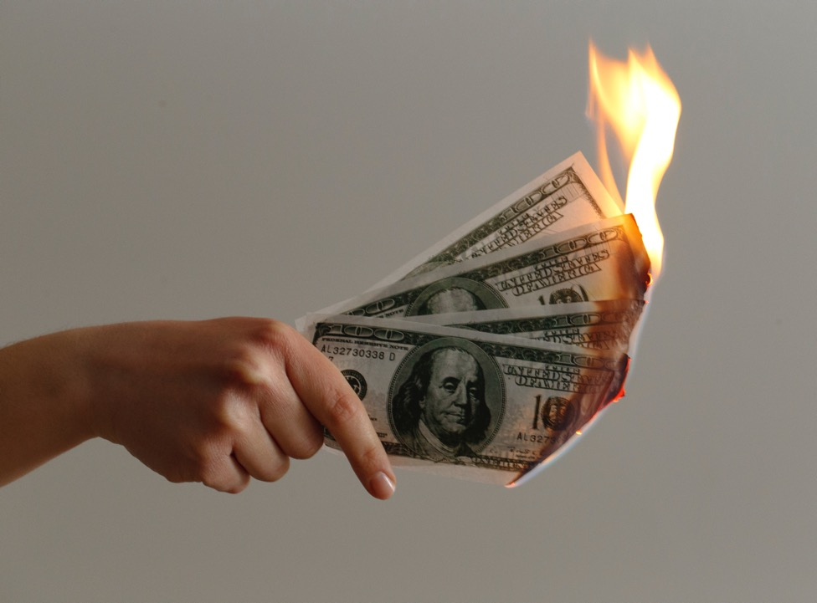
3. If we are not faithful with what belongs to another, we will not be faithful with what belongs to us (see Luke 16:12). This concept is opposite to what most of us teach our children about caring for things.

Slide 21
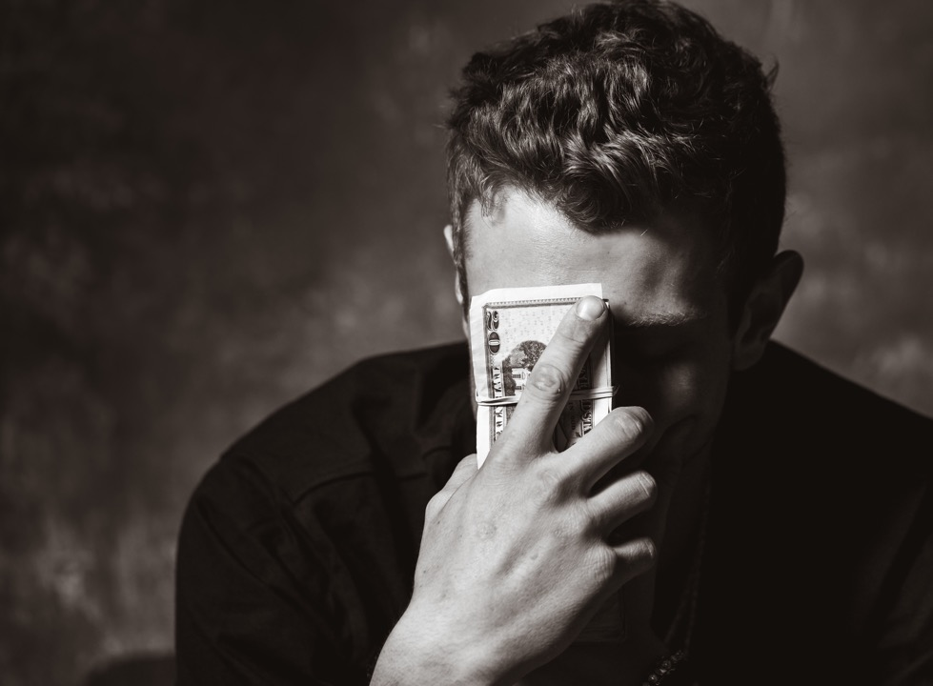
Most of us were taught at an early age that if we don’t take care of our own toys, no one will trust us to handle someone else’s. But Jesus says, it is faithfulness in handling someone else’s property that qualifies us to handle our own.

Slide 22
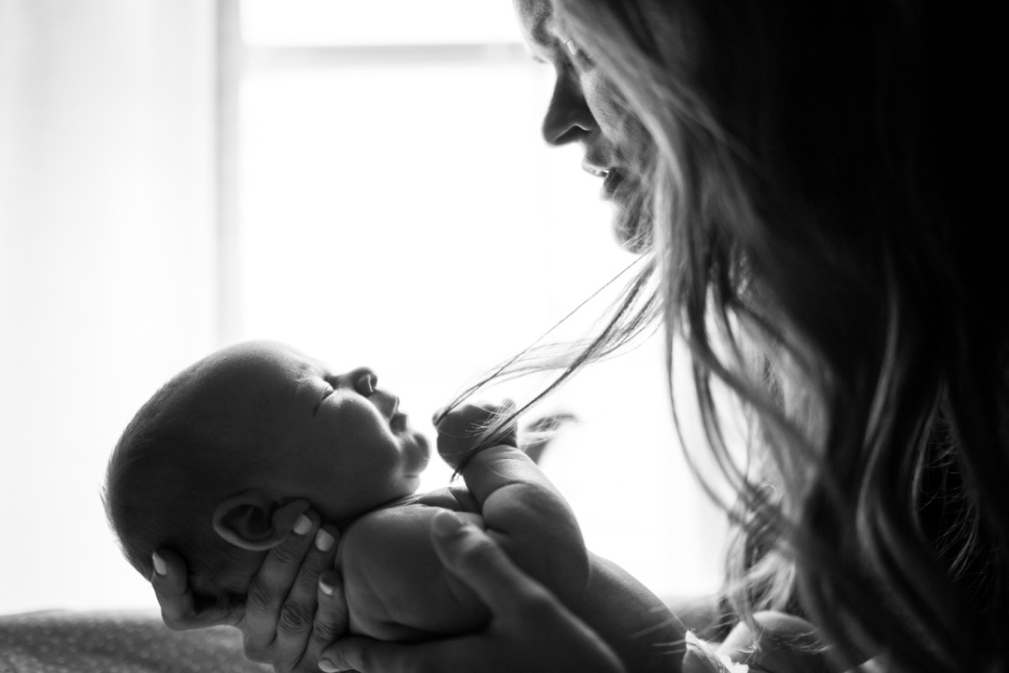
Every one of us started out with what belongs to Another—not what we received at birth from our parents nor the earthly goods we have acquired from any other earthly source or benefactor. What we have is God’s gift to us. This is true whether we believe it or consciously acknowledge it.

Slide 23
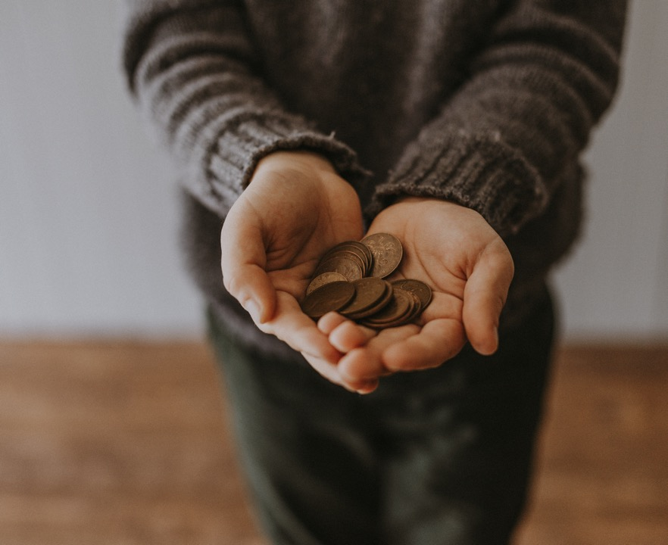
All of what we have is God’s gift to us. Without God we would have nothing to call our own. Equally as important to understand is that what we do with what we have is our gift to God.

Slide 24
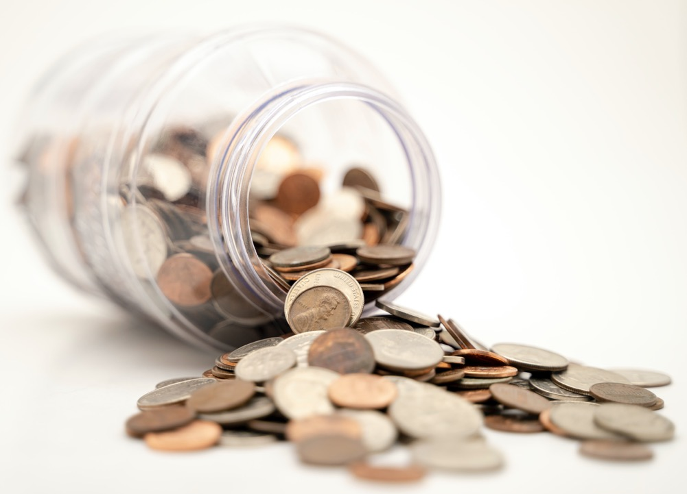
CONCLUSION

Slide 25
The message is clear. Someday, God will call for an audit. There is nothing to fear if our books are in order. We have God’s promise that if we have been faithful in handling what belongs to Him, He will entrust us with that which will last for eternity.

Slide 26
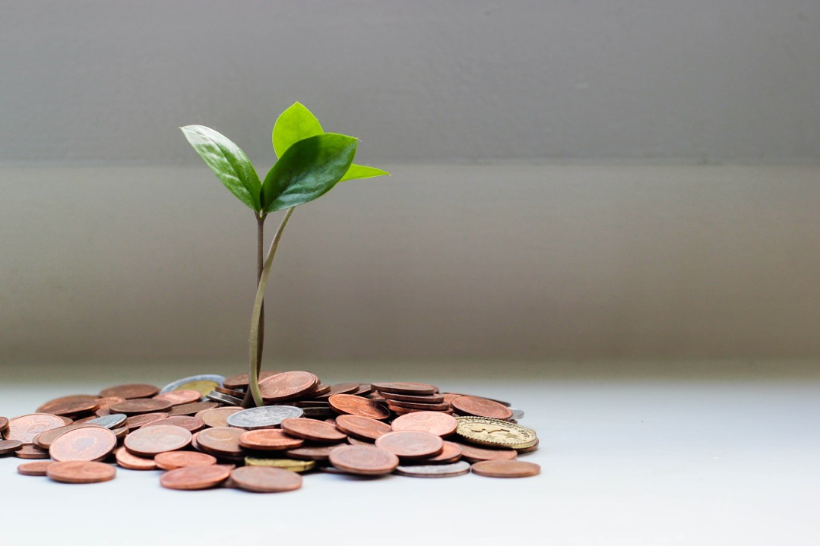
Peter describes what we receive from Him as an inheritance that can never perish, spoil, or fade—it is kept in heaven for [us]. In this parable Jesus presses the issue beyond simple honesty to faithfulness. He says, “If you haven’t been faithful to what belongs to someone else, who will give you what belongs to you?”

Slide 27
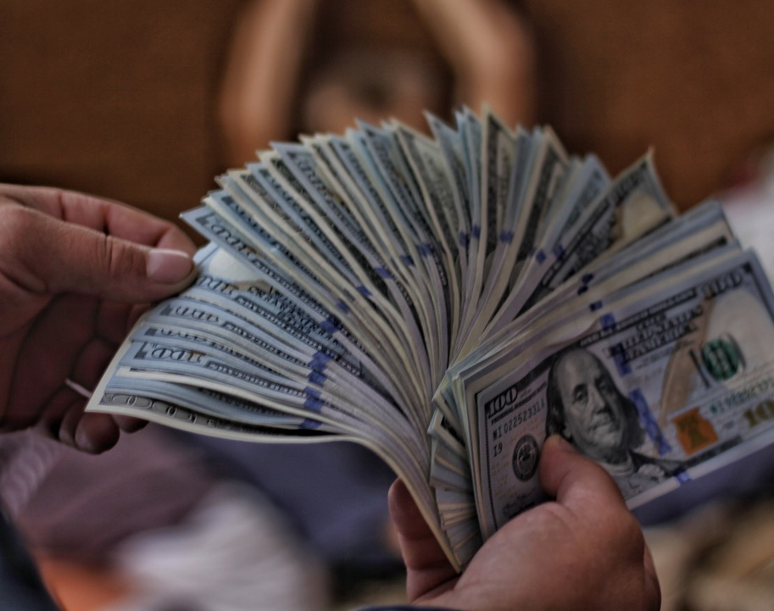
The fact that we haven’t robbed someone of his property doesn’t gain us any points when the Master calls for a full accounting. The issue is even greater than whether we have tithed all that God has placed in your hands, though that is important too.

Slide 28
The central issue in this parable is more profound than how management of possessions. The bottom line is, when the True Owner of these short-term loans audits our books, He will ask but one question: Have you been faithful?

Slide 29
May we each be able to give a positive answer because of the lives we live by His grace and the choices we make now. At the core of what Jesus says here is the unshakeable fact that everything we have at this moment we hold in trust for God, the True Owner of all things.

