Slide 1
& God’s
response!

Slide 3
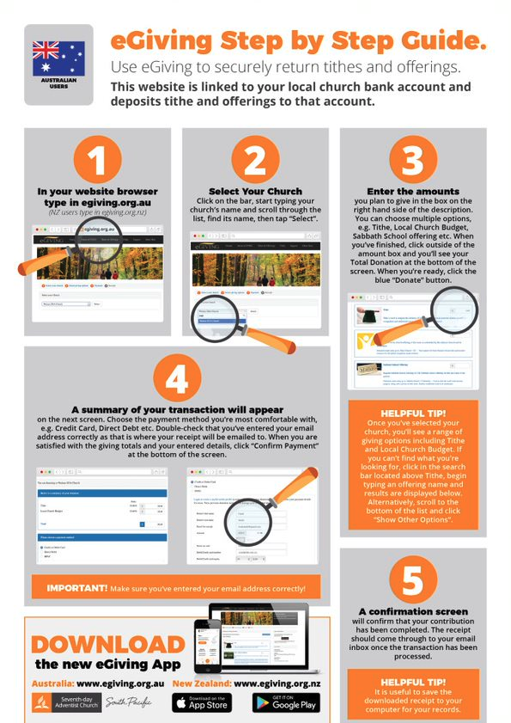

Slide 4
Digital Deacons

Slide 6
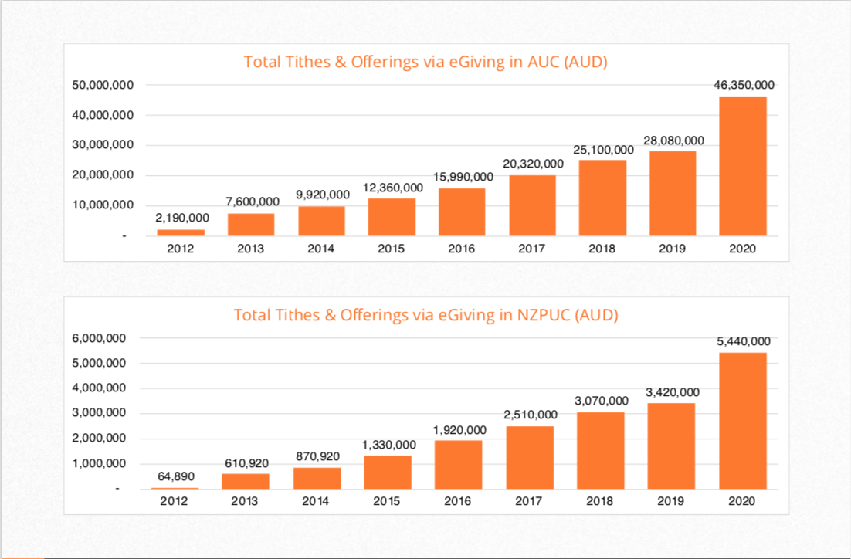

Slide 7
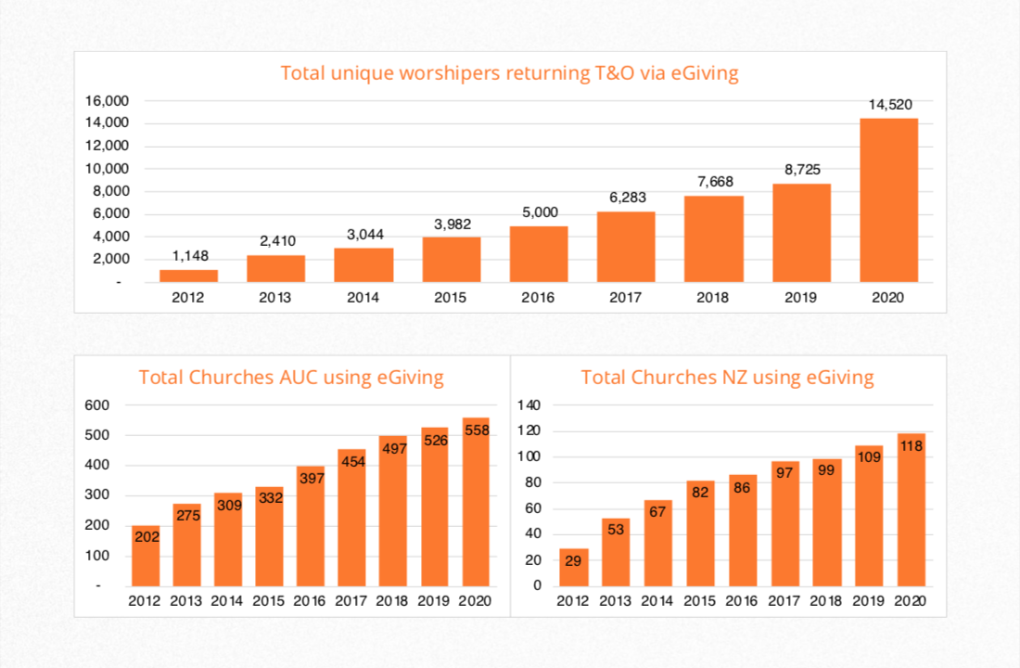

Slide 10
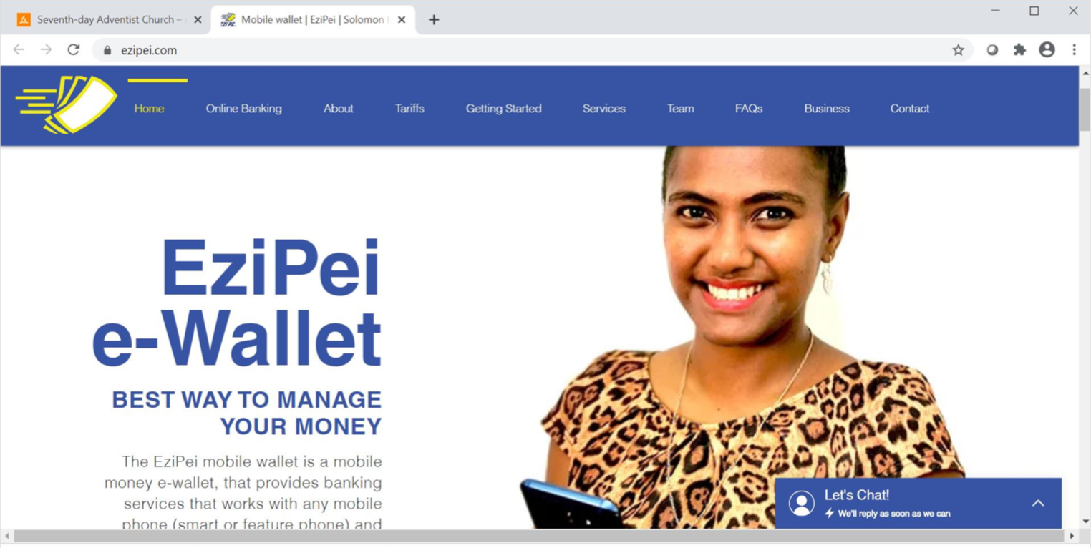

Slide 11
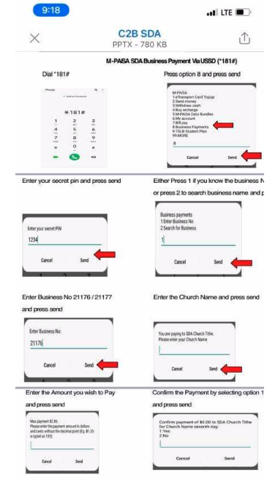
Fiji Mission Phone Giving

Slide 12
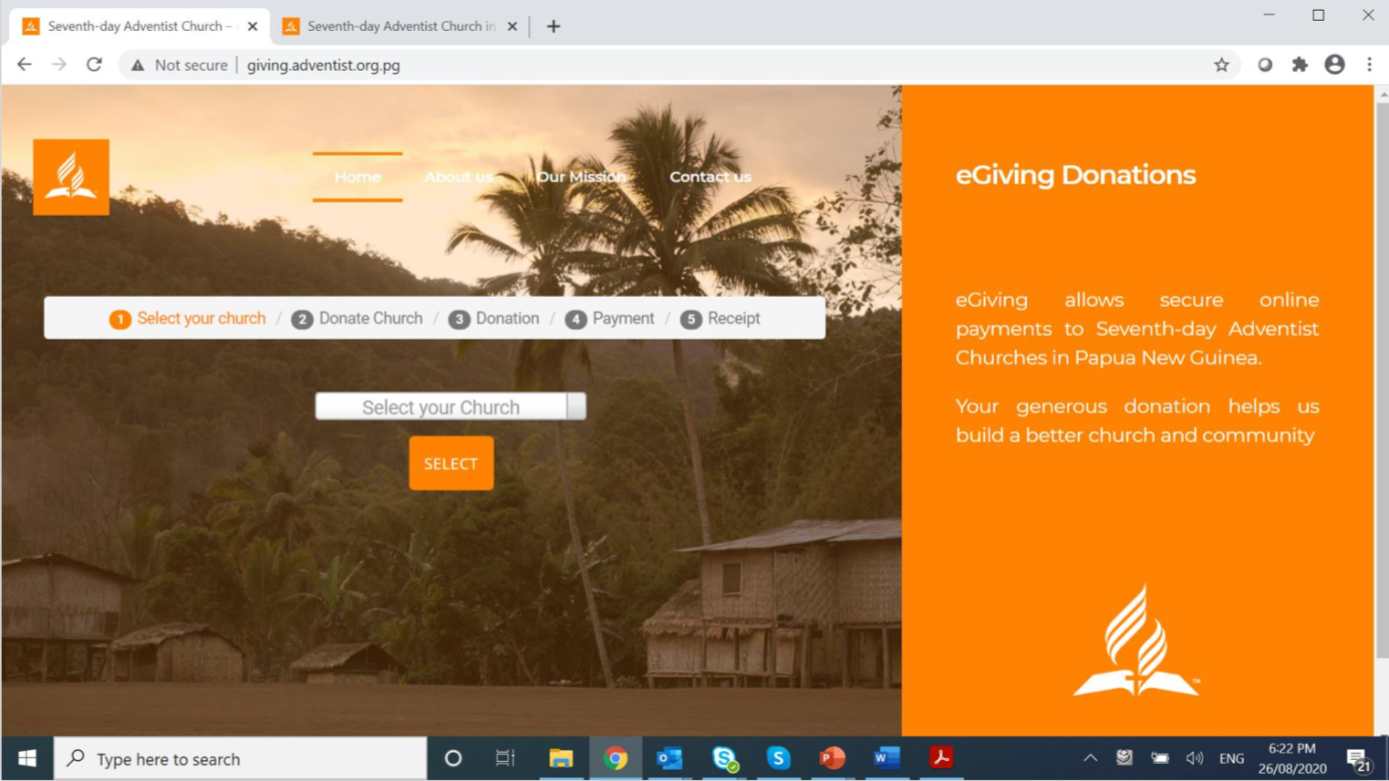

Slide 16
“Worry is blind, and cannot discern the future; but Jesus sees the end from the beginning. In every difficulty He has His way prepared to bring relief. Our heavenly Father has a thousand ways to provide for us, of which we know nothing. Those who accept the one principle of making the service and honor of God supreme will find perplexities vanish, and a plain path before their feet.”
The Desire of Ages, 330

Slide 17
“Now to him who is able to do far more abundantly than all that we ask or think, according to the power at work within us, to him be glory in the church and in Christ Jesus throughout all generations, forever and ever. Amen.”
Ephesians 3:20-21

