Slide 1
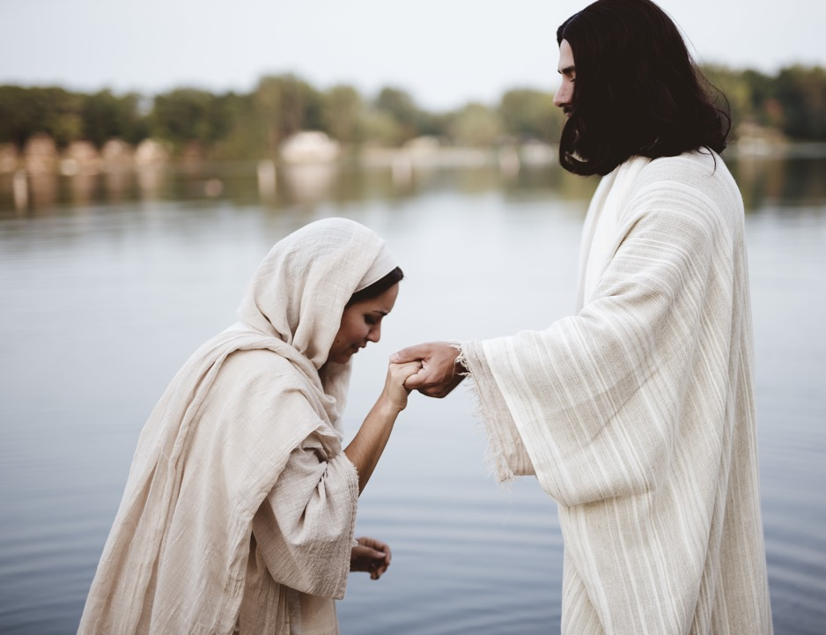
T
he Wonder
of Grace
by Benjamin C. Maxson

Slide 2
Grace
Unmerited favor—getting what we don’t deserve.
Cheap grace—claiming grace while choosing to live in sin.

Slide 3
Grace can be a noun or a verb. Depending on usage, it can function as an adverb or an adjective.

Slide 4
What kind of a picture does God’s grace bring to us?

Slide 5
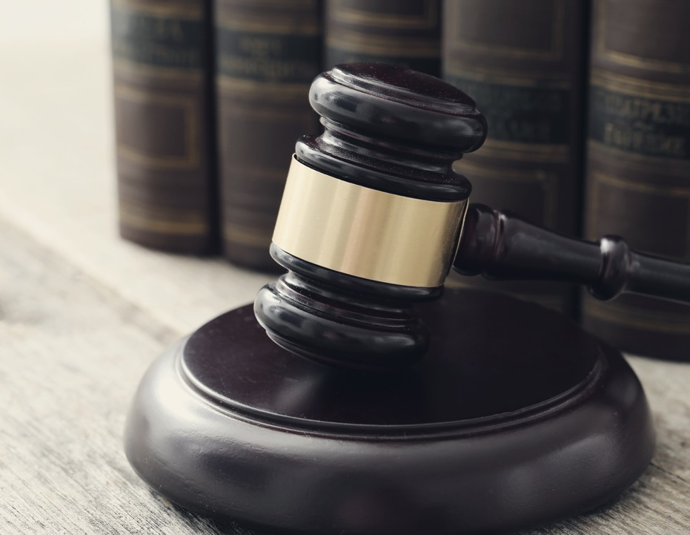
Grace has often been defined by comparing it with justice and mercy.

Slide 6
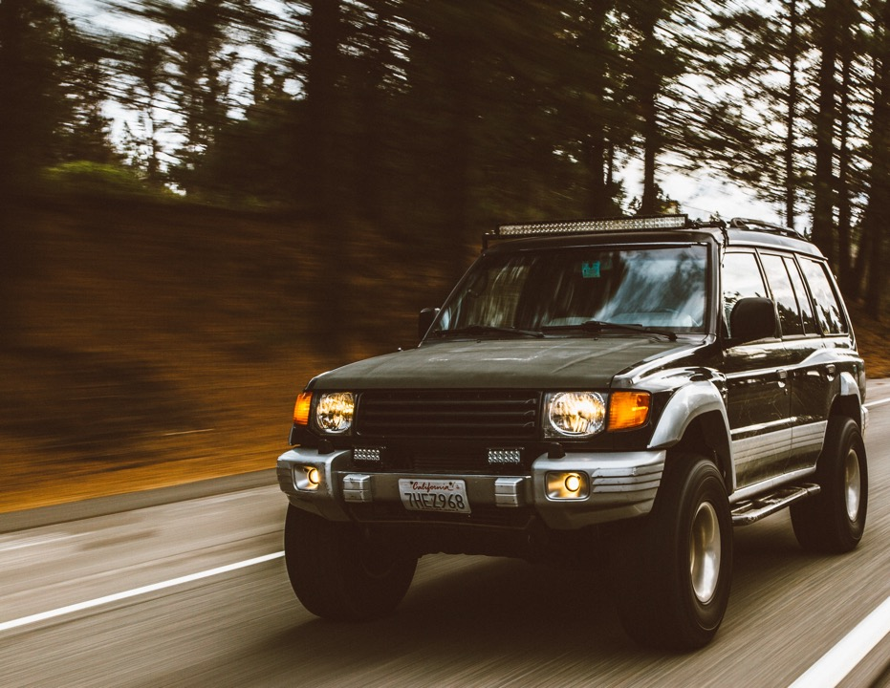
Example: Imagine yourself driving down the road, breaking the speed limit. A police officer stops you. If he gives you a ticket that is justice for you got what you deserve. If he lets you off with just a warning that is mercy for though you deserved a ticket, he did not give you one. However, if, instead of charging you, he personally escorts you to your destination that is grace for he gave you more than mercy, more than pardon, more than you ever expected, more than you could ever deserve.

Slide 7
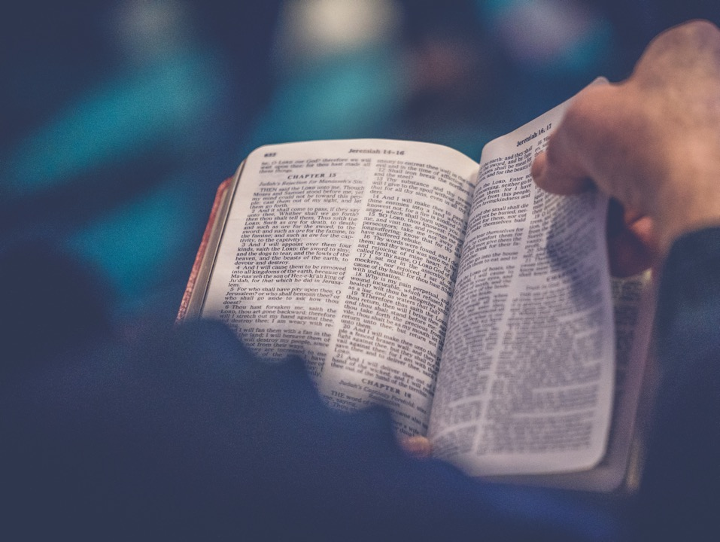
Grace is an integral part of the gospel. God loves us with an everlasting love; a love that drove Him to give His Son to die. Christ dying for us is the essence of biblical grace. Without Calvary we could never understand or experience grace.

Slide 8
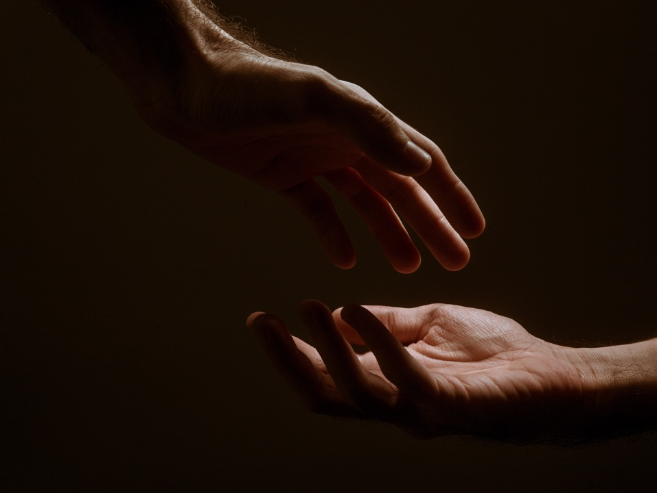
The cross is the ultimate demonstration of the depths and cost of God’s grace. Cheap grace is a denial of the true effect of God’s grace. Only one who has never truly experienced God’s grace would be tempted to diminish the impact and effects of grace.

Slide 9
Do we really understand grace?
Do we accept grace?
Do we experience grace?
Do we then, in turn, extend grace to others?

Slide 10
Grace becomes relevant only when we experience and integrate it into our lives. Theory alone is useless.

Slide 11
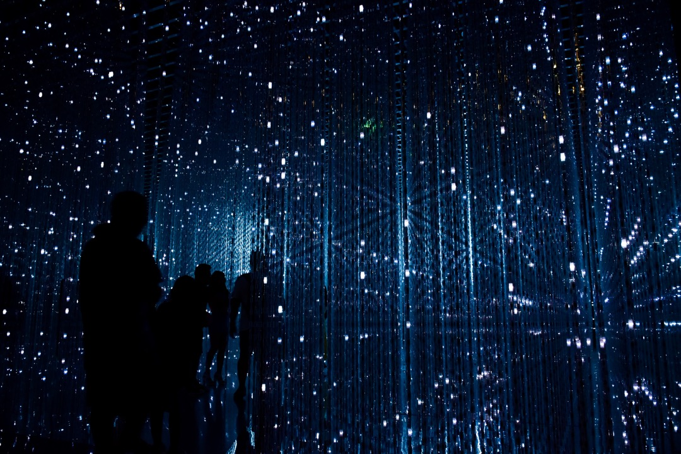
Three dimensions to grace:
PAST, PRESENT, AND FUTURE.

Slide 12
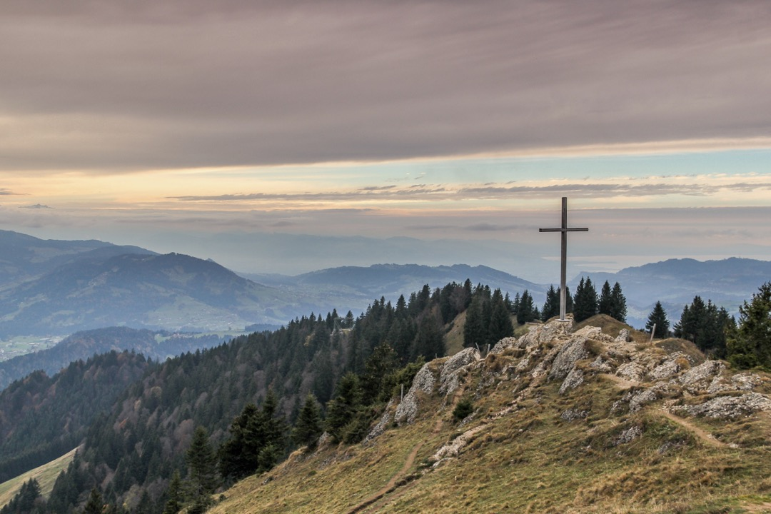
Past grace is what God did for us on Calvary. He provided salvation for all who believe. Because of his great love for us, God, who is rich in mercy, made us alive with Christ even when we were dead in transgressions it is by grace you have been saved (Eph 2:4-5).

Slide 13
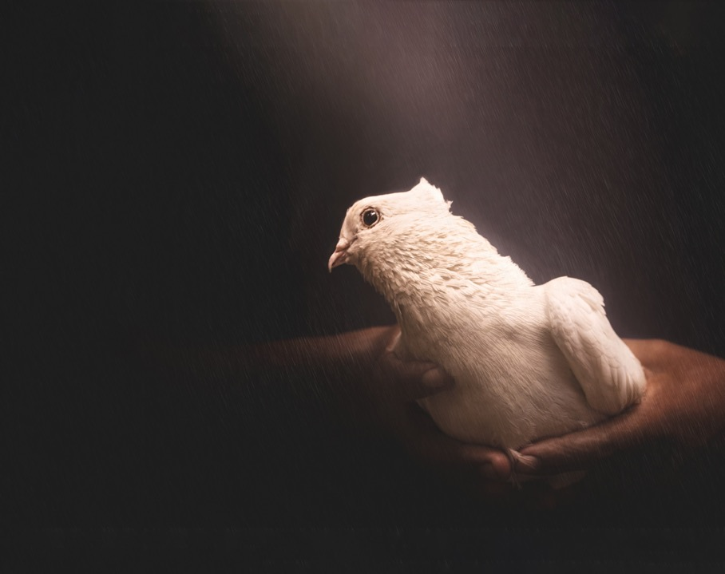
Present grace is the realization of the promised presence of God, the presence that brings strength to live each moment of life in Him. God can make all grace abound to you, so that in all things always, having all that you need, you will abound in every good work (2 Cor 9:8).

Slide 14
Future grace is the promise that the future is already taken care of God is in control. This means that victory is possible in Jesus Christ. Through His Holy Spirit He has provided everything we need to live daily in Him.

Slide 15
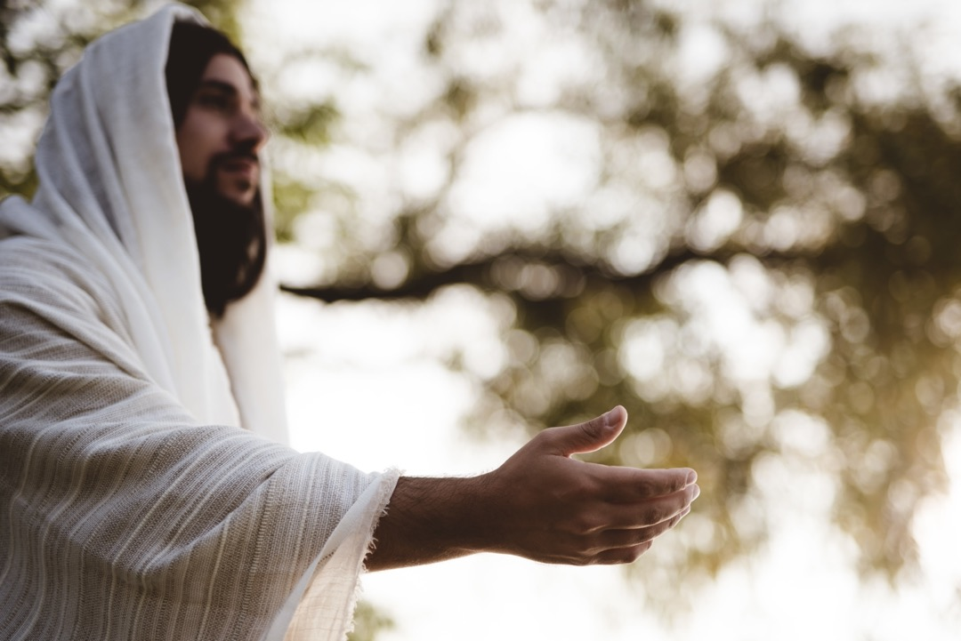
The God of all grace, who called you to his eternal glory in Christ, after you have suffered a little while, will himself restore you and make you strong, firm and steadfast (1 Pet 5:10).

Slide 16
I understand three wonderful aspects to experiencing grace! The first is to accept God’s grace, to accept His forgiveness and salvation.

Slide 17
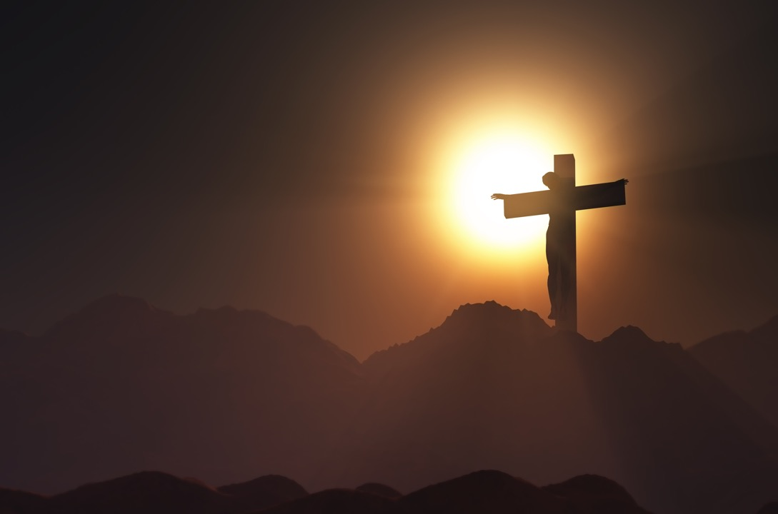
How can God love us in such a way that He is willing to die for us?

Slide 18
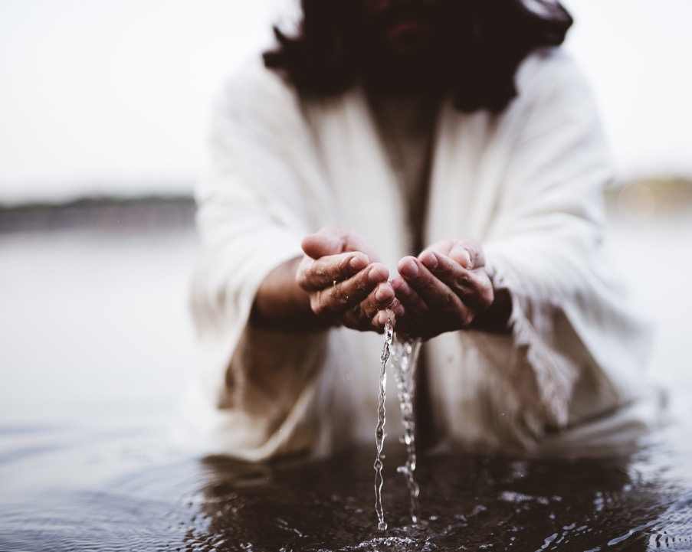
Paul states that we are justified freely by his grace through the redemption that came by Christ Jesus (Rom 3:24).

Slide 19
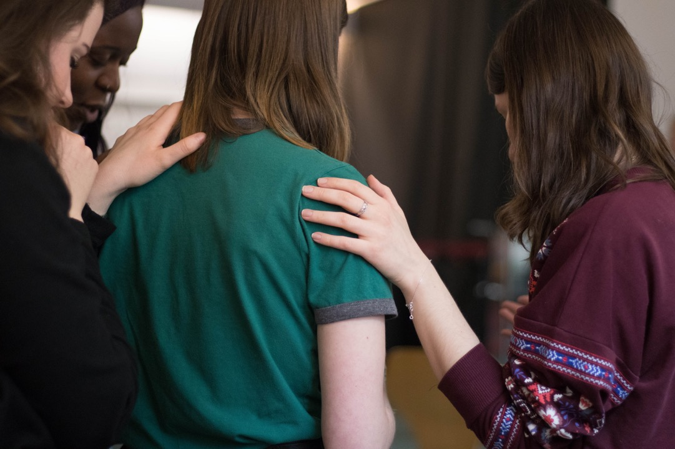
The testimony of others who have experienced grace assures us that we also can have it. It is as simple as believing that Jesus died for us; confessing our sins and believing He has fulfilled His promise to forgive us (1 Jn 1:9); and believing that because we have trusted in Him, we have eternal life
(1 Jn 5:11-13).

Slide 20
The second aspect of experiencing grace is integrating it into life. We can move beyond accepting what God has done for us to what He can do in us.

Slide 21
While God accepts us in our sin, He does not leave us there. When we accept Him as Savior and surrender our lives to Him as Lord, He begins a process of transforming us. He miraculously fills us with His Spirit (Eze 36:26, 27).

Slide 22
Through His Spirit He brings the living presence of Christ into our hearts (Eph 3:16-19). God even makes us partakers of His divine nature (2 Pet er 1:3, 4).

Slide 23
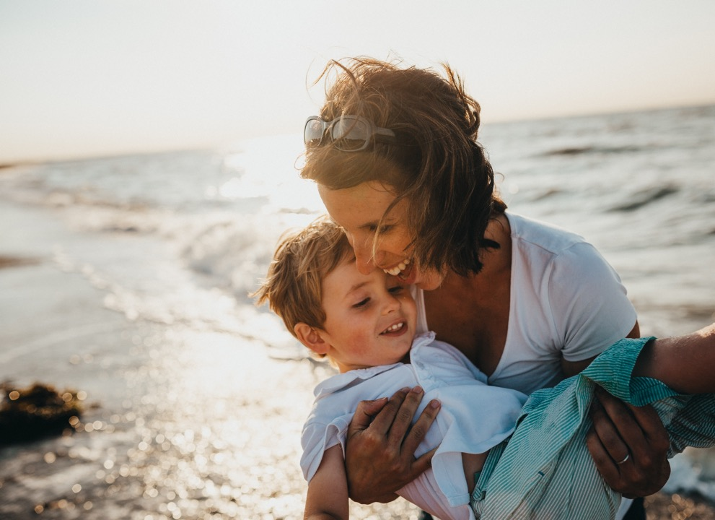
All of this becomes ours through a choice of the will to believe that God will do what He has promised. That leads to a choice to accept by faith that it is a current reality when we choose to accept it. And finally, a choice to make every decision, every issue of life, an opportunity to surrender to His will and His control. It is fascinating to notice that even believing is the result of experiencing God’s grace (Acts 18:27).

Slide 24
The third aspect of experiencing grace is to extend the grace we have experienced to others. We can never fully experience God’s grace until we integrate it into the way we treat one another.

Slide 25
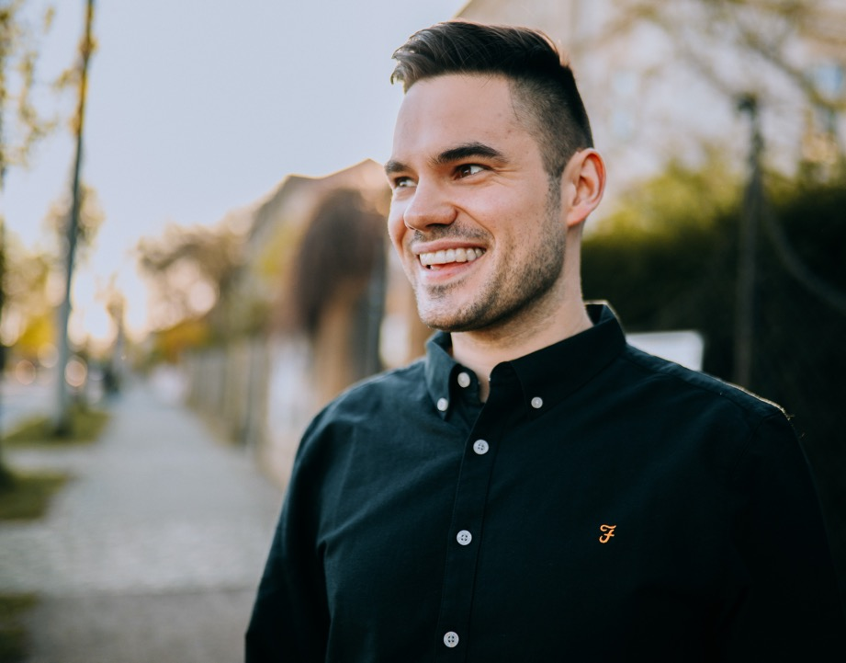
So, from now on we regard no one from a worldly point of view. Though we once regarded Christ in this way, we do so no longer. Therefore, if anyone is in Christ, he is a new creation; the old has gone, the new has come! (2 Cor 5:16, 17).

Slide 26
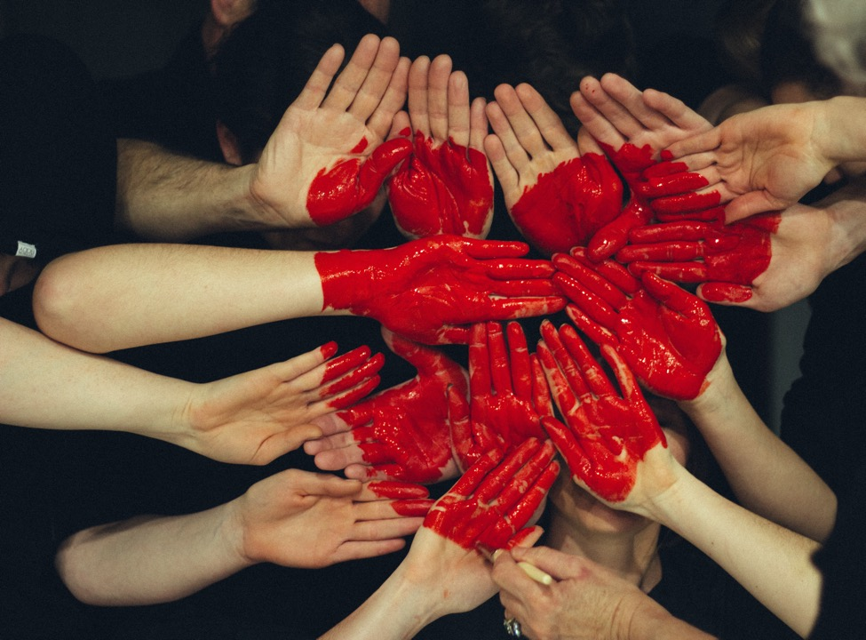
Paul includes the ministry of leading others to salvation as part of the effect of grace. Through Him and for His name’s sake, we received grace and apostleship to call people from among all the Gentiles to the obedience that comes from faith (Rom 1:5).

Slide 27
Even the gifts we have for ministry are part of this grace
(Rom 12:6; Eph 4:7).

Slide 28
When we share the gospel with others, we are extending God’s grace to them. When we forgive those who have wronged us, we extend grace to them. Thus, the one who has accepted God’s forgiving grace goes on to experience it even more fully by treating others with grace.

Slide 29
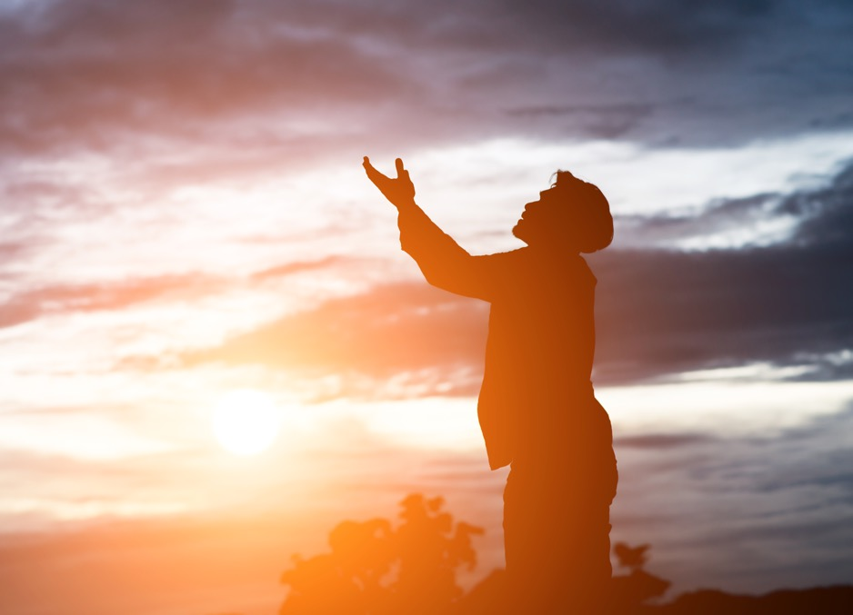
Oswald Chambers has this powerful statement on grace: The grace you had yesterday will not be sufficient for today.

Slide 30
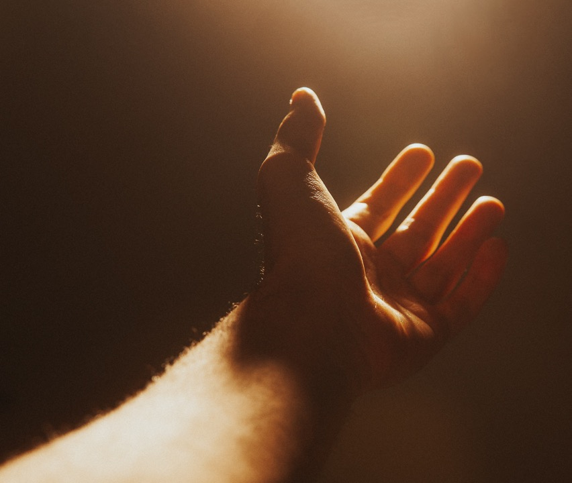
Grace is the overflowing favor of God, and you can always count on it being available to draw upon as needed. “. . . in much patience, in tribulations, in needs, in distresses that is where our patience is tested.”

Slide 31
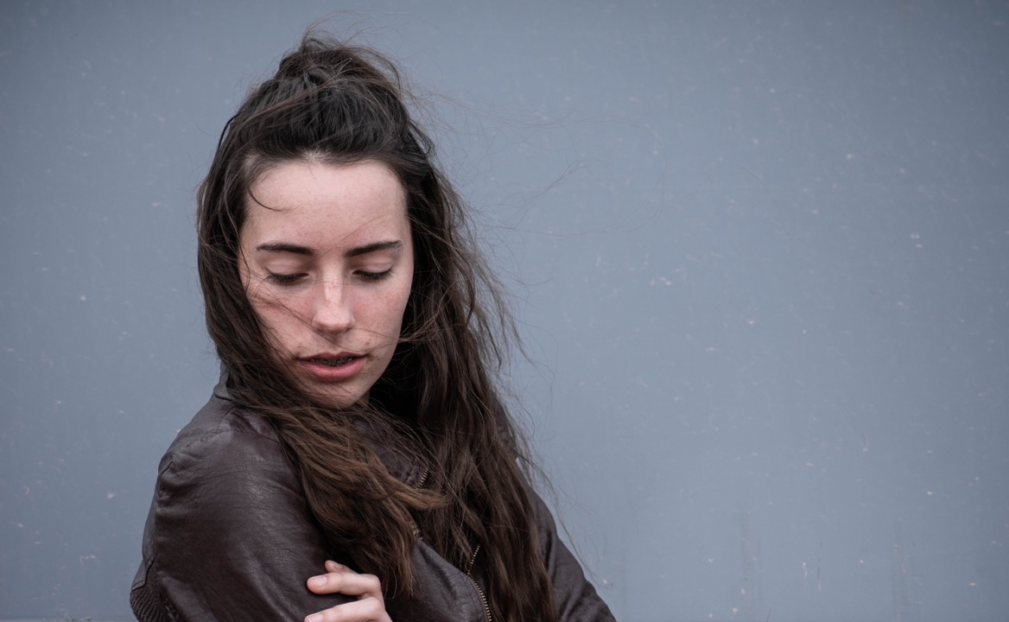
Are you failing to rely on the grace of God there? Are you saying to yourself, “Oh well, I won’t count this time’? It is not a question of praying and asking God to help you it is taking the grace of God now.

Slide 32
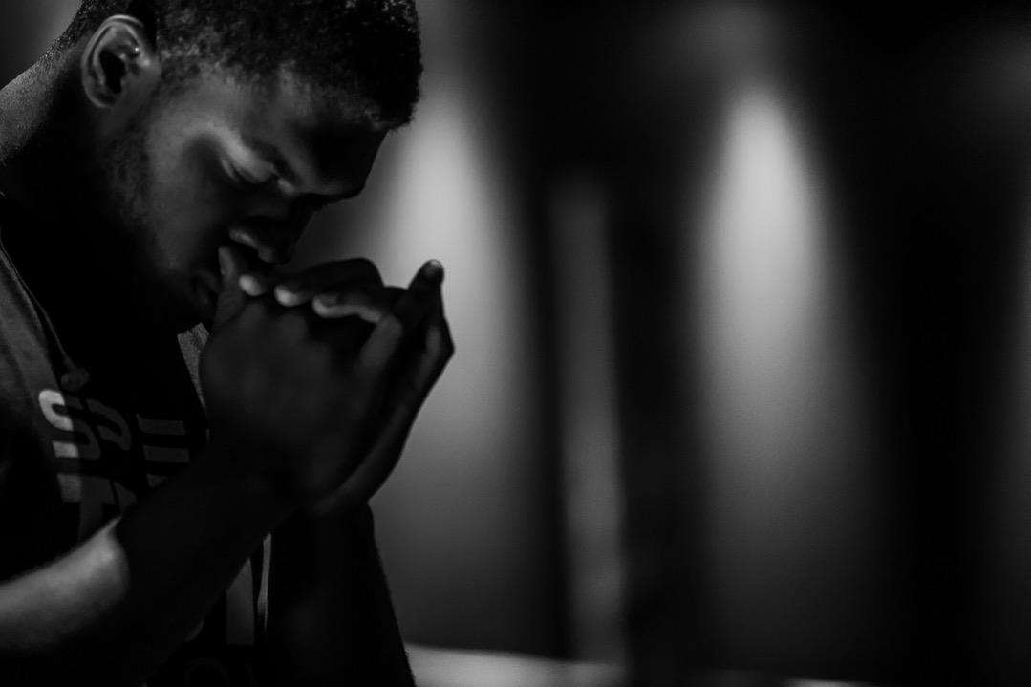
We tend to make prayer the preparation for our service, yet it is never that in the Bible. Prayer is the practice of drawing on the grace of God. Don’t say, “I will endure this until I can get away and pray.’ Pray now, draw on the grace of God in your moment of need. Prayer is the most normal and useful thing; it is not simply a reflex action of your devotion to God. We are very slow to learn to draw on God’s grace for prayer. (Oswald Chambers, My Utmost for His Highest, June 26.)

Slide 33
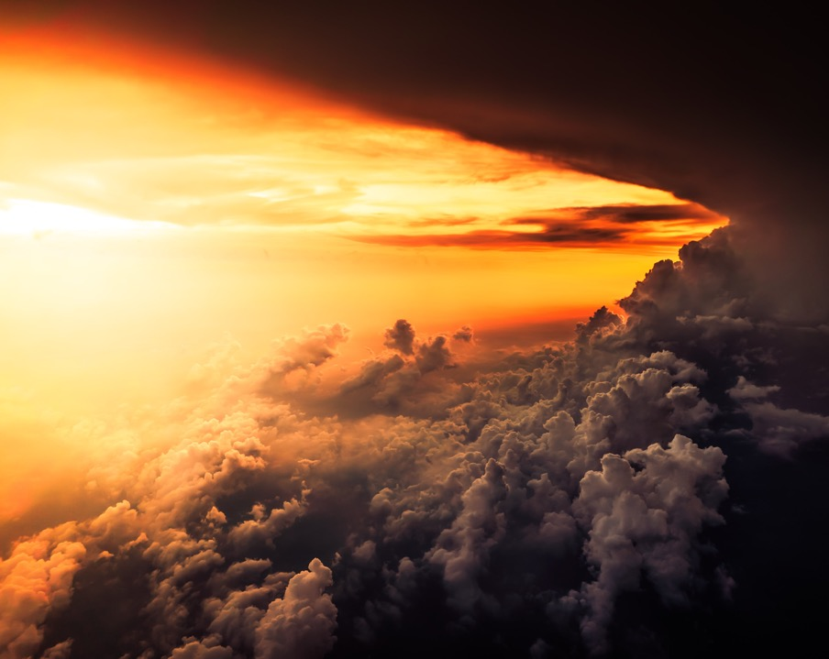
God invites us to come to Him at the throne of grace with the confidence that He loves us and has provided for all our needs (Heb 4:16). We are believers. We have experienced His grace, and thus we accept the challenge of being stewards of God’s grace as we minister to one another (1 Pet 4:10).

Slide 34
OH, THE WONDER OF GOD’S GRACE!

Slide 35
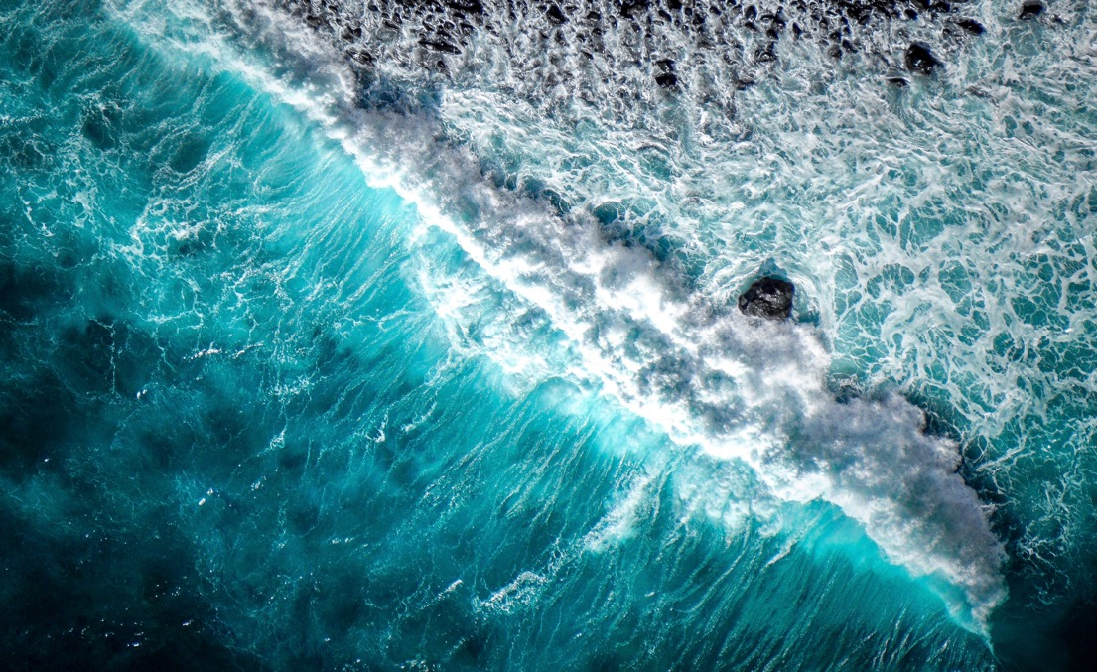
The least movement affects all nature, the entire sea changes because of a rock. Thus, in grace, the least action affects everything by its consequences; therefore, everything is important.

Slide 36
In each action we must look beyond the action at our past, present, and future state, and at others whom it affects, and see the relations of all those things. And then we shall be very cautious. —Blaise Pascal

Slide 37
The Wonder
of Grace

