Slide 1
ACCEPTABLE AND UNACCEPTABLE OFFERINGS

Slide 2
THE LORD EVALUATES, ASSESSES, AND RATES OUR GIVING OR ITS ABSENCE!
Poor widow’s episode (Mark 12:41) – Jesus sat opposite the treasury
Cornelius’ alms “have come up for a memorial before God” (Acts 10:4).

Slide 3
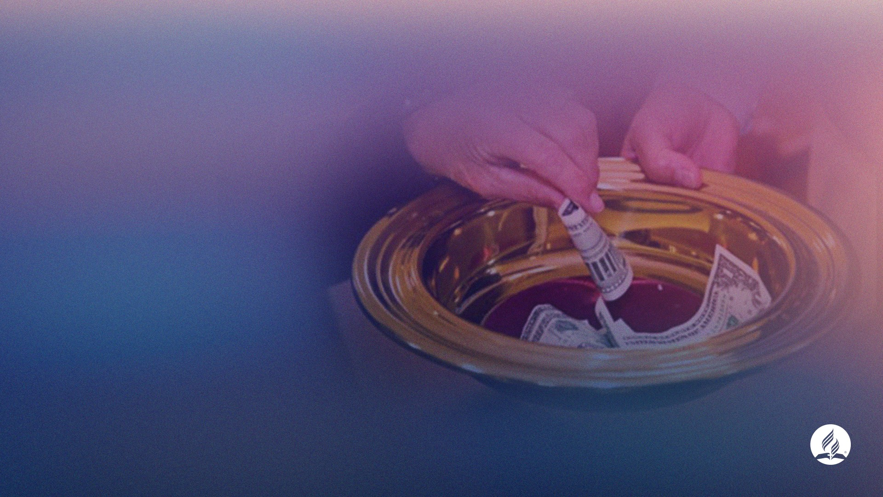
SOME OFFERINGS CANNOT BE ACCEPTED…
Some offerings may even be offensive to God
Irrespective of their amount

Slide 4
CONDITIONS FOR GOD TO ACCEPT AN OFFERING
1. WHEN IT IS PRESENTED BY A HEART THAT IS RIGHT WITH GOD
(Psalm 40:6–8; 51:16, 17; Isaiah 1:10–13;
Hosea 6:6; Malachi 3:2–5; Matthew 9:13;
Mark 12:33)

Slide 5
OFFERINGS ARE ACCEPTED WHEN (MALACHI 3):
Are brought “in righteousness” (v. 3)
Are brought by those who have allowed God to purify, to reïne them (v. 2)

Slide 6
AN OFFERING IS UNACCEPTED WHEN THERE ARE UNCONFESSED SINS LIKE (MALACHI 3:5):
Sorcery
Adultery
Perjury
Overreaching or oppressing hirelings in their wages
Oppression of the vulnerable and foreigners

Slide 7
ONLY AFTER SINS ARE DEALT WITH WILL
“THE OFFERINGS … BE ACCEPTABLE TO THE LORD” (MALACHI 3:4).

Slide 8
THE LORD EVALUATES THE GIVER BEFORE THE GIFT!
The best and biggest offering will never be accepted if the giver’s heart is not right with God.
“Heart offering” must come before any “monetary offering.”

Slide 9
HOW TO OFFER A “HEART OFFERING”?
Taking time daily to examine ourselves (2 Cor 13:5; Psalm 139:23, 24).
Studying God’s word (& prophetic voice) to know His will
Comparing thoughts and behavior with God’s word.
Confessing sins (1 John 1:9)
Asking for a new heart (Ezekiel 36:26, 27)

Slide 10
CONDITIONS FOR GOD TO ACCEPT AN OFFERING
2. WHEN IT IS BROUGHT BY A HEART THAT IS RIGHT WITH MEN
(Matthew 5:23, 24; Hebrews 13:16)

Slide 11
RELIGION IS FALSE WHEN:
There is a contentious spirit.
Feelings, rights, and needs of others are despised.
Then, the offerings cannot be accepted!

Slide 12
JESUS SAID…
When someone has something against you (Matthew 5:23, 24):
Stop bringing your offering.
“First be reconciled to your brother.”
“Then come and offer your gift.”

Slide 13
TO THINK BEFORE BRINGING AN OFFERING:
Am I doing all I can to live peaceably with all men and women (Rom 12:18)?
Am I helping those in need around me (Isaiah 58)?

Slide 14
CONDITIONS FOR GOD TO ACCEPT AN OFFERING
3. WHEN PRESENTED BY AN OBEDIENT PERSON
(1 Samuel 15:22; Psalm 40:6–8; Isaiah
66:2–4)

Slide 15
SAUL WAS EAGER TO PRESENT OFFERINGS (1 SAMUEL 15)!
But to cover his willful disobedience to the Lord.
He kept giving excuses for his disobedience.
Can offerings compensate for breaking the Sabbath, for example?
Can a wife accept a cake prepared by her husband’s girlfriend as compensation?

Slide 16
SAMUEL ANSWERS TO SAUL:
“Has the Lord as great delight in burnt offerings and sacriïces, as in obeying the voice of the Lord? Behold, to obey is better than sacriïce, and to heed than the fat of rams” (1 Samuel 15:22, NKJV).

Slide 17
OFFERINGS CANNOT BE OFFERED AS A REPLACEMENT FOR LOYALTY TO GOD’S COMMANDMENTS!

Slide 18
CONDITIONS FOR GOD TO ACCEPT AN OFFERING
4. WHEN THE WORSHIPER IS SEEKING FOR HEAVENLY (NOT EARTHLY)
REWARD!
(Matthew 6:1–4)

Slide 19
SOME LESS-THAN-IDEAL MOTIVATIONS FOR BRINGING OFFERINGS:
To be recognized as a philanthropist/benefactor
To get spiritual authority (to be recognized as zealous)
To get a position on the church’s committee
For loving the pastor

Slide 20
WHEN DOES GOD REWARD OFFERINGS?
When there is no expectation of any human recognition!
“Your Father, who sees what is done in secret, will reward you” (Matthew 6:4).

Slide 21
CONDITIONS FOR GOD TO ACCEPT AN OFFERING
5. WHEN IT REPRESENTS AN APPROPRIATE PROPORTION OF THE
INCOME
(Deuteronomy 16:17; Mark 12:41–44; 1
Corinthians 16:1, 2)

Slide 22
WHAT IS MORE VALUED BY GOD: AMOUNT OR PROPORTION?
The poor widow gave a lesser amount and was valued above all who gave larger amounts
(Mark 12:41-44)
Jesus’ estimation of what we give is not based on the amount but on the proportion
given
In His sight, 6% of the income given by the poorest is the same as 6% of the wealthiest (even though the amounts differ greatly)

Slide 23
BY CHOOSING THE PROPORTIONAL SYSTEM TO DECIDE WHEN AND HOW MUCH…
We testify that we do not give to earn merit.
We give in response to God’s giving.
We recognize that He is always the ïrst to give
We acknowledge that He never expects us to give if He has not given us something before (2 Corinthians 8:11, 12).

Slide 24
“FOR IF THERE IS FIRST A WILLING MIND, IT IS ACCEPTED ACCORDING TO WHAT ONE HAS, AND NOT ACCORDING TO WHAT HE DOES NOT HAVE” (2 CORINTHIANS 8:12).

Slide 25
BY NOT PURPOSING A FIXED PERCENTAGE OF THE INCOME AS OFFERING…
It will be left to the heart to decide when and how much to give
Problem: the heart is deceitful (Jeremiah 17:9) and selïsh by nature

Slide 26
BY PRAYERFULLY CHOOSING A PROPORTION OF THE INCOME TO GIVE AS OFFERING…
God will be in control of when and how much to give.
Giving will be in response to His giving.
It will lessen the temptation of trying to earn merit by giving.
It will be a proportion of what He gives.

Slide 27
BY PRAYERFULLY CHOOSING A PROPORTION OF THE INCOME TO GIVE AS OFFERING…
We partner with Him in His business of saving souls.
The more we are blessed, the bigger the amount returned.
If He needs more in His business, He will give us more.

Slide 28
CONDITIONS FOR GOD TO ACCEPT AN OFFERING
6. WHEN IT IS GIVEN ACCORDING TO THE SPECIFICATION
(Genesis 4:4, 5; Hebrews 11:4)

Slide 29
CAIN DID IT HIS WAY…
AND GOD “DID NOT RESPECT CAIN AND HIS OFFERING” (GENESIS 4:5).

Slide 30
ABEL FOLLOWED GOD’S GUIDANCE…
HE BROUGHT FROM “THE FIRSTBORN OF HIS FLOCK AND OF THEIR FAT. AND THE LORD RESPECTED ABEL AND HIS OFFERING” (GENESIS 4:4).

Slide 31
GOD-FIRST PRINCIPLE (MATTHEW 6:33) ALSO APPLIES TO OFFERINGS THEY ARE PRIMARILY
TRIGGERED NOT BY
Good feelings
A speciïc call
Sympathy for a religious leader
The desire to provide for the mission work

Slide 32
GOD-FIRST OFFERINGS ARE TRIGGERED BY…
God’s initiative of sending any form of income or increase

Slide 33
GOD-FIRST OFFERINGS
Are a means to worship God, in addition to the tithe (Malachi 3:8-10)

Slide 34
IT IS TIME TO ASSESS OUR HEARTS…
Is there still an unconfessed sin?
How is my relationship with God?
How is my relationship with others?
What motivates me to give? Is it to show off?
Is my offering as regular as God’s financial blessings are?
Is my offering a proportion (percentage) of God’s blessings?
Is it the best that I can offer?
Does it express gratitude and allegiance to Him?

