Slide 1
Day 1

Slide 2
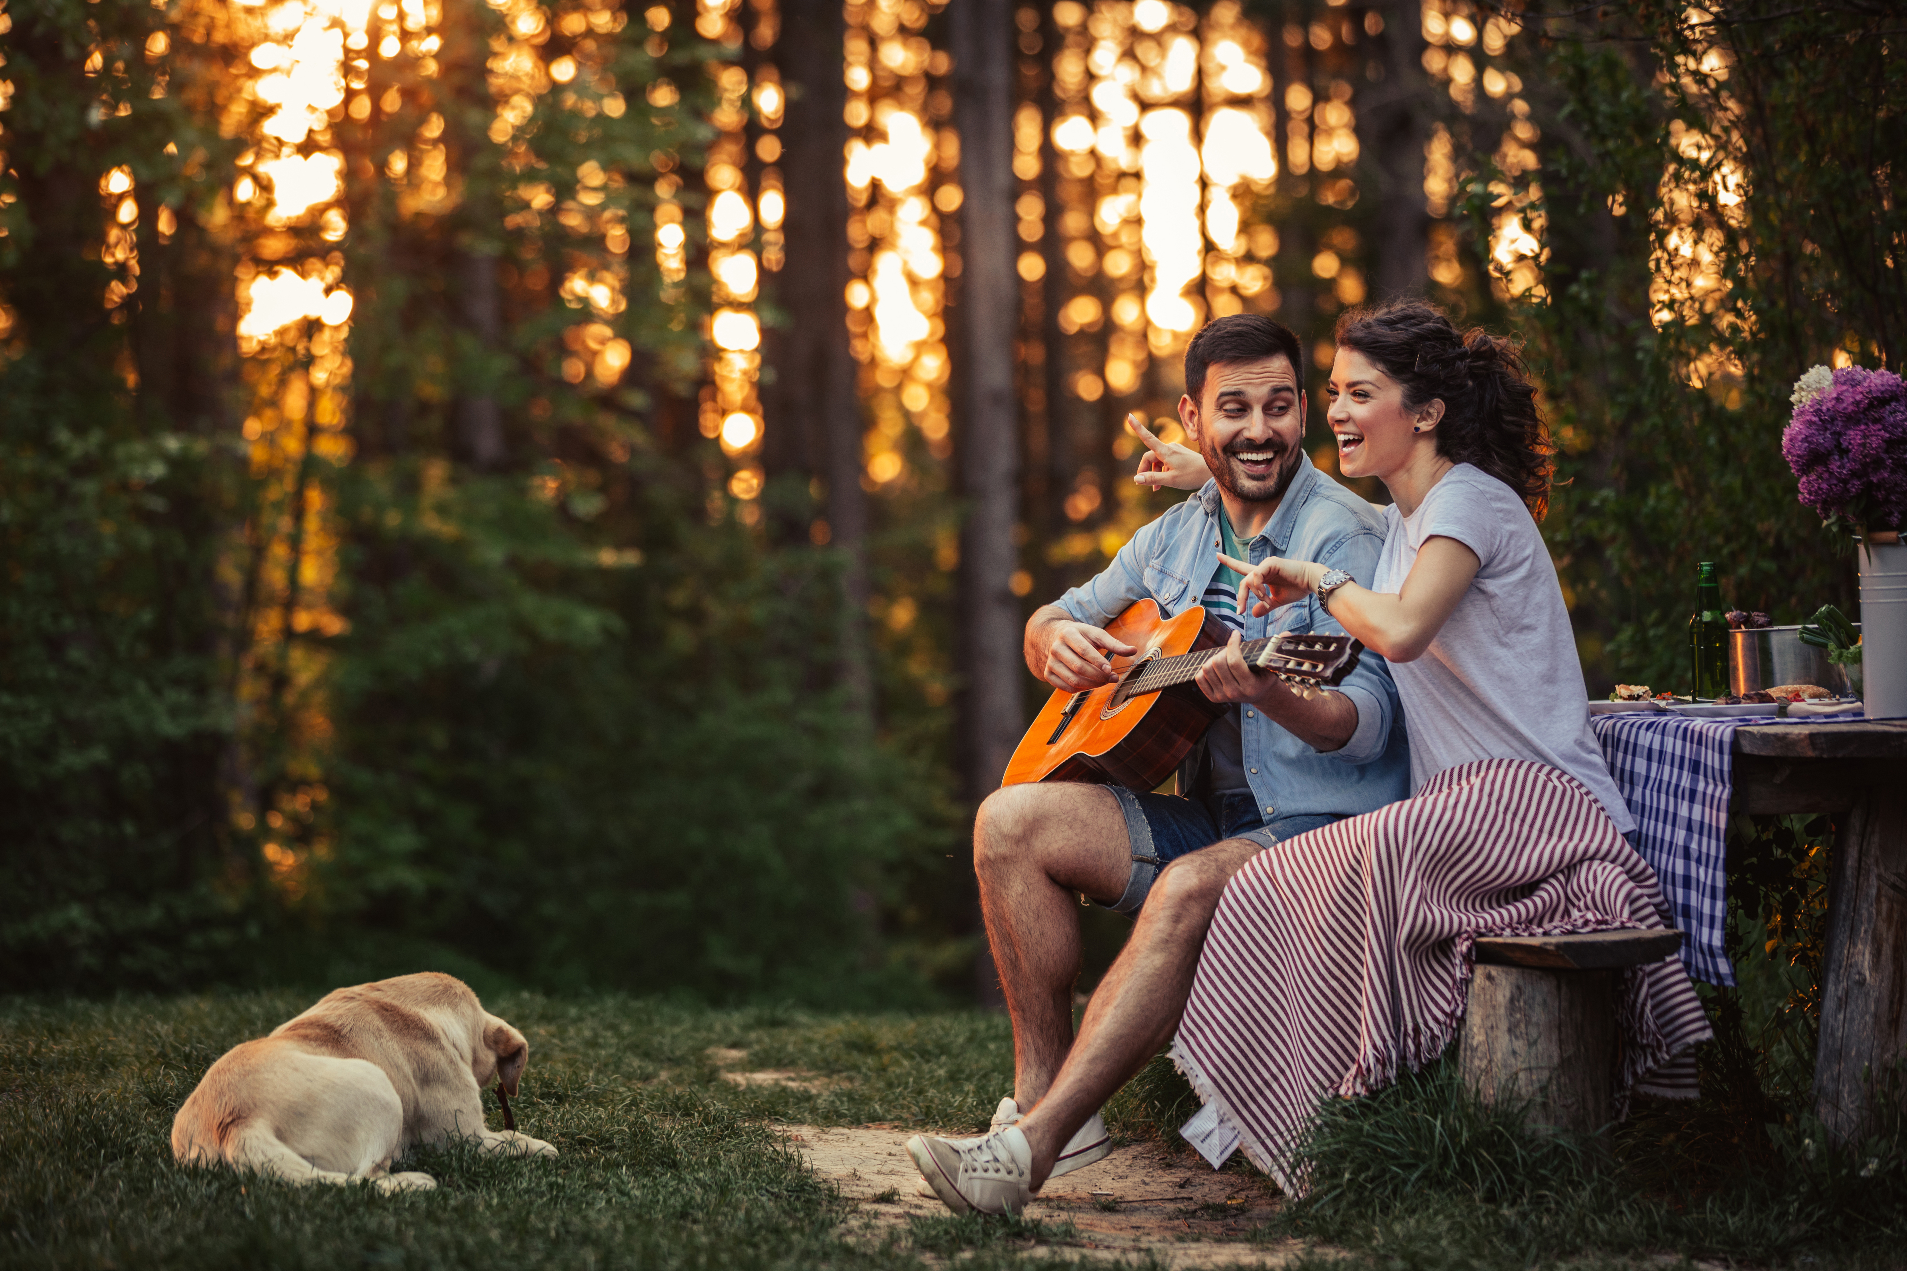
From Sadness to Singing
“For this child I prayed, and the Lord has granted me my petition which I asked of Him”
(1 Sam. 1:27).

Slide 3
A Family and a Nation in Crisis

Slide 4
God Still Works

Slide 5
A Promise Before Owning

Slide 6
Hope for Difficult Times

Slide 7
Questions:
If a single prayer could change the history of a nation through God’s intervention, what could happen today if we pray?
Standing “before the Lord,” what are the things we promise, personally, in the family or as a church?
Are there ways through which we can also express our hope and trust in God today?
Why do you think Hannah was able to fulfill her vow and bring her precious offering when she realized the corrupt spiritual condition of religious leaders at that time?

Slide 8
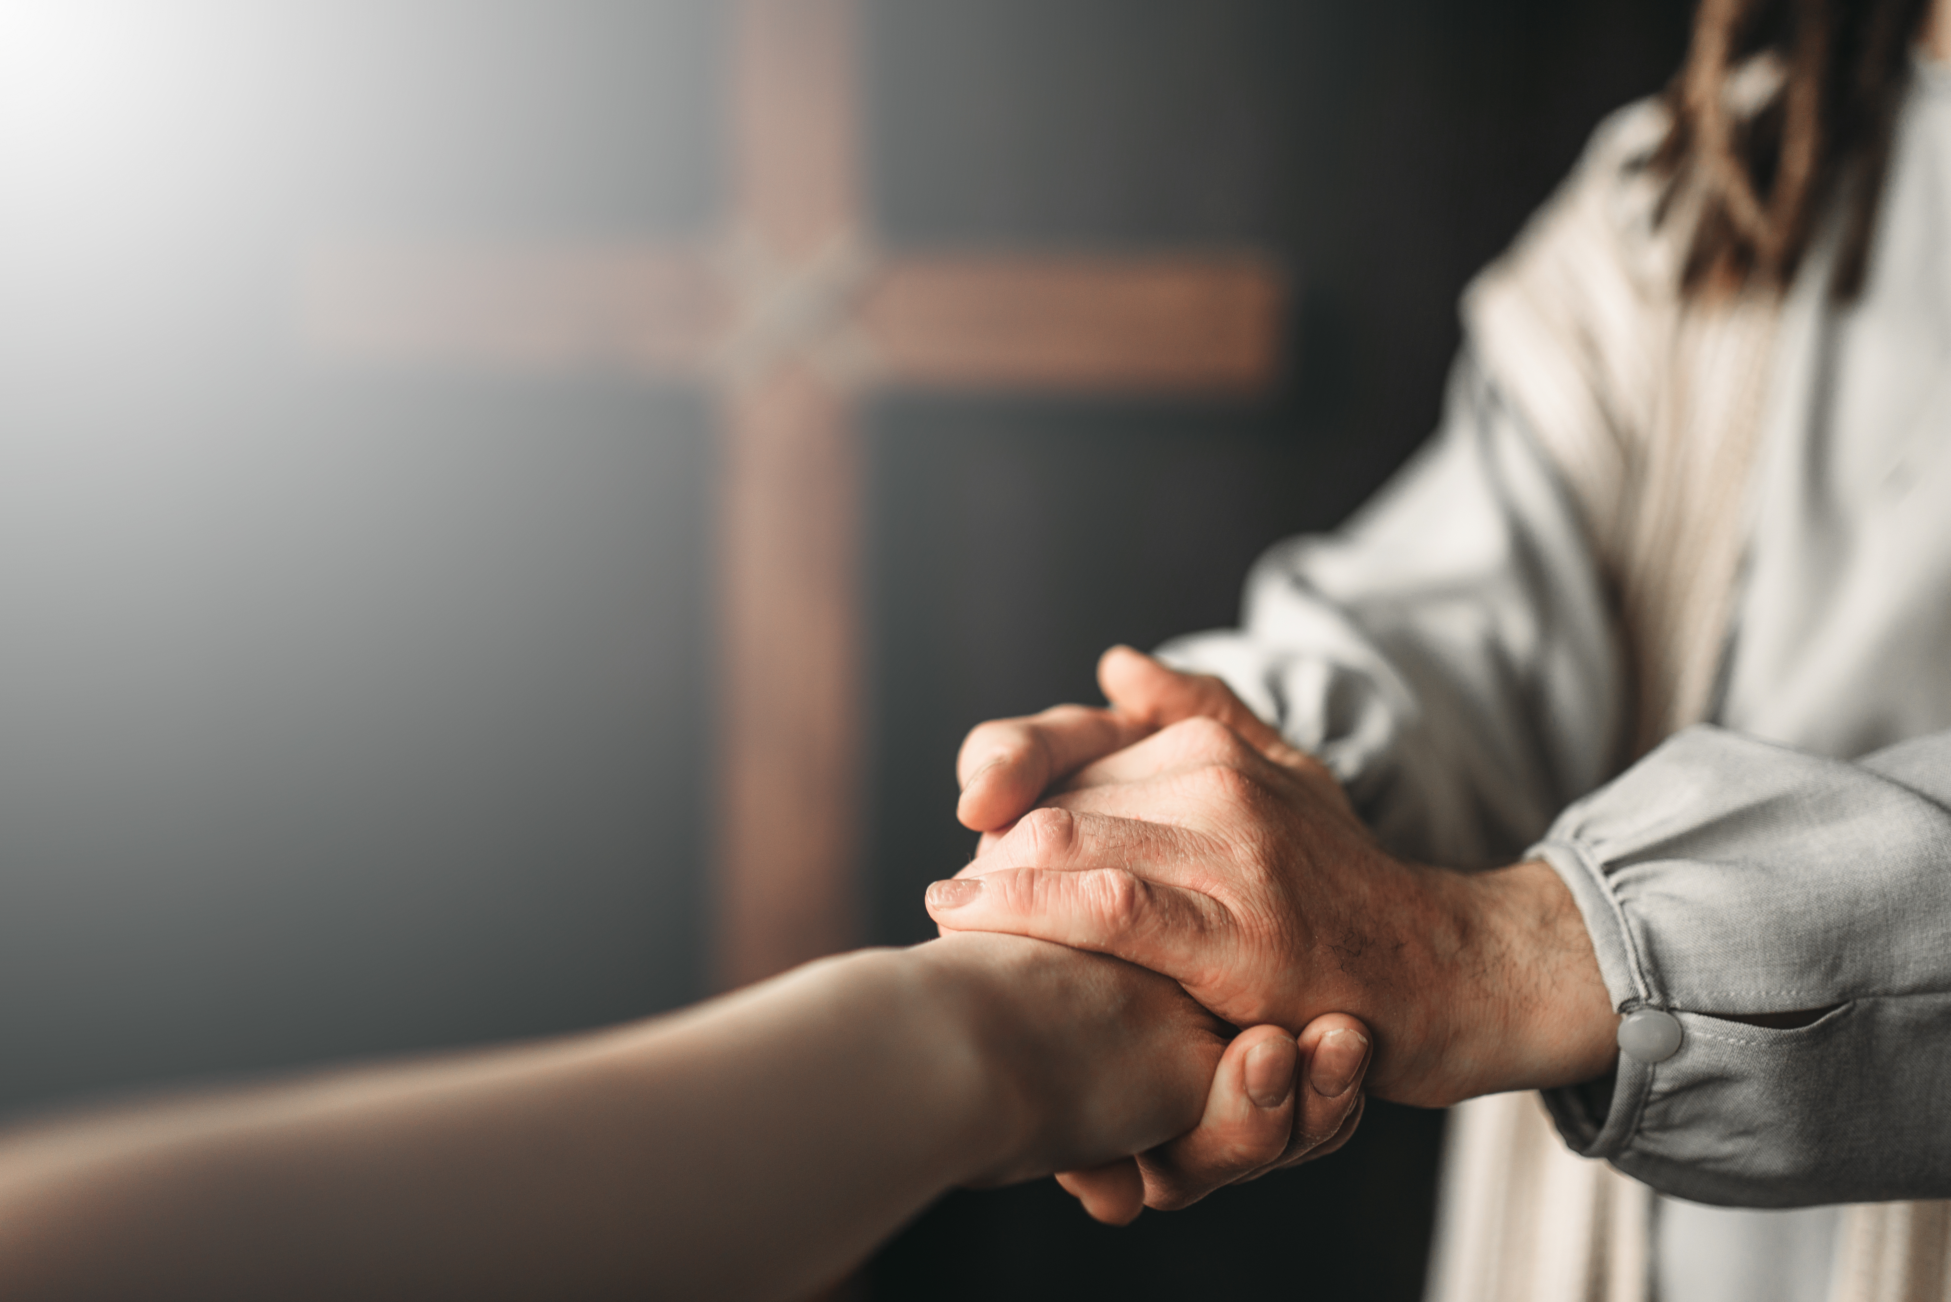
Johnny’s Faithful Prayer

Slide 9
Children’s Story: Johnny’s Faithful Prayer
“Assuredly, I say to you, whoever does not receive the kingdom of God as a little child, will by no means enter it” (Mark 10:15).

Slide 10
Questions:
Why do you think children are special to Jesus?
Can we trust God even when He answers our prayers different from how we expect?
Do you have an experience you can share of when God answered your prayer?

