Slide 1
T
by Marcos F. Bomﬁm
HE MOST NEEDED fiIND OF OFFERING
Part 2

Slide 2
If church members tithe, do they need to give offerings as well? Previously in this three-part series, in the last Dynamic Steward ^{[1]} we explored some reasons giving regular offerings is as important as to return the tithe.

Slide 3
The reasons are: (1) God requires and expects offerings just as He does tithe (Mal. 3:8), (2) regular offerings are an expression of recognition and gratitude as it is the tithe (1 Chron.
29:14), and (3) offerings can accomplish what tithe cannot (tithe funds may be used only in accordance with God’s guidance, in a very restricted way).

Slide 4
OFFERINGS AND THE STOREHOUSE
PRINCIPLE

Slide 5
Another important question related to offerings is where to bring and how to distribute regular and systematic offerings (we call it “promise”).^{[2]} You will find below some reasons Jesus’ commission in Acts 1:8 can be fulfilled more efficiently if we bring the regular and systematic offering (“promise”) to the storehouse, and if we distribute it according to Jesus’ directives found in that commission.

Slide 6
1. The Bible suggests it . The Bible is very clear about the importance of bringing the tithe to the storehouse. By the way, tithe will be tithe only if the three following items are observed: (1) it is given in the right percentage (10 percent of the income); (2) it is brought to the right place (the storehouse);

Slide 7
and (3) it is applied as prescribed by God (to the maintenance of those who are appointed and accredited by the church to preach the gospel). It is not an accident that offerings are also included in all the same contexts in which the tithe is commanded to be brought to the storehouse.^{[3]}

Slide 8
2. God’s end-time worldwide missionary commission requires it. According to Jesus, the ﬁnal sign that will precede the end is that “this gospel of the kingdom will be preached in all the world as a witness to all the nations, and then the end will come” (Matt. 24:14).^{[4]}

Slide 9
As offerings cover roughly one third of the church’s mission work expenses, Jesus’ commission can be accomplished only if we imitate the apostolic church and bring all our resources to a common fund (see, for example, Acts 2:44, 45; 4:32, 34-37; 5:1-11).

Slide 10
Then we must decide how to use those funds after a collective decision, rather than our personal discretion.
The Bible says ﬁguratively that the church is the body of Christ. When you feed your body, there is only one place by which food enters to nourish all its parts.

Slide 11
Instead of feeding individual parts, you put all food in a common place (mouth), and from there it will be distributed equitably to nourish the whole body.

Slide 12
Also, when a country is waging war, the army must not be supplied according to the personal discretion of each citizen. If one gives to the pantry because her cousin is the cook, and another provides money for purchasing comfortable boots because his soldier son has calluses on his feet, this war is unlikely to be won.

Slide 13
If a country hopes to win the war, the government must carefully collect all resources and then distribute them so that the army may be supplied in an equitable and regular way.

Slide 14
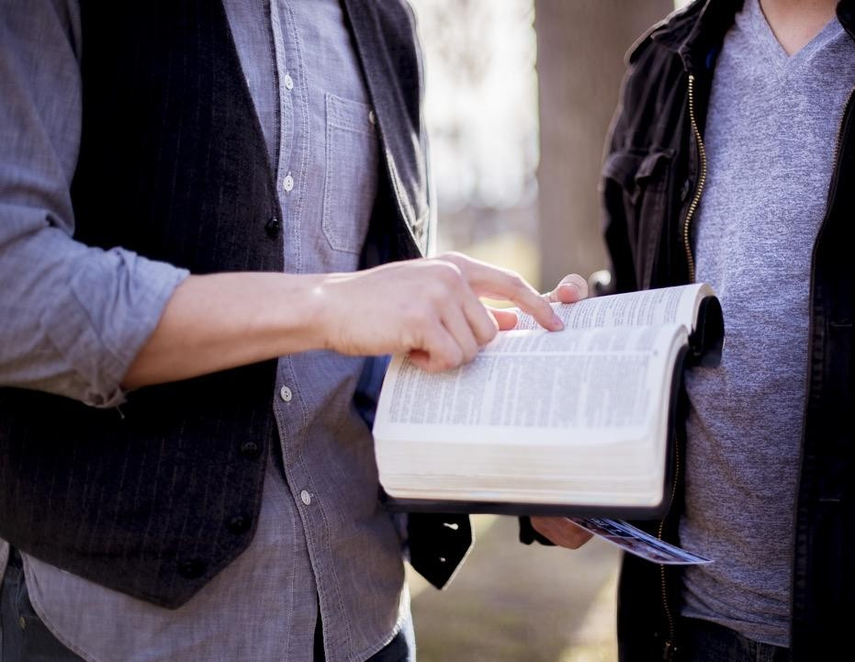
Should we consider our war of lesser importance, and should our spiritual army be less organized than the secular ones?
Let us not allow the sons of this world to be shrewder in their generation than the sons of light (Luke 16:8)!

Slide 15
3. There is safety in the multitude of counselors. The storehouse principle presupposes that others will ultimately decide how “my” “promise” (regular and systematic offerings) will be distributed and spent. I must confess that I don’t like this idea, because I feel as though I lose some power and agency. It hurts me because I am part of an individualistic generation that wants to be in control.

Slide 16
Nevertheless, the battle will be lost if each soldier ﬁghts the war alone on the basis of an individual, idiosyncratic strategy. “Without counsel, plans go awry,” says Solomon, “but in the multitude of counselors they are established” (Prov. 15:22).

Slide 17
Thus, in the Adventist Church, no individual or institution is supposed to decide alone on plans, strategies, or ﬁnances. The decision power is shared through committees, composed of leaders appointed through the representative system for predetermined periods of time.

Slide 18
No one owns the church or will become rich by working for it. Leaders, pastors, and missionaries have a limited income. If more funds become available, the church will always use those extra funds to move the church’s mission forward rather than increase workers’ salaries.

Slide 19
This concept of “shared decisions” is rooted in our theology. The angels depicted in Revelation 14, for instance, represent a movement with worldwide implications. This requires a well-organized army, united in message, strategies, initiatives, and distribution of resources. This is opposite to the idea of scattered individuals, wandering about, trying to do “whatever is right in his own eyes” (Deut. 12:8).

Slide 20
That is why I need to put aside suspicion, thoughts of supremacy, conceit, pride, arrogance, and selﬁshness and allow
God to work through His body, the church, if I
want to be part of this global movement that proclaims the last message to a dying
world.

Slide 21
To lose control of “my” offering is a humbling but necessary experience that will require self-denial, mutual submission, and trust, producing spiritual growth through the unity
of the Spirit.

Slide 22
By putting self aside, I recognize that my vision is very limited and my heart is deceptive (Jer. 17:9). I need to trust that God is leading the movement as a whole.
My brothers and sisters around the world also have the Holy Spirit guiding them and, like me, are also willing to do their best to accomplish Jesus’ commission.

Slide 23
It doesn’t mean that we cannot support other personal or collective missionary projects, some of them initiated by well-intentioned church members. Instead, it means that our support of missionary endeavors outside the church’s structure should never supersede the big picture, never replace what we do together as a worldwide movement.

Slide 24
Instead, it should be considered as that second mile, something beyond and above the commitment we have to what we do together as a body, with local, regional, and global implications, because there is no other way to accomplish Jesus’ commission. Together we are stronger, can do more, do it faster, and go further!

Slide 25
4. Funds are distributed to reach all the world. Another
reason regular offerings should be brought to the storehouse may be found in Jesus’ farewell message to the disciples, mentioned above. In that speech He made a promise with a purpose:

Slide 26
“But you shall receive power when the Holy Spirit has come upon you [this is the promise]; and you shall be witnesses to Me in Jerusalem, and in all Judea and Samaria, and to the end of the earth [here is the purpose]” (Acts 1:8).

Slide 27
It is interesting to note that the promise of the outpouring of the Holy Spirit is preceded by the information that the disciples were “assembled together” (verse 4) or that “they had come together” (verse 6).

Slide 28
This was crucial for Jesus’ purpose to be accomplished, namely, to be witnesses in the three geographic segments mentioned by Him: (1) in Jerusalem (local), and (2) in all Judea and Samaria (regional), and (3) to the end of the earth (global).

Slide 29
How would Jesus’ disciples, if each
would go alone, by themselves, be able to be missiologically relevant at the same time in all those three geographic segments?

Slide 30
Two elements then become imperative for the accomplishment of a worldwide mission: (1) to receive the outpouring of the Holy Spirit and (2) being together (Luke 24:49; Acts 1:4, 6, 8)—spiritually, emotionally, organizationally, and ﬁnancially together!

Slide 31
But this is possible only if we understand the enormity of the task before us and put all our resources together so that they may be distributed equitably (as suggested by the Combined Offering Plan, for example).

Slide 32
On the other hand, if I assign all my offerings to one single project, ministry, or region, according to my discretion, all the others could end up unsupported, and the work would be delayed!

Slide 33
What Paul said about spiritual gifts, could rightly be applied to the way we do mission. Because “God is not a God of disorder,” Paul said in 1 Corinthians 14, “everything should be done in a ﬁtting and orderly way” (verses 33, 40, NIV). May the Lord grant us an unselﬁsh and humble heart that will lead us to work together in harmony and mutual trust, under the guidance of the Spirit.

Slide 34
FOOTNOTES:
Marcos F. Bomfim, “The Most Needed Kind of Offering in a Church With a worldwide Mission, Part 1,” Dynamic Steward 24, no. 4 (October-December 2021), https://stewardship.adventist.org/the-most-needed-kind-of-offering-in-a-church-with-a- worldwide-mission-part-1.
To know more about the concept of “promise” (regular and systematic offerings), access https://stewardship.adventist.org/promise-offerings.
For more about the storehouse principle in the Bible, applied for tithe and nontithe funds, see for instance, Deut. 12:5-28; 14:22-29; 16:9-17; 18:1-8; 2 Kings 18:4, 22; 2 Chron. 31; Neh 10:32-39; 12:44-47; 13:8-14; Mal. 3:8-10; Mark 12:41-44; Luke
21:1-4; 1 Cor 9:3-14.

Slide 35
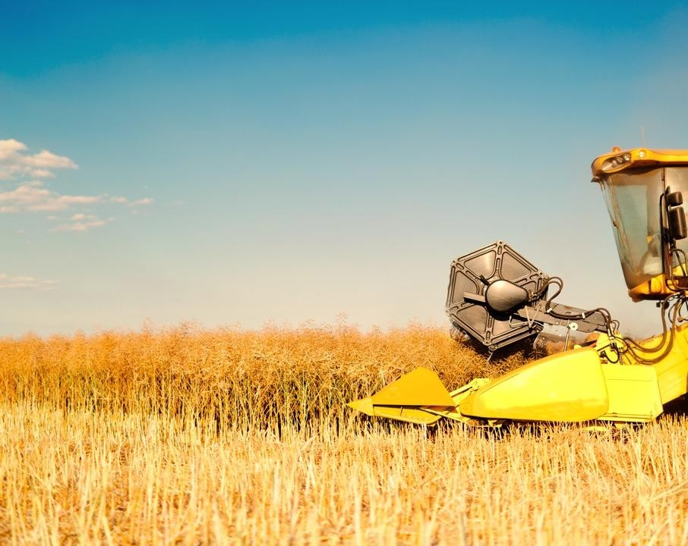
In the book of Acts it is possible to see the practice of that same principle, as the believers would centralize their financial resources in a common fund and distribute them in an equitable way, not according to an individual’s discretion (see Acts 2:44, 45; 4:32, 34-37; 5:1-11).
In Ed Reid’s “Where Do We Bring Our Tithe? In Search of the Storehouse” you may find also a clear explanation of this principle as applied to the tithe. Go to https://stewardship.adventist.org/books
and scroll down to find options to read or download this book in English or in French.
[4] Unless otherwise noted, Bible texts are from the New King James Version.

Slide 36
THE MOST NEEDED fiIND OF OFFERING
Part 2

